Slide 1

Notes:
Attention
The number one mental skill today's children need - Where attention goes energy and life flows. If you don’t learn to aim and sustain attention you will live a life of someone else’s making not your own.
To learn to aim and sustain attention is one of the most crucial skills for kids in our fast paced digitally dependent world where kid’s attention is in high demand from social media platforms, advertisers and other corporate entities.
These attention exercises can be tweaked according to the age of the child. They are designed to strengthen the muscle of attention by repeated practice of focusing on an object then noticing if the mind wanders and directing it back to the object.
This strengthens the “attention muscle”
You can use these attention based cards as separate exercises without explanations. It is recommended that an attention based exercise is performed at least 5 mins per day.
Be aware that children need to practice both open (floodlight) and closed (spotlight) attention exercises as they are both very different and important skills. Spotlight or floodlight of attention is a useful analogy.
- e.g. 10 sounds where they are opening their awareness to all of the surrounding sounds vs closed awareness or fixed focus.
- e.g. back to breath where they focus on specifically their breath.
- e.g. when driving it is very important to be able to have open attention and filter stimuli from every angle. When focusing on an exam it is important to focus on a specific task and manage distractibility.
Questions to help to pre-empt these exercises for older children
When do you need to pay attention?
How do you pay attention?
What distracts you?
Who decides what you pay attention to?
Why do you need to pay attention?
Bring your own boundaries.
The values we hold for our children may be very different to the goals society has for our children's attention. It is very important that children learn to create their own boundaries. This involves shifting attention when necessary and appropriate. Mindfulness practice –helps manage impulsivity and hence boundary setting.
The earlier we instil and practice these exercises the easier it is to make them habitual.
Additional Exercise (if time or at home)
Describe your values & goals for your children.
Describe your child's goals & values.
Discuss social media company’s goals and values for children’s.
When someone is acting irrationally we may say “they just need to come to their senses”.
All of these exercises engage a specific sense. Training attention involves training of the individual senses.
Inquiry questions for after the exercises What sense did this exercise strengthen?
Taste e.g. mindful bite
Hearing e.g. 10 sounds
Proprioception e.g. body scan
Seeing/looking Combination of senses e.g statues/ mindful walk
Be creative and make up as many of your own exercises to strengthen the muscle of attention.

Slide 2
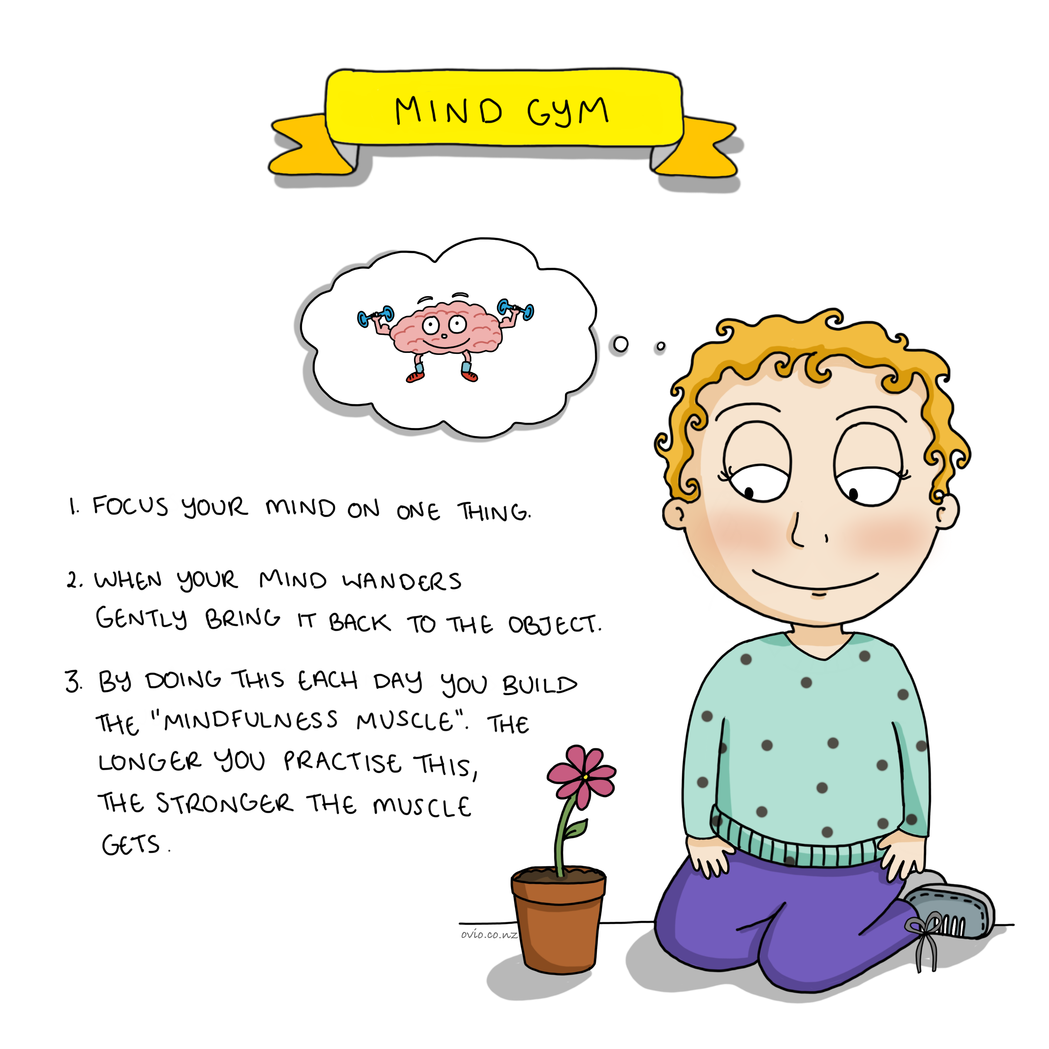

Notes:
Mind Gym
The slide describes an exercise but can also be used as an explanation/teaching slide. It explains why we do the attention exercises and why it is important not to judge ourselves if we get distracted but we feel grateful when we notice that we have become distracted. As it is this movement from distracted to attentive that builds the “attention” or “mindfulness” muscle.
The reward of gratitude when the mind returns to the object of focus, helps train the mind and creates new neural pathways.
Remember it is an exercise not a test!
Please demonstrate a bicep curl to explain the analogy as we move the arm up and down we build the bicep muscle. Just as we move our focus from the object to the distraction then back to the object we build the “attention” muscle.
You can use any object for this exercise: e.g. the child can focus on their hands a stone or anything else in the room.

Slide 3
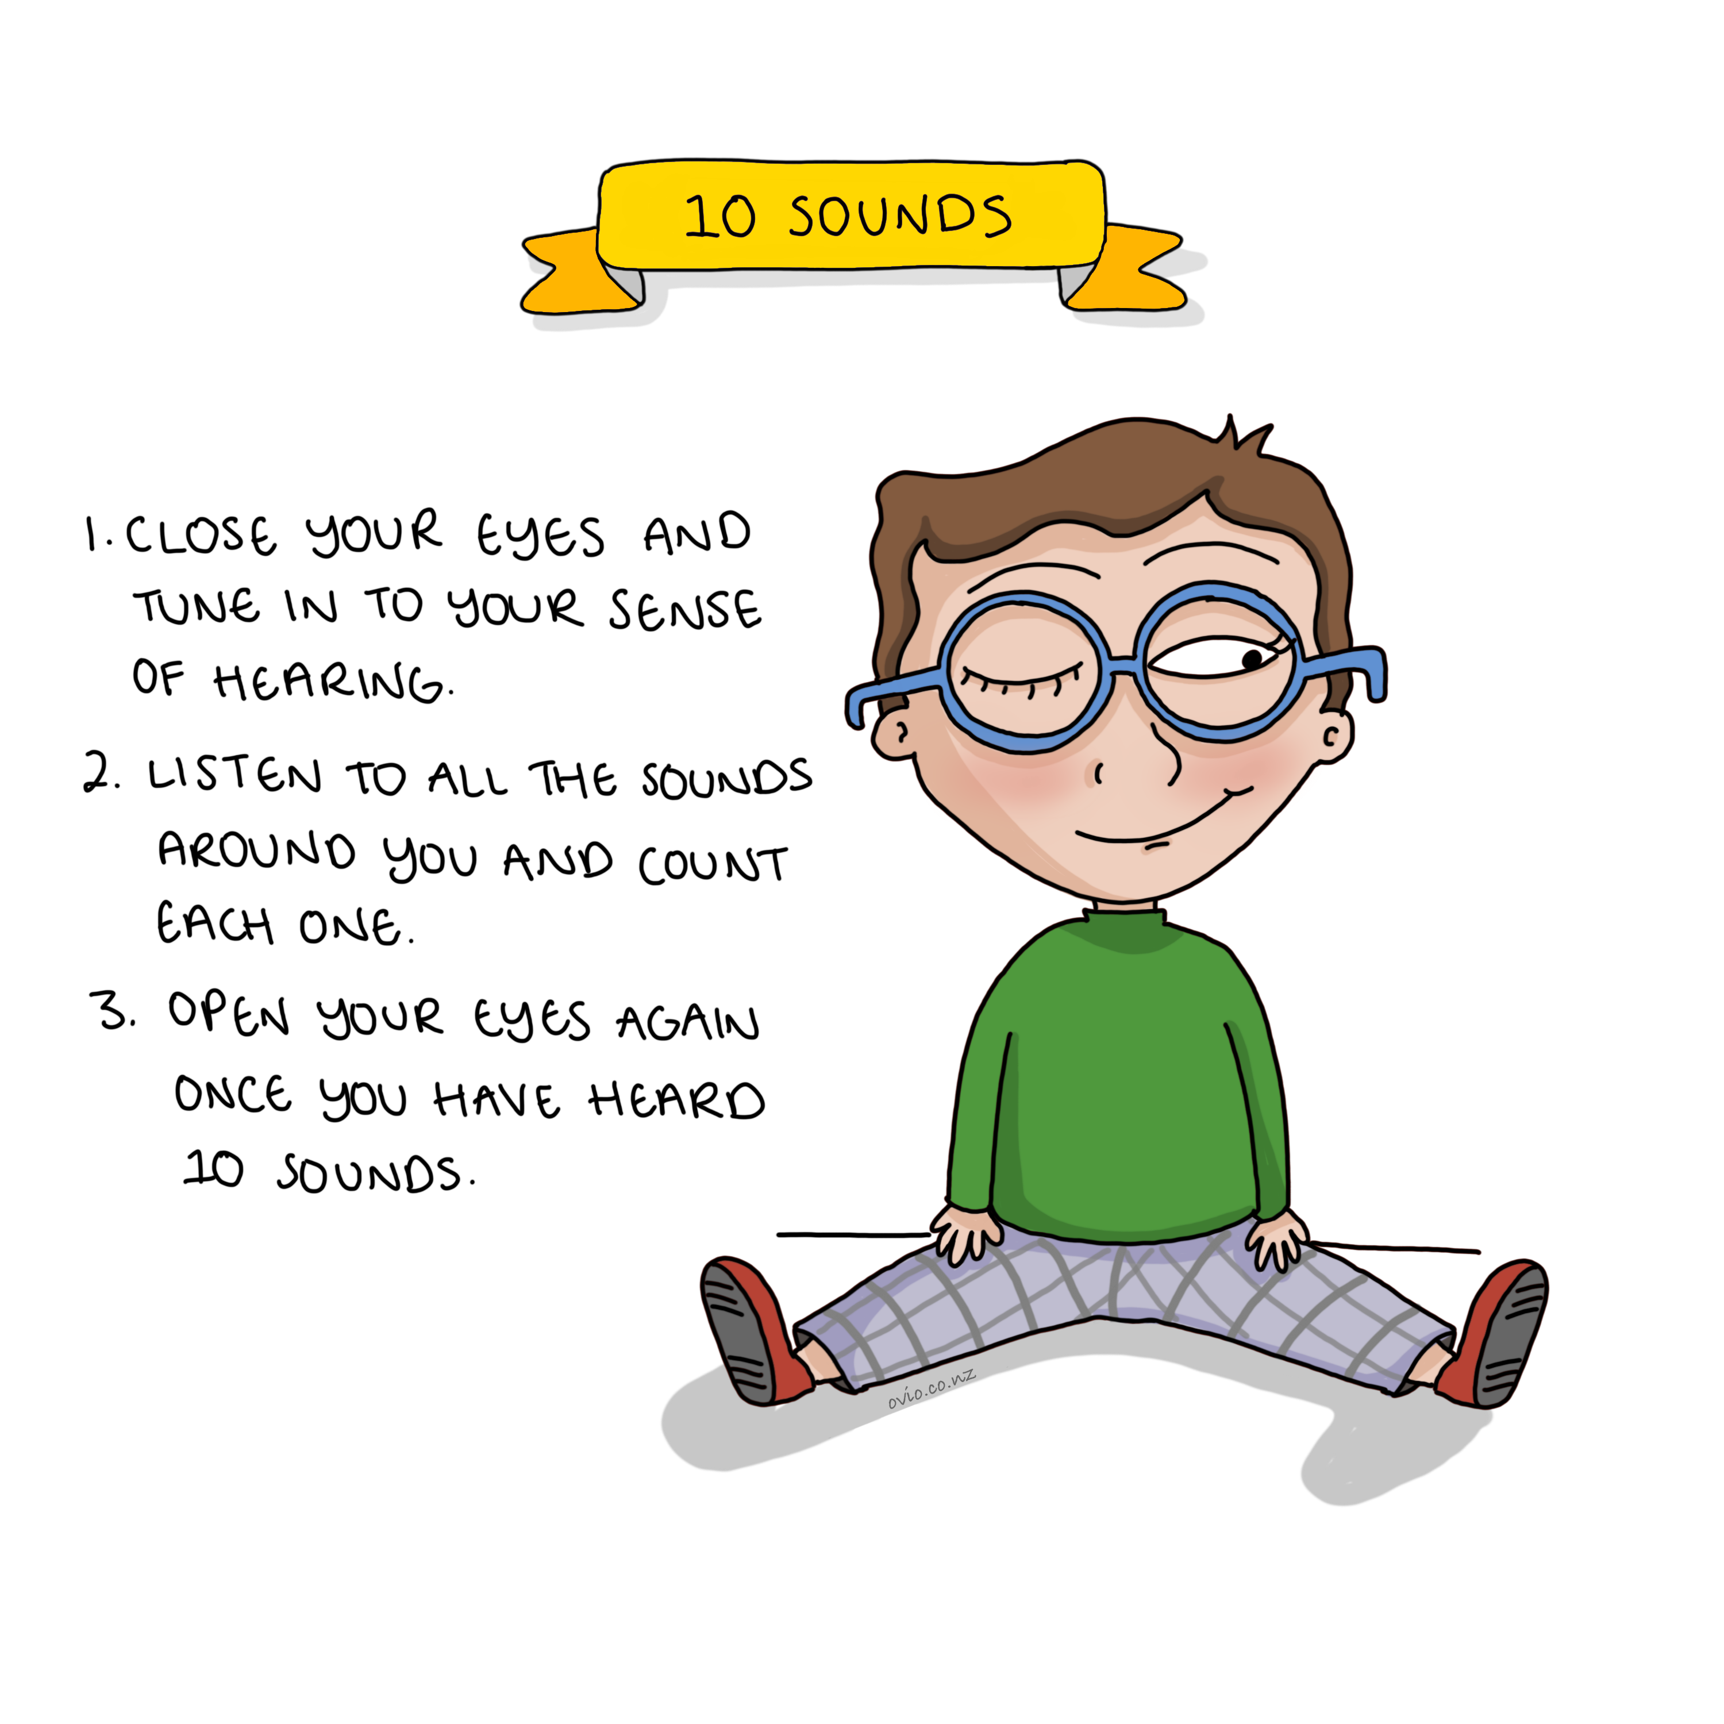
Notes:
10 sounds
In this exercise we are strengthening the muscle of attention by shutting off the sense of sight and focusing on the sounds around us.
Note: If children feel unsafe/uncomfortable shutting their eyes suggest they look downwards towards the floor.
You can increase or decrease the number of sounds the child has to find depending on age
You can also add complexity by asking for 10 sounds outside the room/inside the room/inside the body.
Remember to be creative.

Slide 4
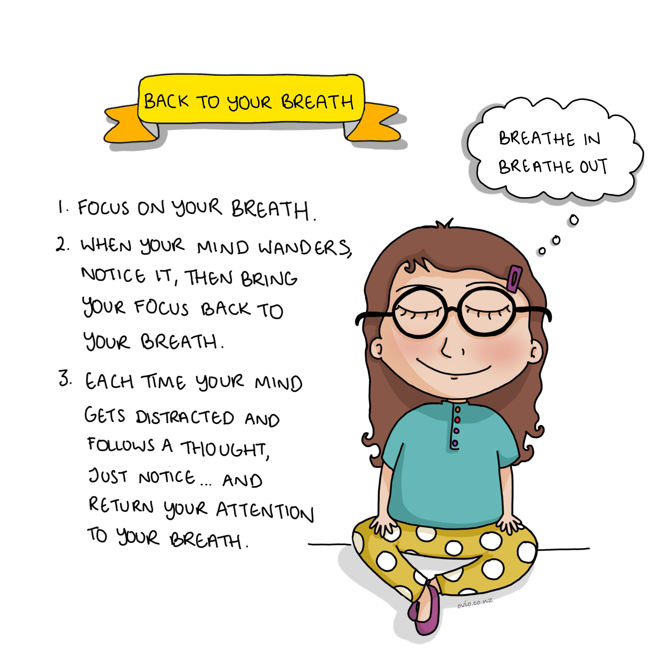
Notes:
Back to your breath
The breath is a great place to focus our attention, as it is always available.
This trains our sense of hearing and proprioception.
Proprioception is often referred to as the sixth sense. It is the ability to notice a sense of self movement or body position. It is very important for good spatial awareness.

Slide 5
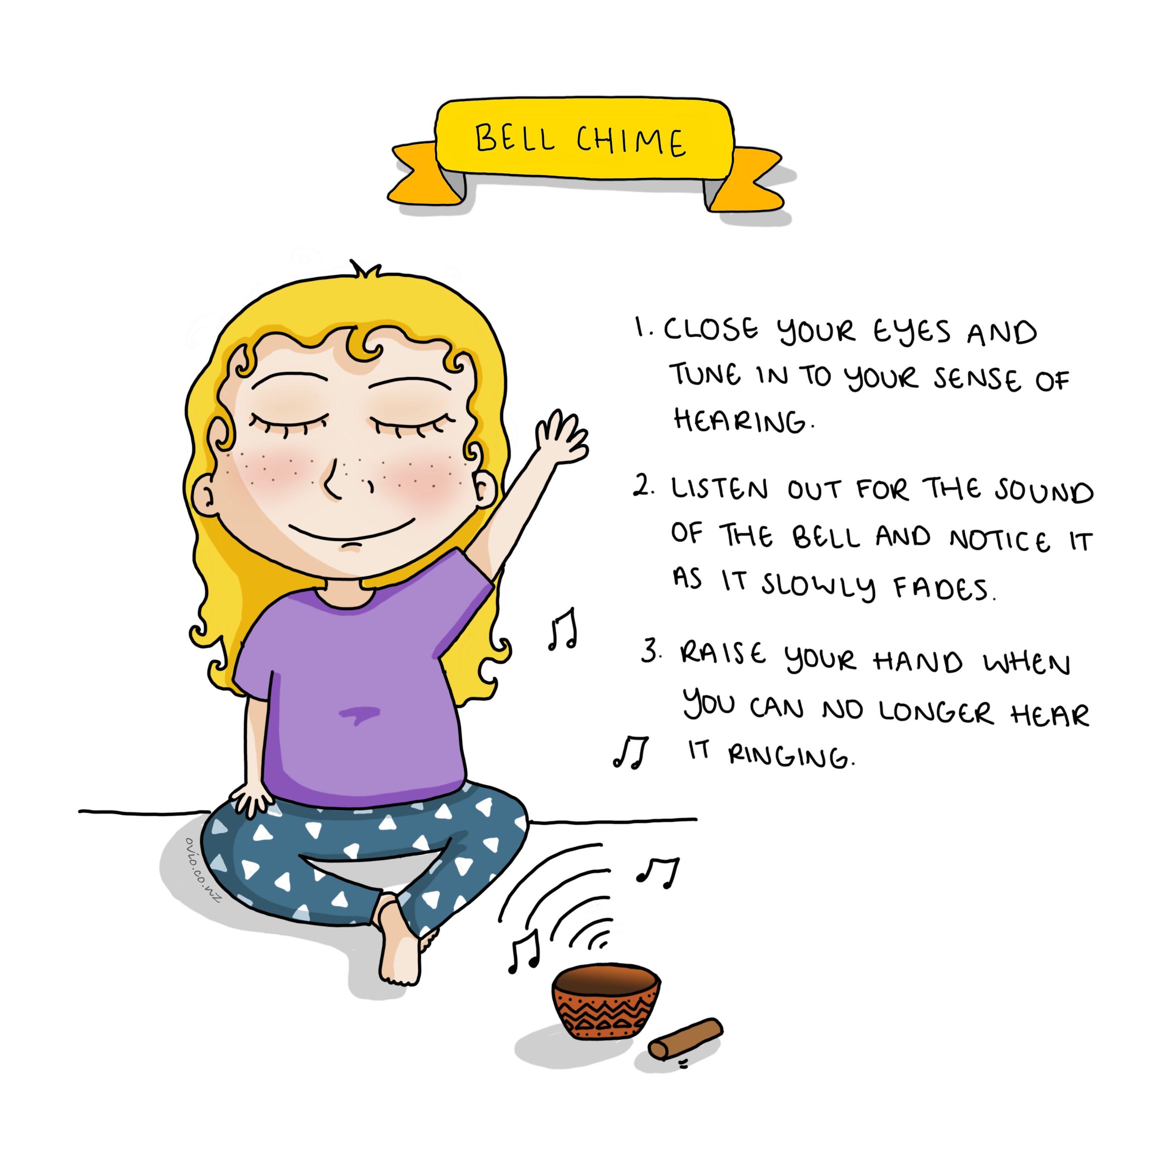
Notes:
Bell Chime
This exercise trains attention using sounds
This is different from the 10 sounds open awareness sound exercise as we are focusing on a specific sound finding it (aiming) and listening until it fades away (sustaining)
Note
You can use any musical instrument or anything that makes a noise that fades away.

Slide 6
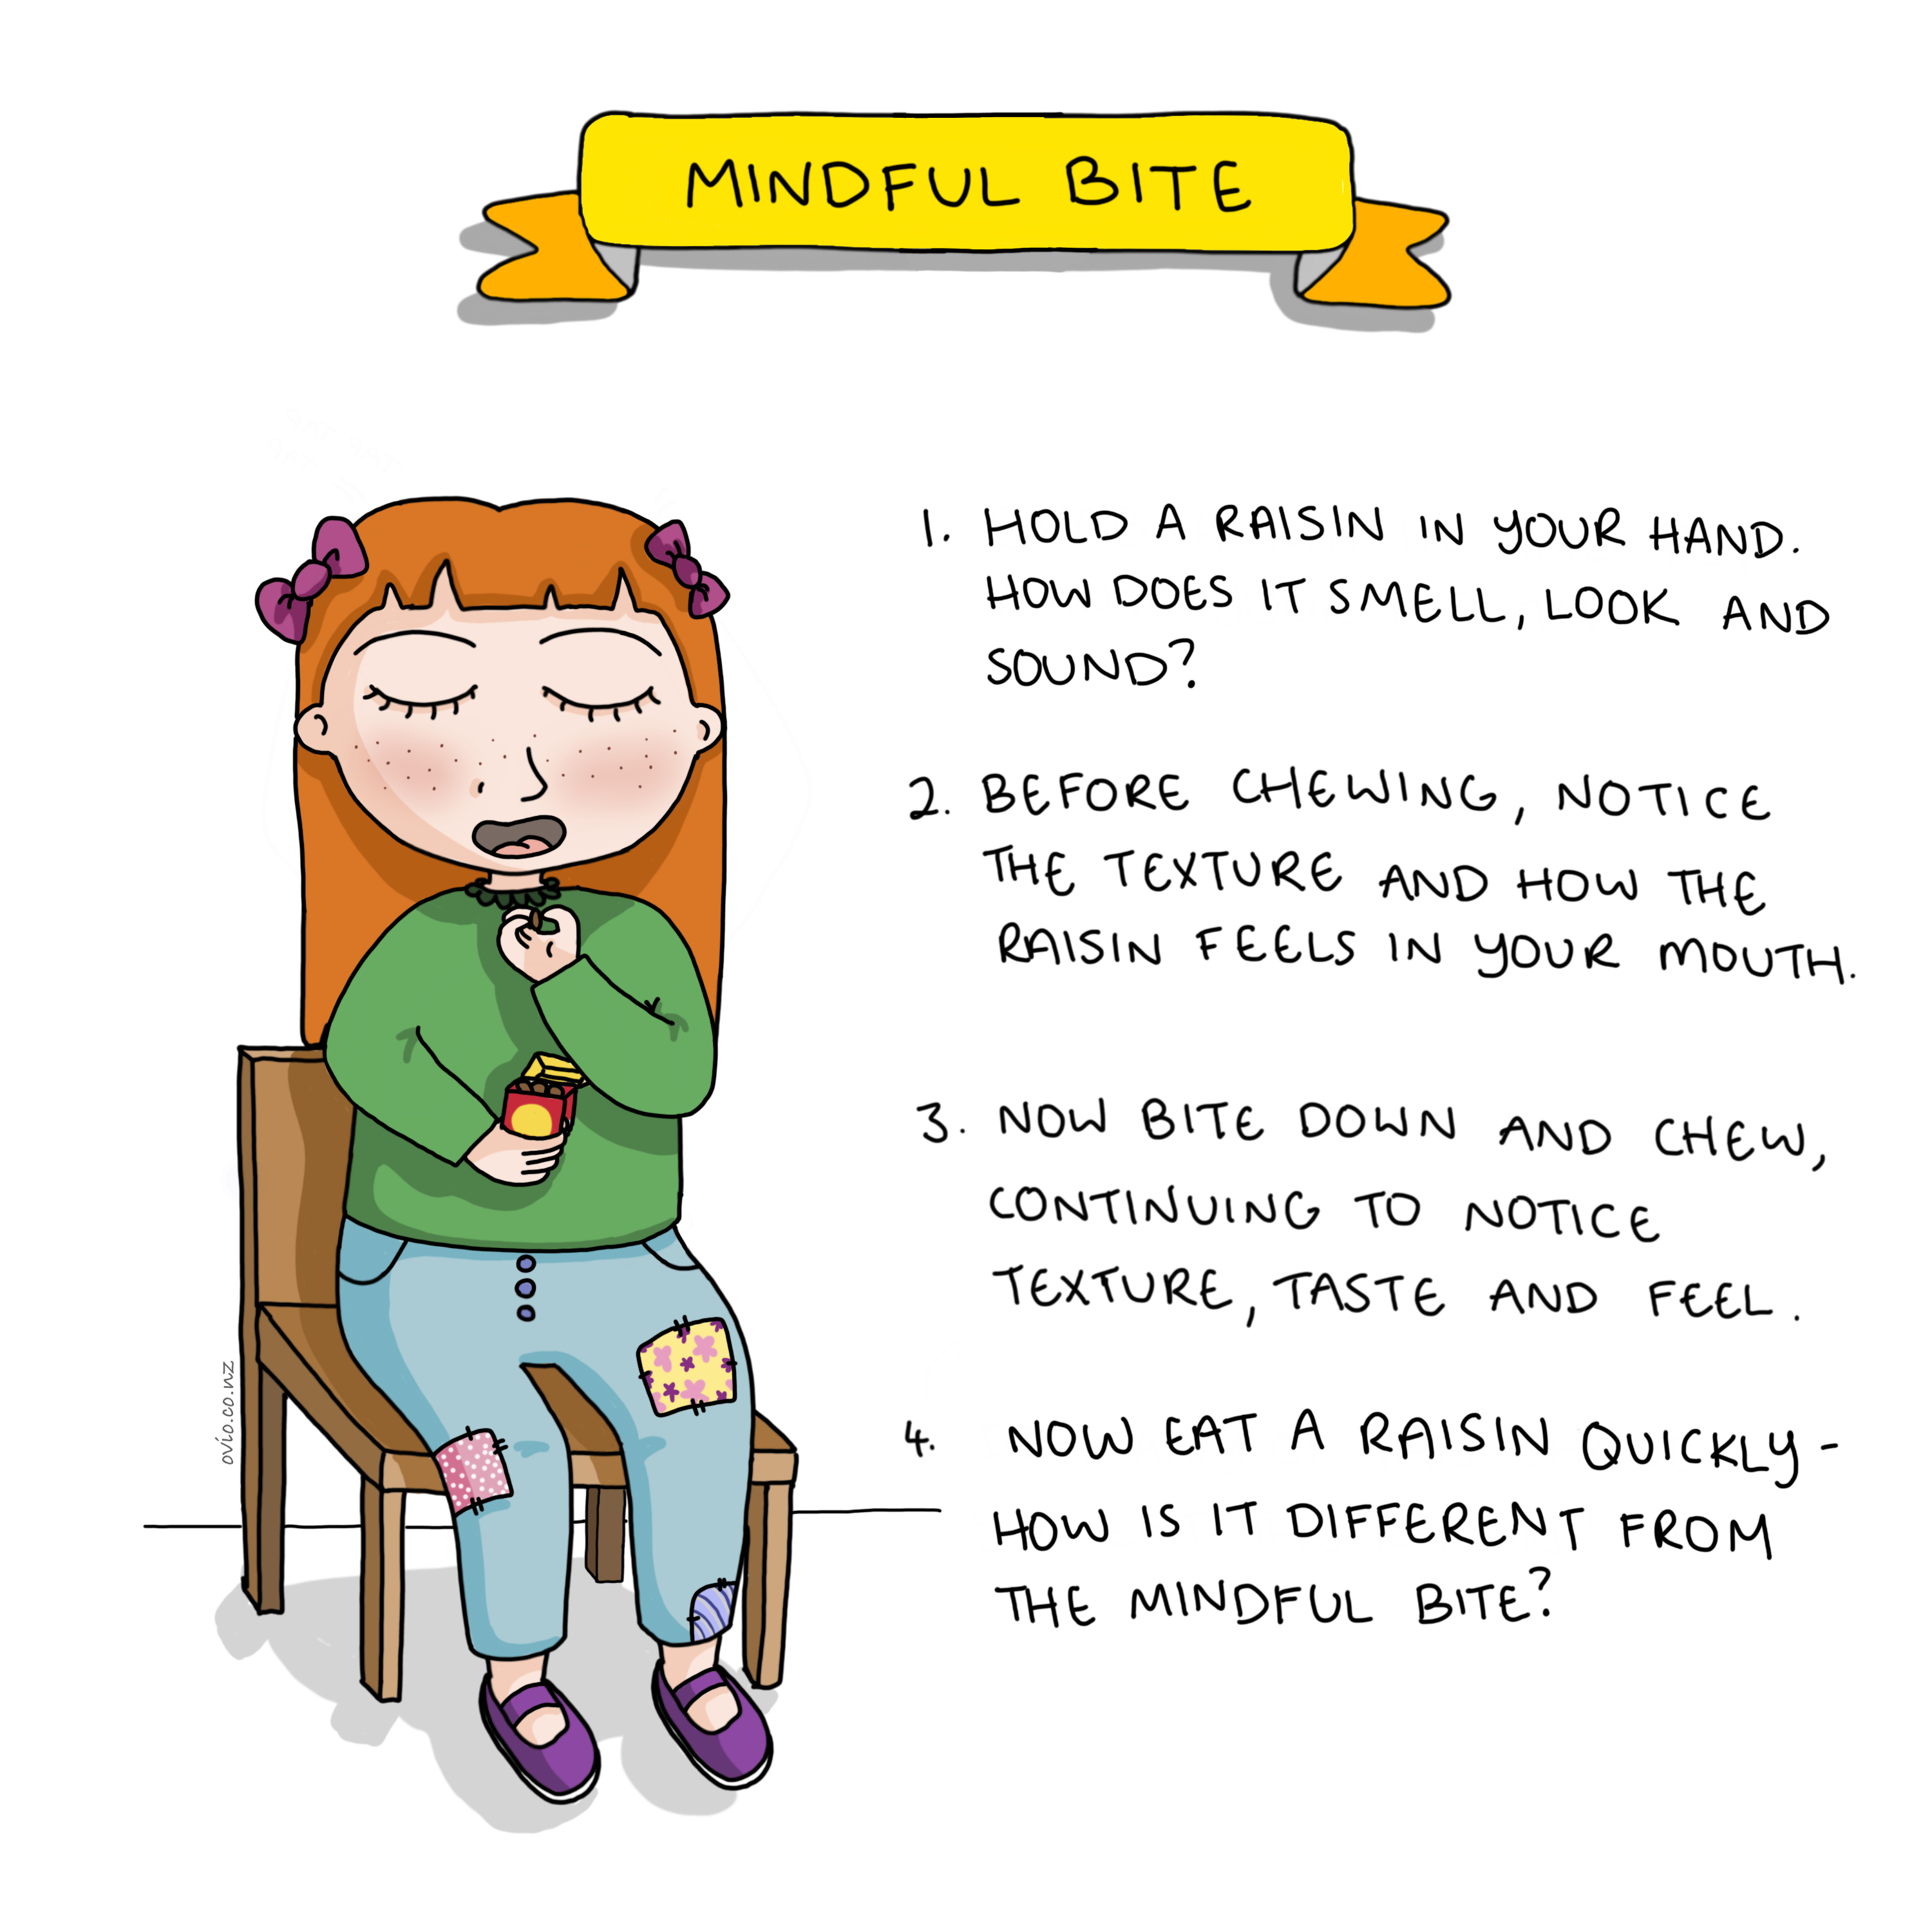
Notes:
Mindful Bite
In my experience kids really love this mindful eating exercise.
It engages all of the senses and is a fun way to train attention and promote good eating habits.
Children usually notice that when eating mindfully the raisin tastes better, is more juicy, flavoursome and satisfying.
For older children you can ask
What was involved in getting this raisin to you?
What went into growing this raisin?
Remember to get creative.

Slide 7
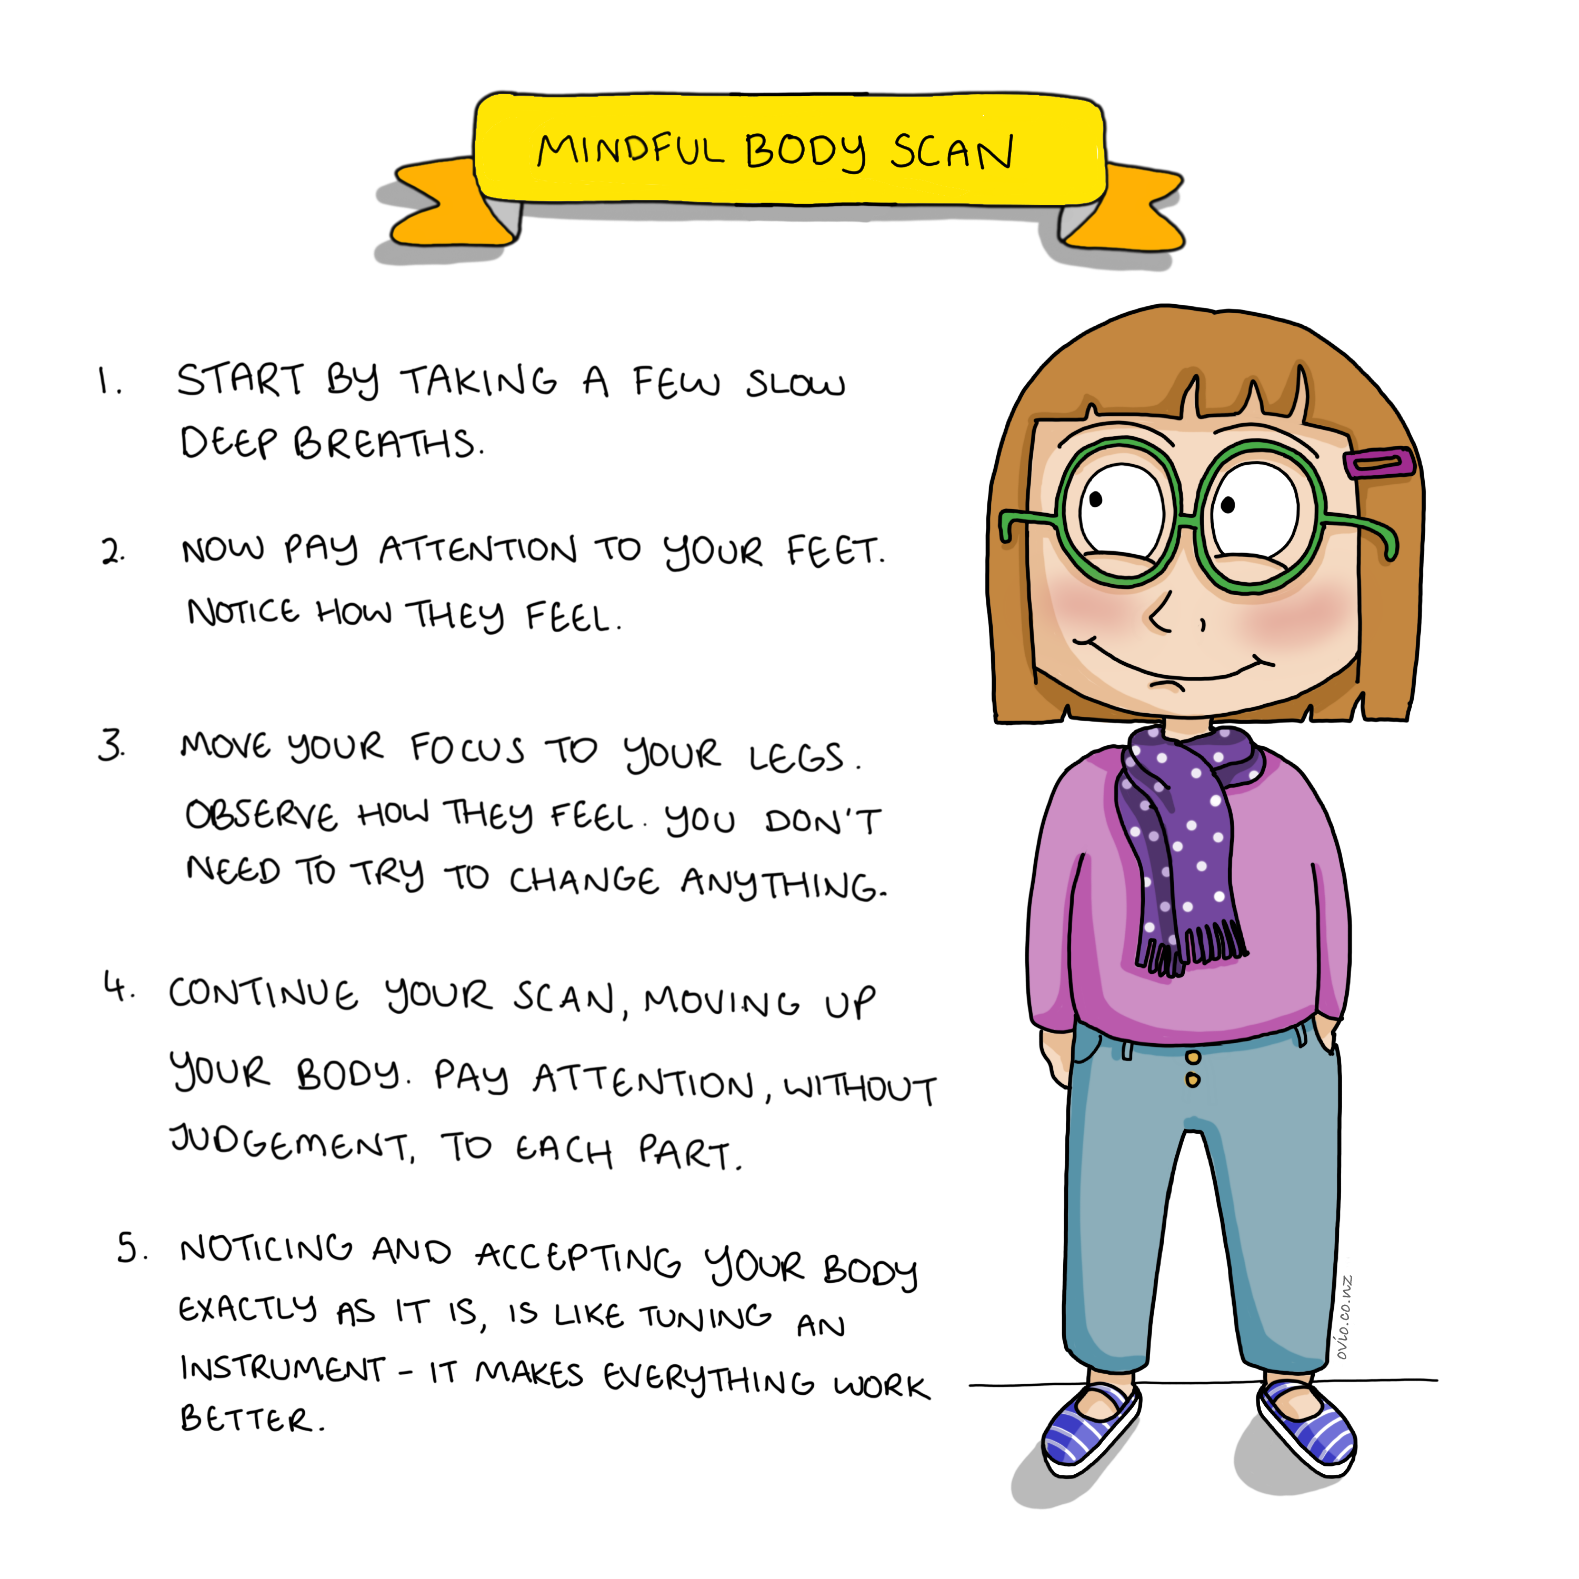
Notes:
Mindful Body Scan
This is a foundational mindfulness exercise that has many different applications:
Calming
Training attention
Aiding sleep
This exercise helps children notice themselves without judging or editing/changing what they feel. It allows them to become more self-accepting and happy as they are. This helps to build self-confidence and resilience.
It can be practised seated, or lying down if space permits.
The pace of how quickly you scan the body depends on the child’s age and context
3 minute body scan: https://soundcloud.com/oviomindfulsolutions/body-scan-3mins
7 minute body scan: https://soundcloud.com/oviomindfulsolutions/body-scan-7mins

Slide 8
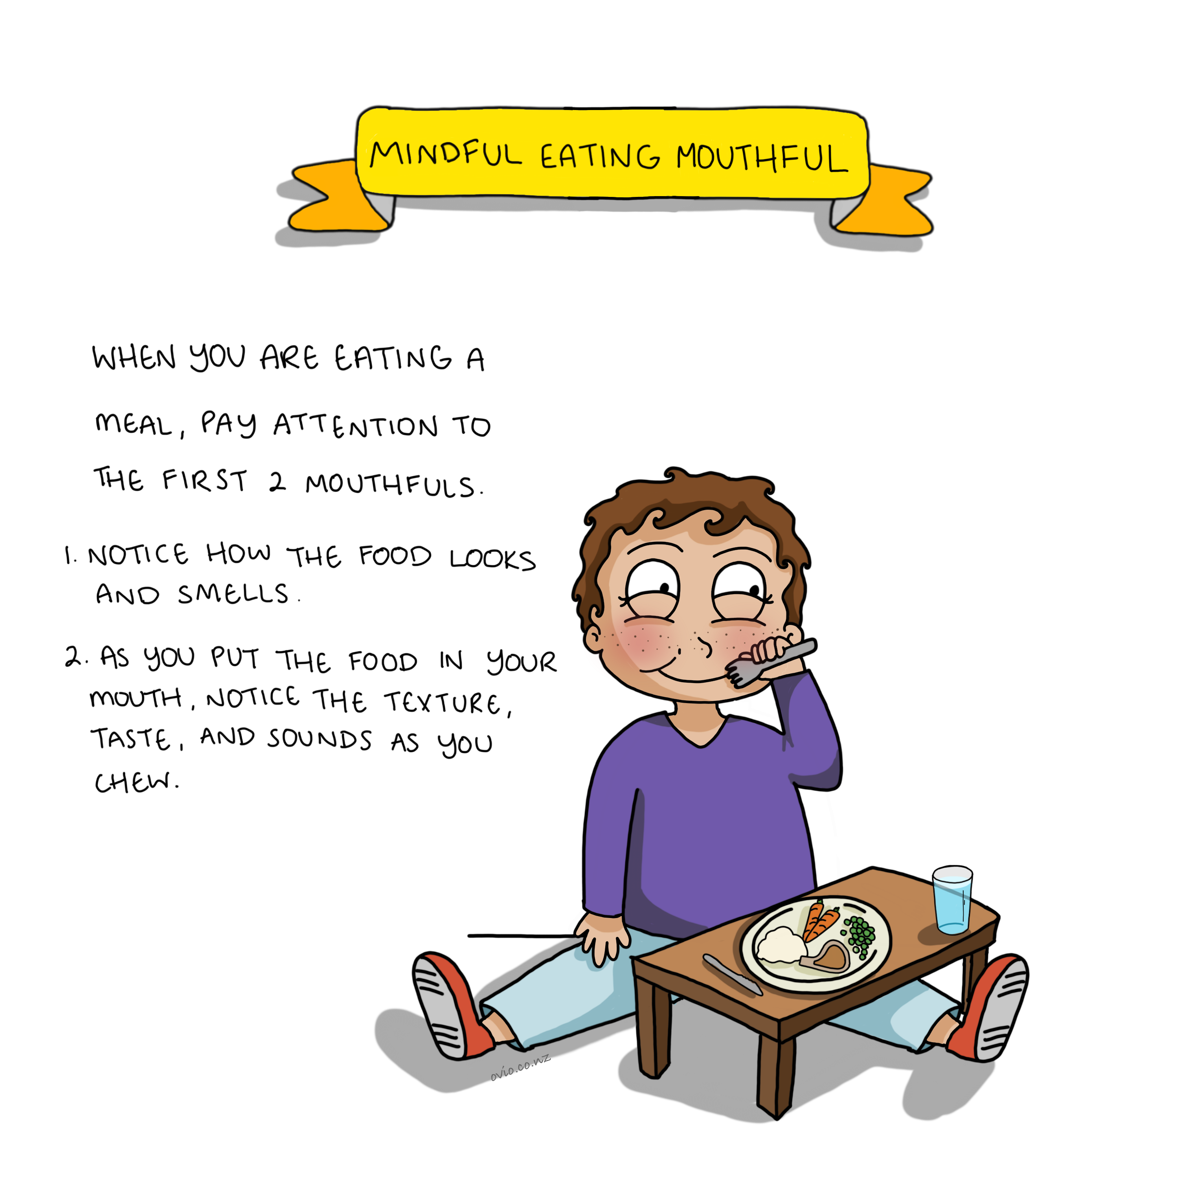
Notes:
Mindful Eating Mouthful
Mindful eating is a great habit to instil in children as well as being useful for training attention.
Note Children should be encouraged to attend to any routine activity mindfully.
E.g. Eating or brushing teeth or any other routine activity that can act as a prompt to remember to practice mindfulness.

Slide 9
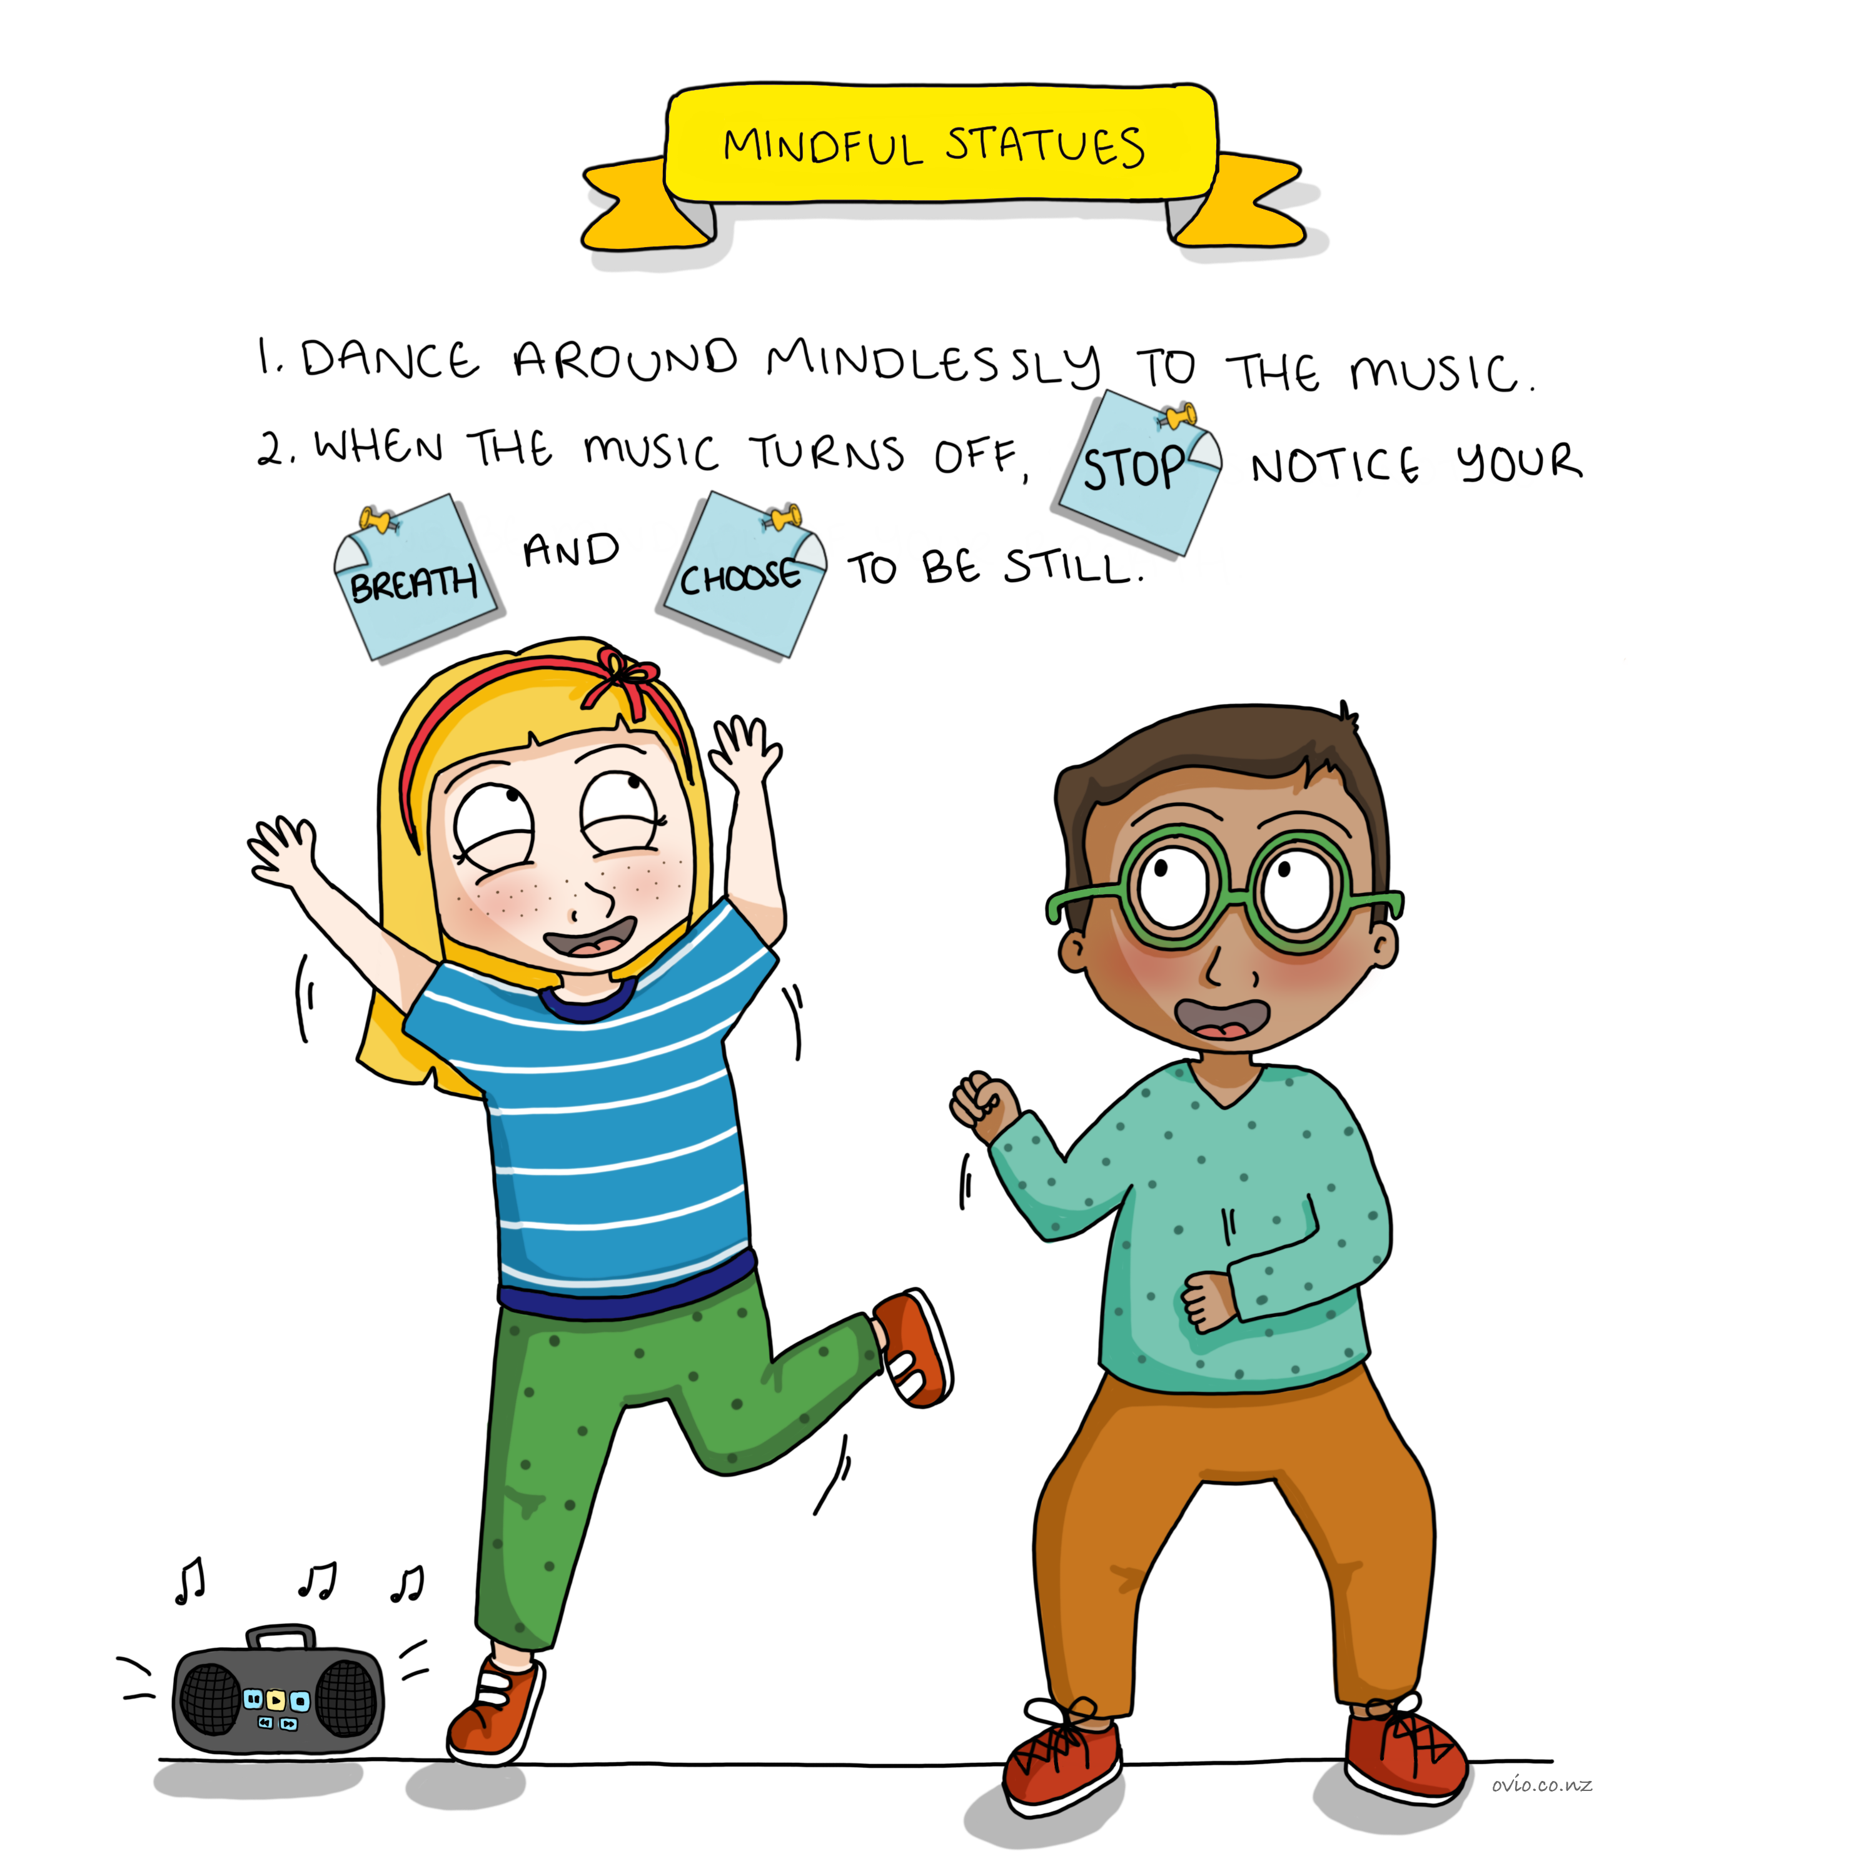
Notes:
Mindful Statues
This is so much fun and is a great way to help children connect as well as practicing the art of: Stopping/breathing-balancing /choosing.
Encourage children to stop when the music turns off and place their hand on their belly and notice the rise and fall of their belly with the breath.(to regulate emotion, see balance section)
Children then notice they have to make a choice to be still.
Decision making or choosing is crucial in order for children to experience healthy outcomes in life.
By practicing this exercise it helps children understand the importance of the 3 stages of decision making:
Stopping (noticing)
Balancing mood –in this case we use breath to do this. (emotional regulation)
Choosing behaviour
By extending the space between stimulus (music stopping) and response children have a chance to respond vs react. This becomes important for children in day to day life when they get triggered they have practiced emotional regulation prior to choosing their response.
Note: If this exercise gets “out of control” ask children to dance with feet “glued” to the floor.

Slide 10
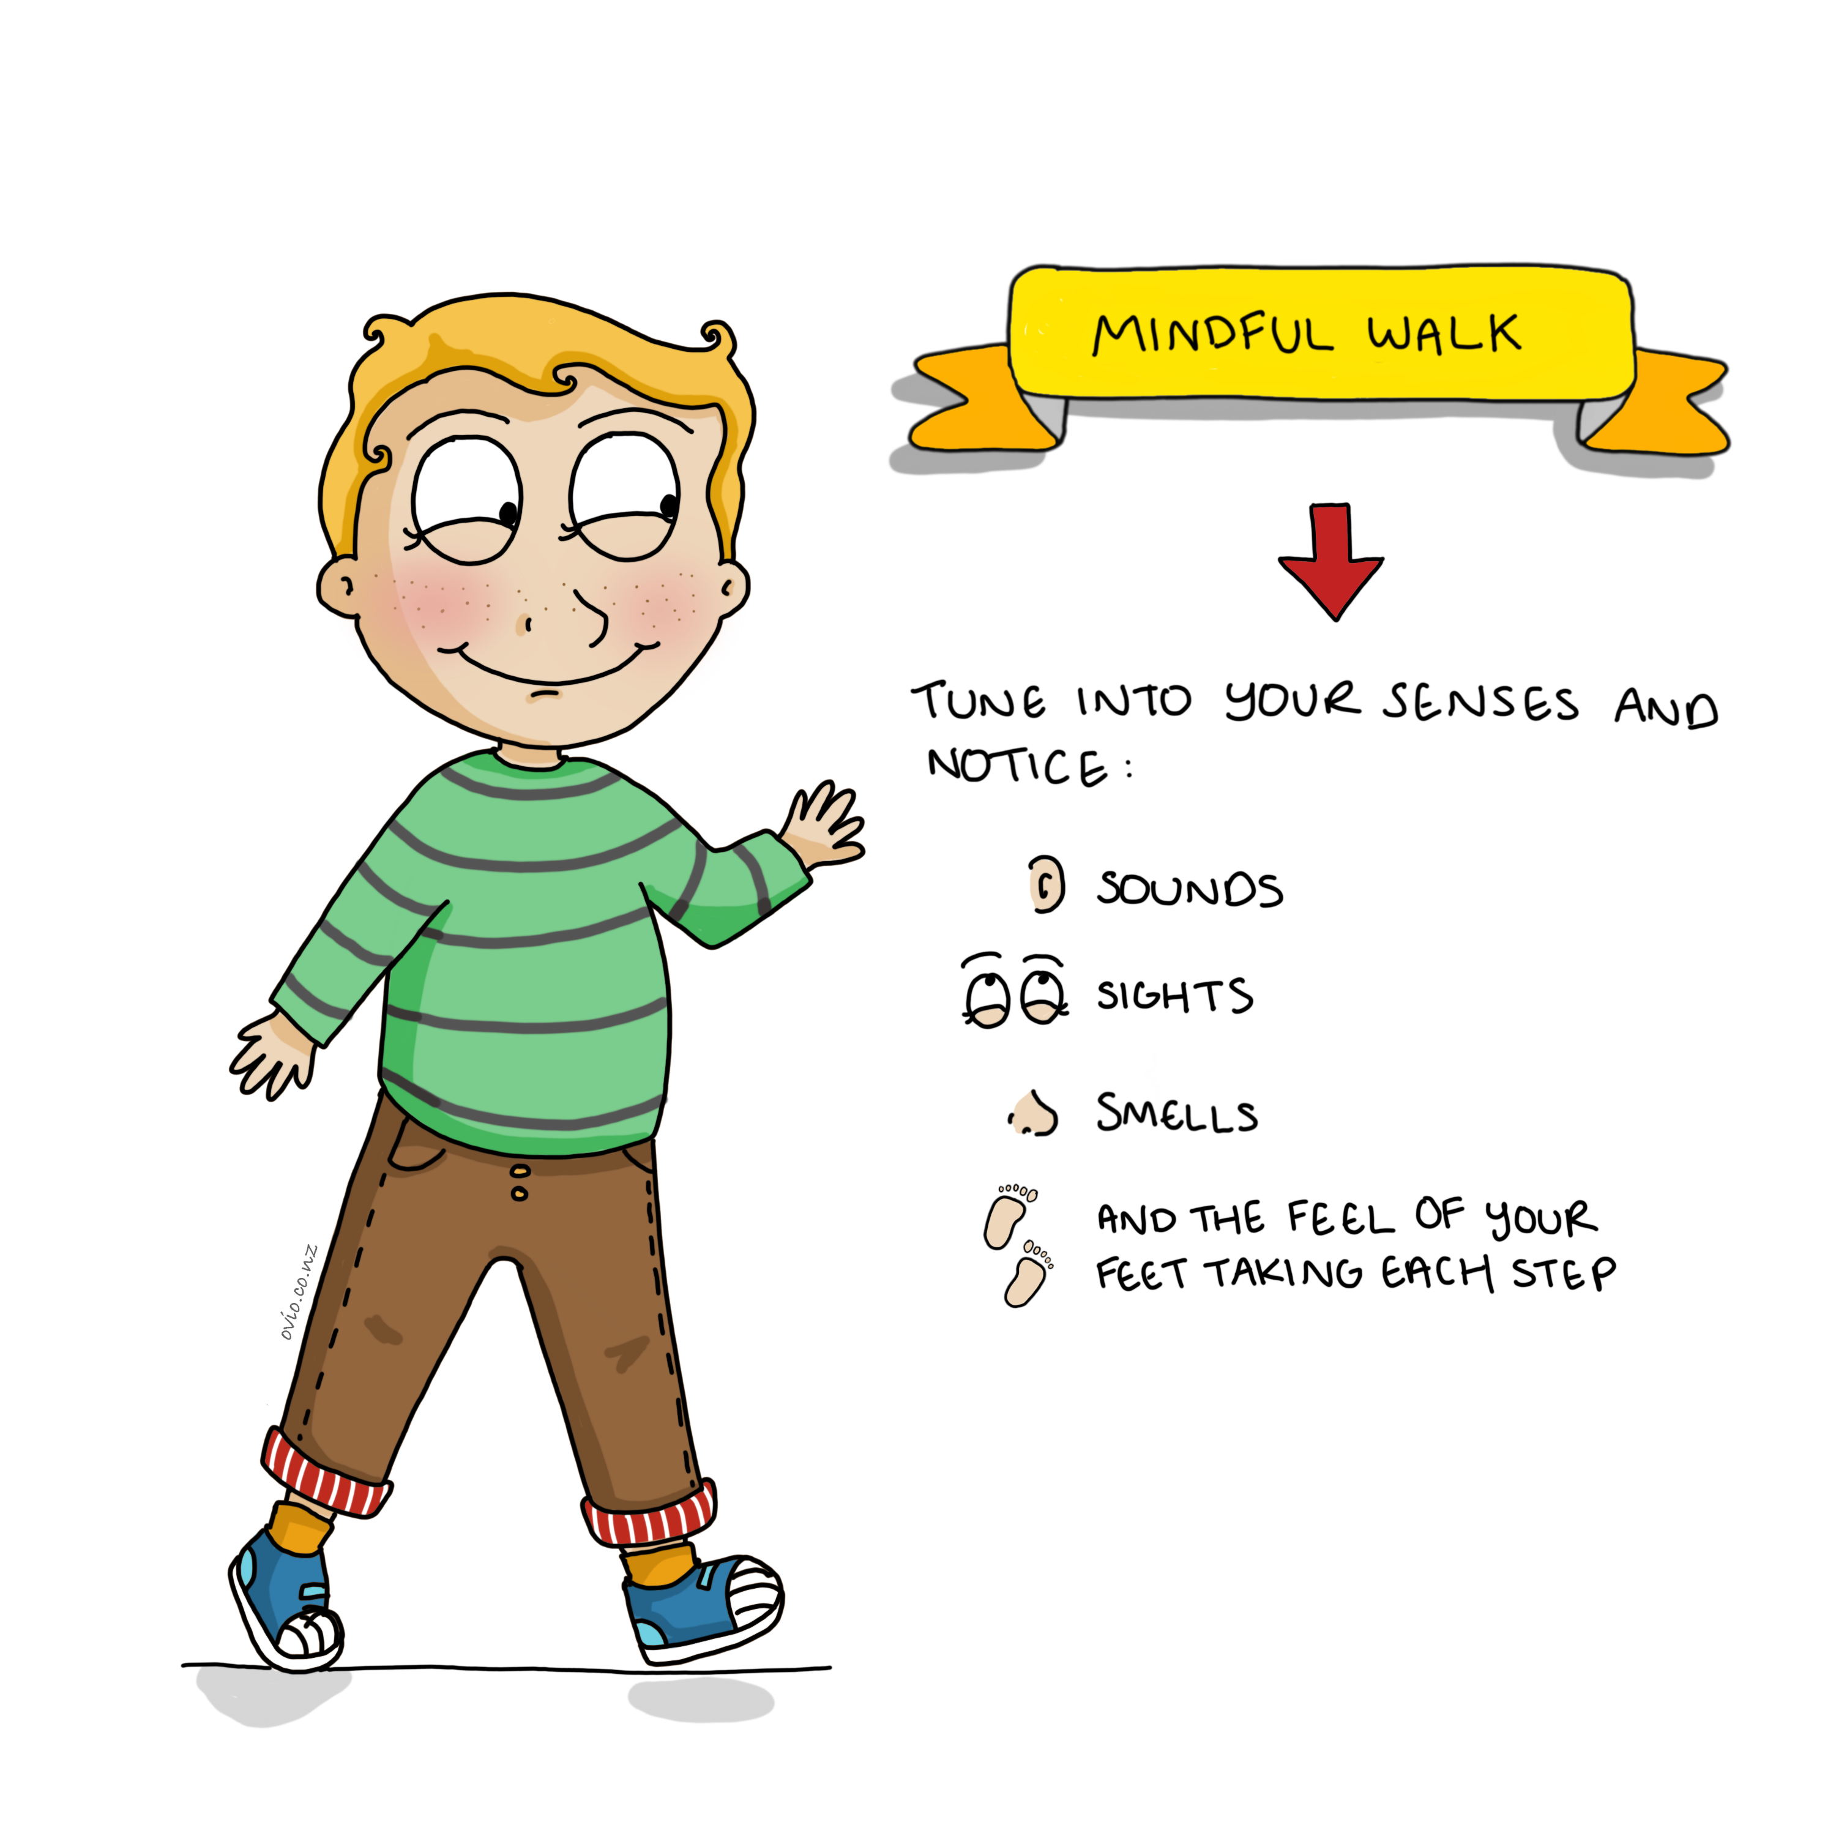
Notes:
Mindful Walk
Mindful walking is a lovely way to calm and relax as we train our muscle of attention.
You can be creative with this exercise asking children what they saw/heard/smelt upon their return.
It is important to encourage curiosity and not make the exercise a competition as to who noticed the most.
Everyone's experience is valuable no matter how unique.

Slide 11
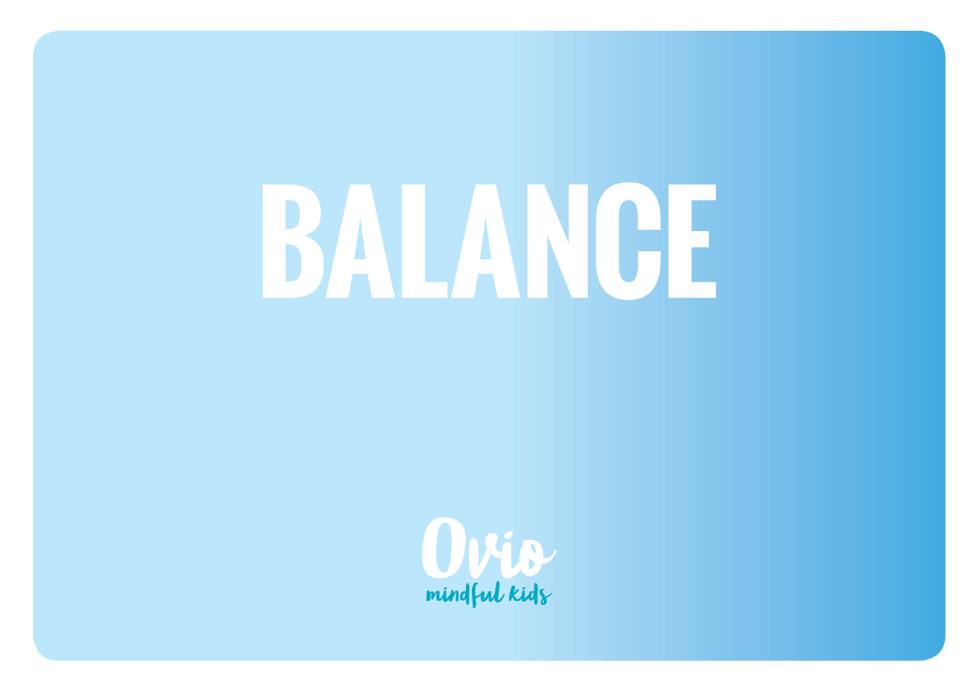
Notes:
Balance or emotional regulation is another crucial skill for children to learn.
The second crucial life skill is that children know how to feel a sense of balance in life so that they can sense when they are out of balance in order to come back to baseline of that which feels good grounded and “normal”. These exercises help children to notice their emotional state and to learn to re-centre.
To be able to regulate or regain composure when stressed, over excited or upset allows the child to take time to respond wisely. (To think before acting.) This is an important part of resilience.
Just right
Calm
Present
Content
Grounded
Settled
Attentive
Too much
Hypervigilant
Overwhelmed
Stressed (flight response)
Anxious
Over excited
Angry
Too little
Nervous
Low energy
Depressed
Sadness
Very anxious or stressed (freeze response)

Slide 12
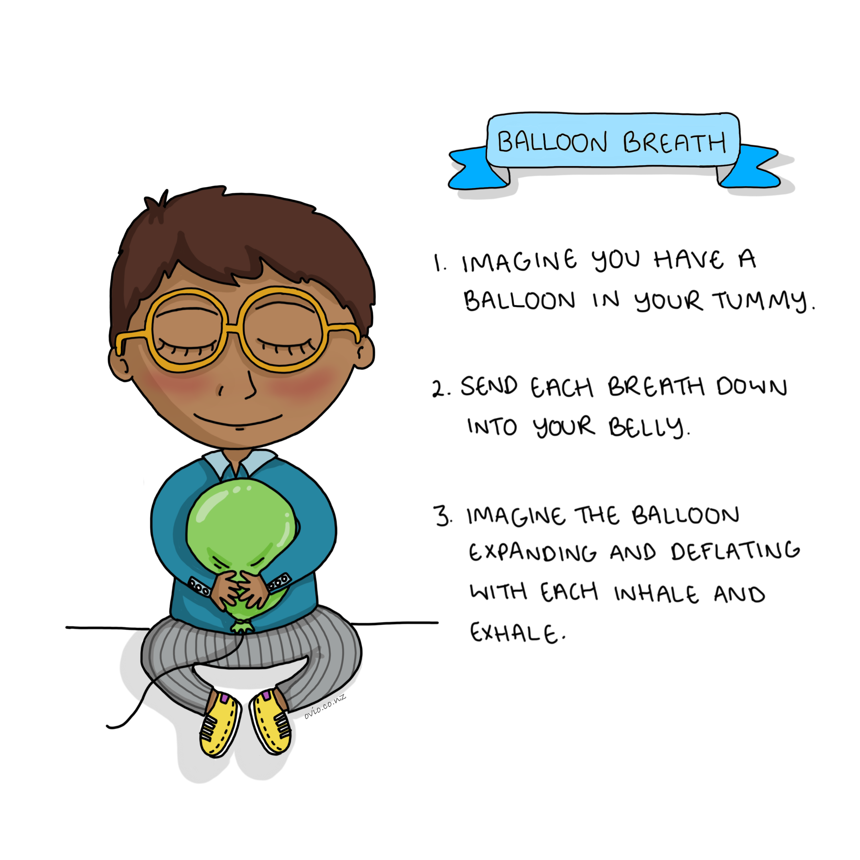
Notes:
10
This balloon breath exercise is a great way to induce the relaxation response especially diaphragmatic breathing as in the bear and balloon and book breath.
Diaphragmatic breathing can reduce Heart rate and blood pressure as it stimulates the parasympathetic nervous system.
If focusing on breath makes a child anxious remember to stop and move onto another exercise (First do no harm)

Slide 13
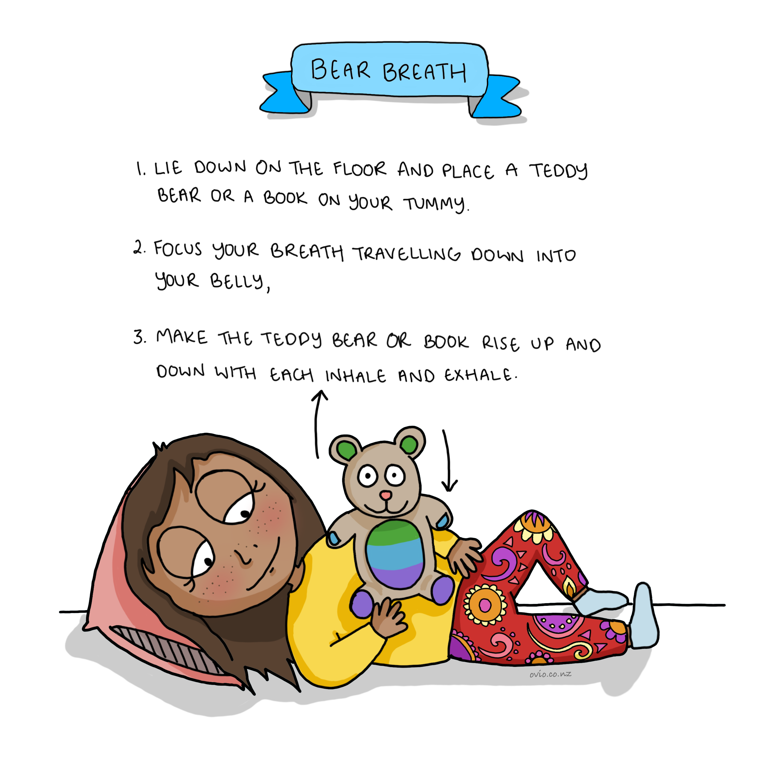
Notes:
11
A great way pre bed exercise to aid sleep
Diaphragmatic breathing can reduce Heart rate and blood pressure as it stimulates the parasympathetic nervous system

Slide 14
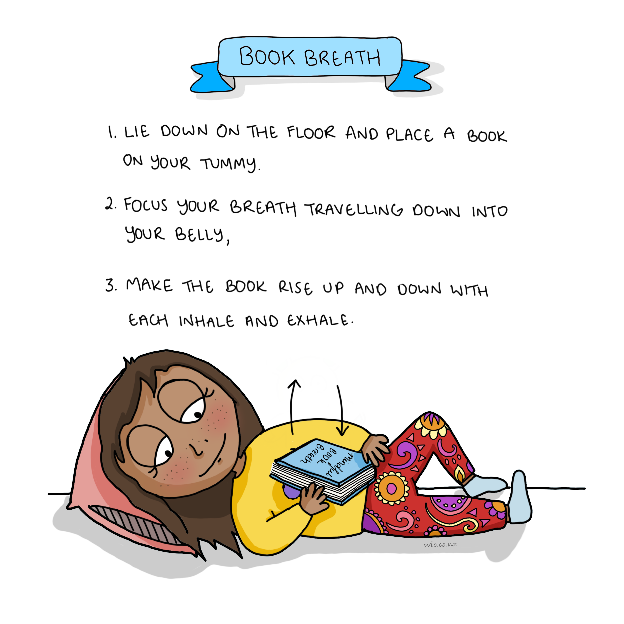
Notes:
Book Breath
A great pre bed exercise to aid sleep or it can be used any time a child needs to calm down.
Diaphragmatic (belly) breathing can reduce heart rate and blood pressure as it stimulates the parasympathetic (rest and digest) nervous system.

Slide 15
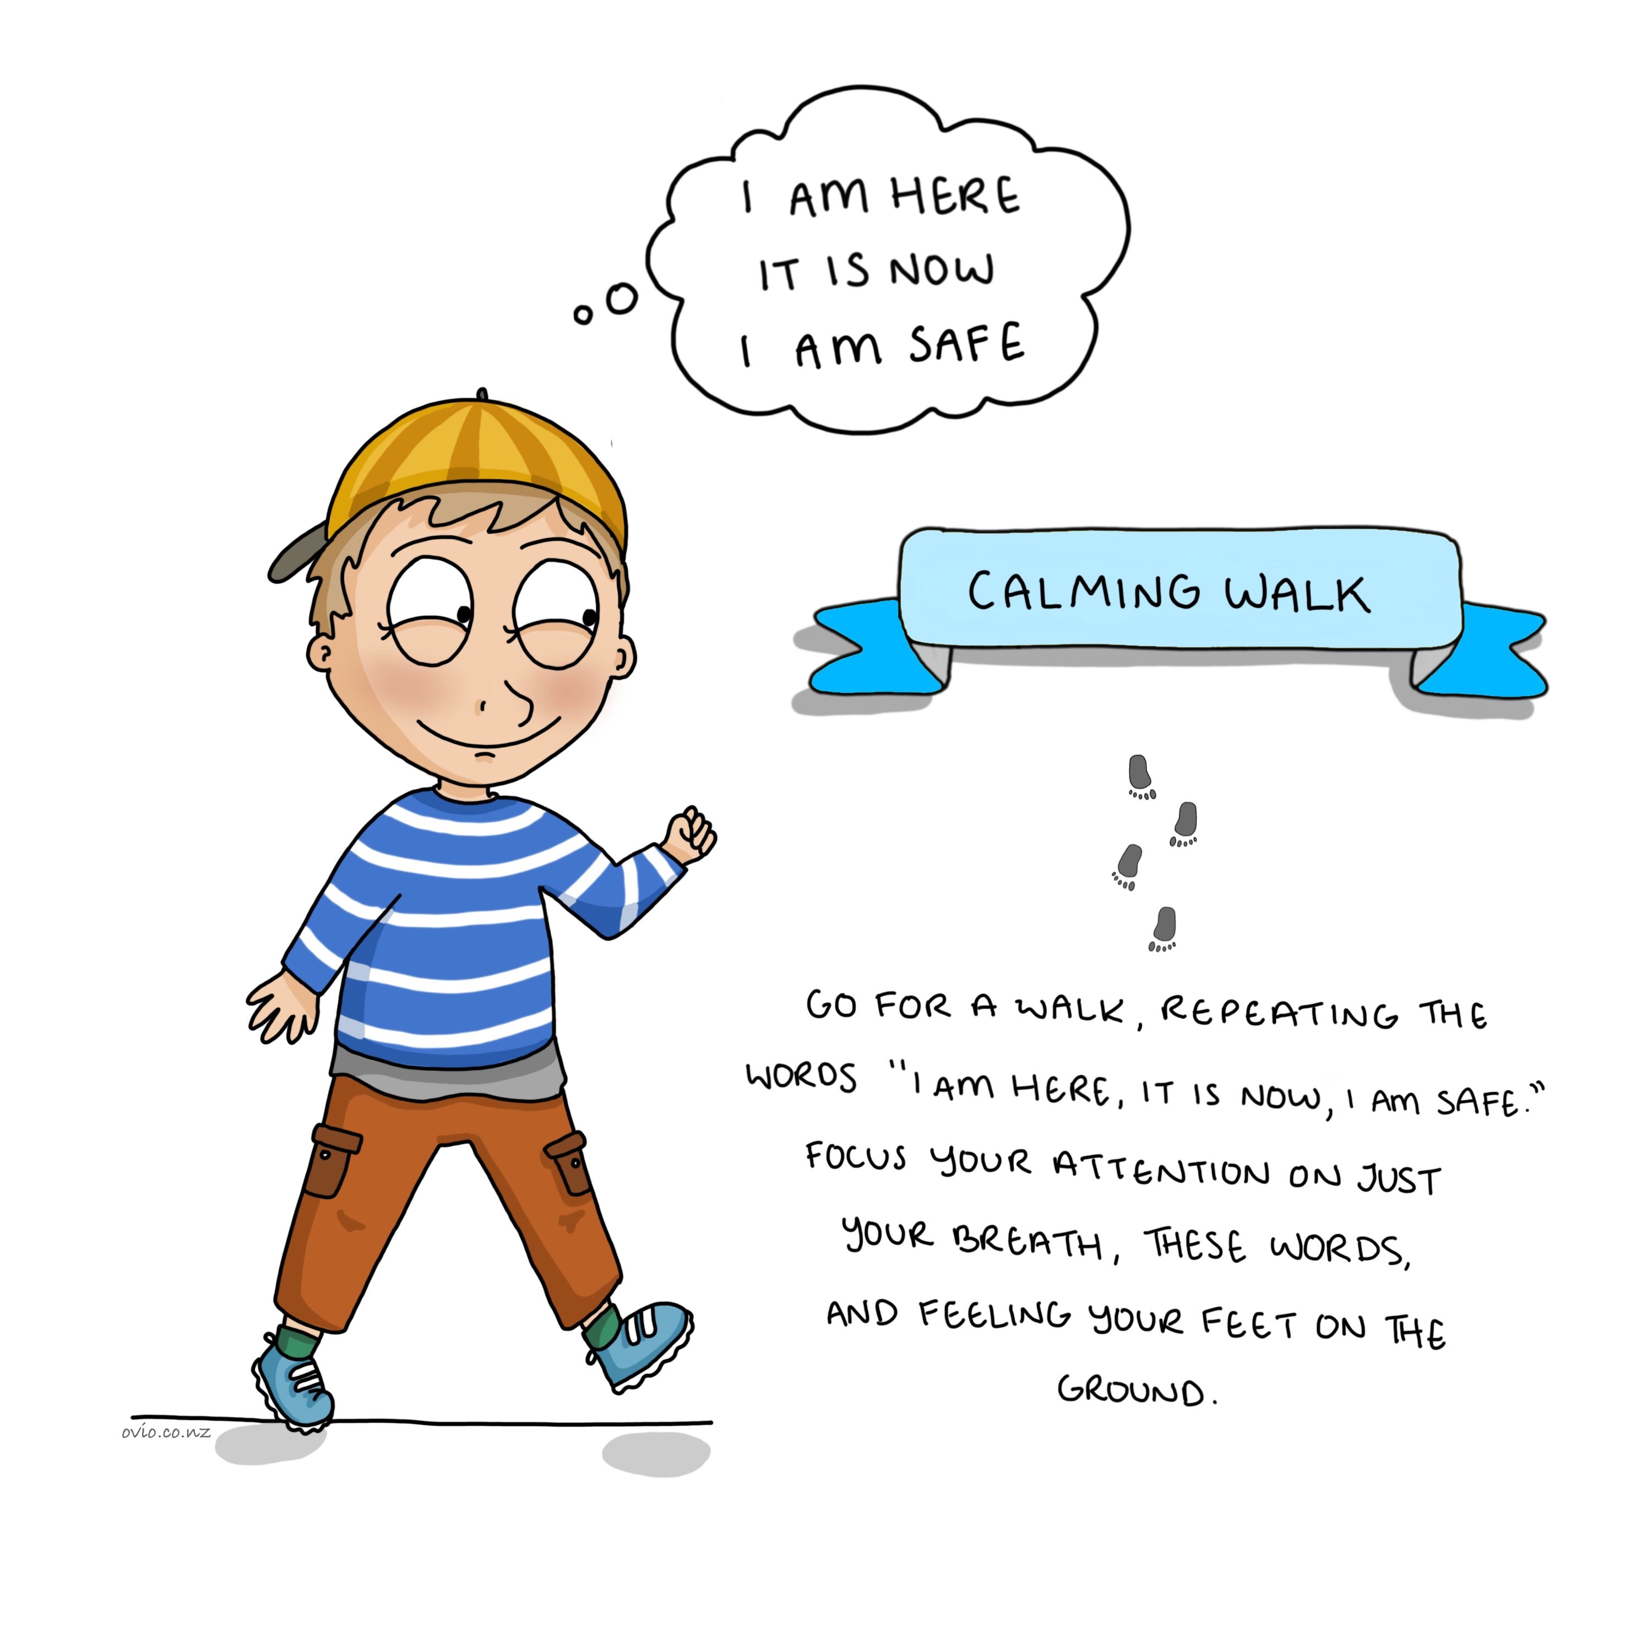
Notes:
Calming Walk
This is a wonderful grounding or calming exercise for children. It is a great pace to start for children who find it hard to sit still.

Slide 16
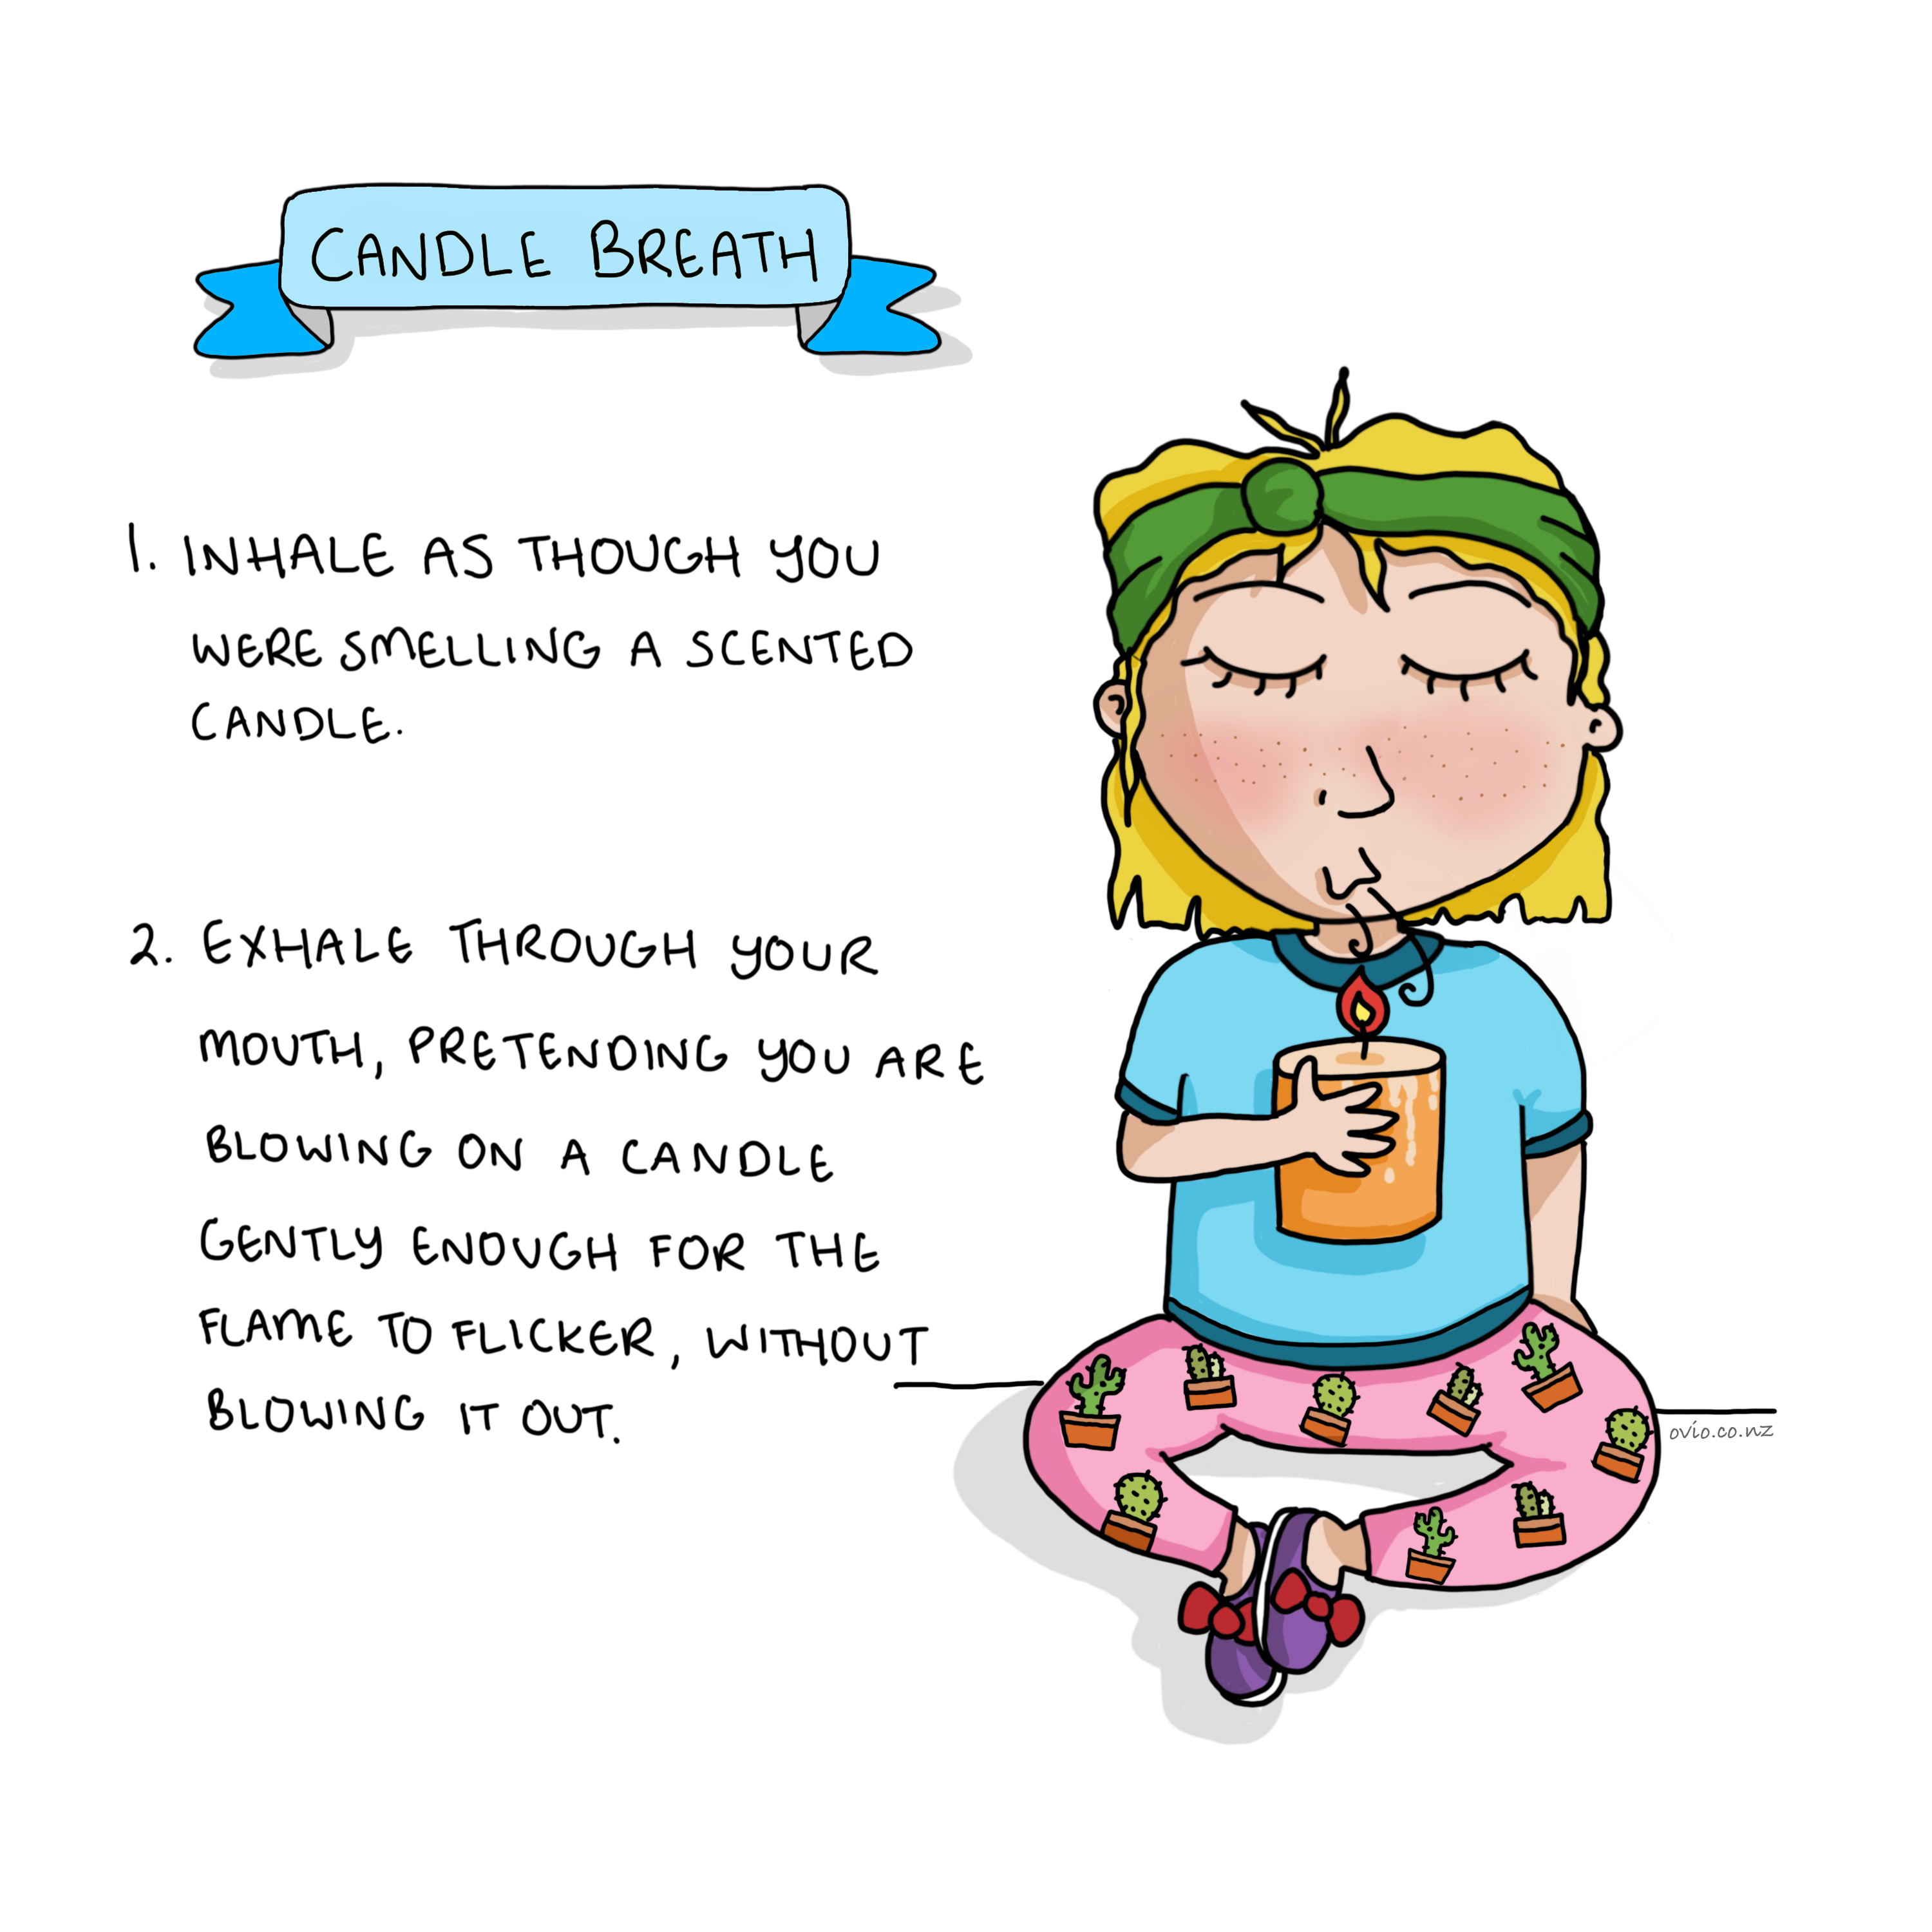
Notes:
Candle Breath
This candle breath (real) or visualized (pretend) can help slow the breath, regulate emotion and induce calm and happy thoughts.
It is a great idea in a classroom or learning context to practise this exercise with a candle as it will make it easier for the child to use this as a visual when they need to calm down and re calibrate.
This exercise encourages the child to exhale slightly longer than inhaling. This activates the parasympathetic nervous system (rest and digest )
Note : This needs to be natural not forced as when it is forced it can have the reverse effect.

Slide 17
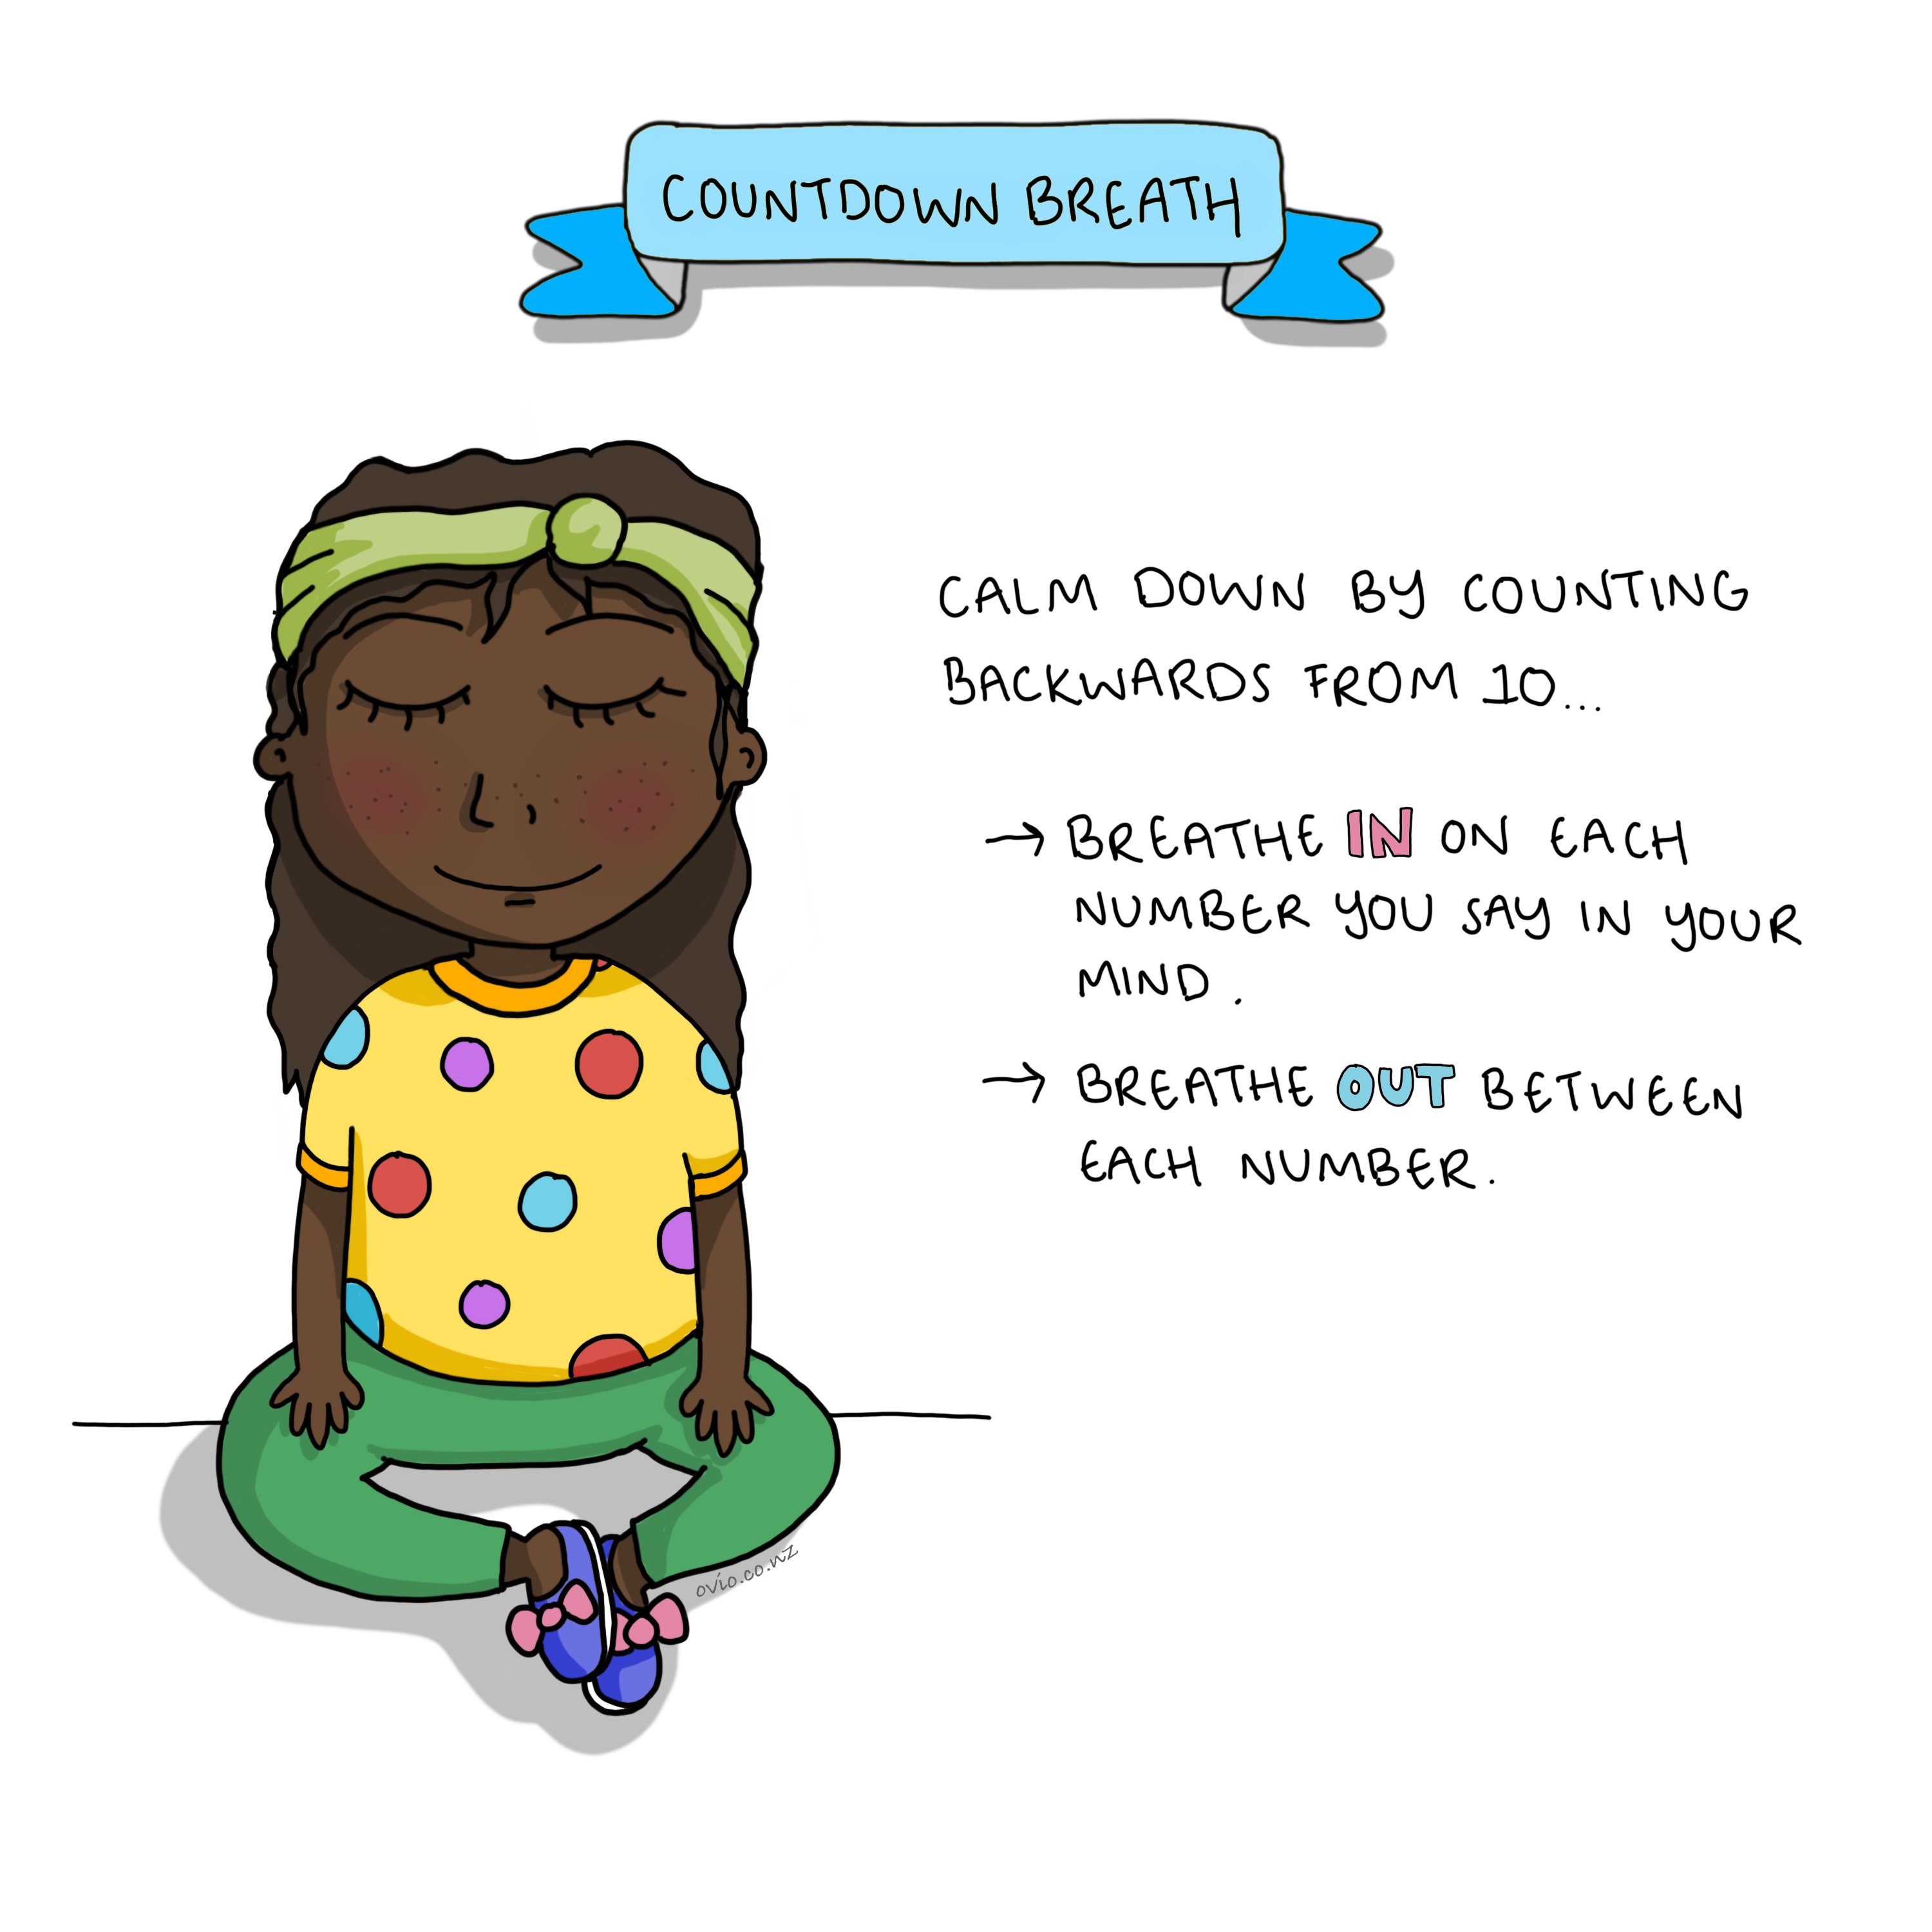
Notes:
Countdown Breath
This simple exercise of counting backwards from 10 can engage the parasympathetic nervous system and relax the child.

Slide 18
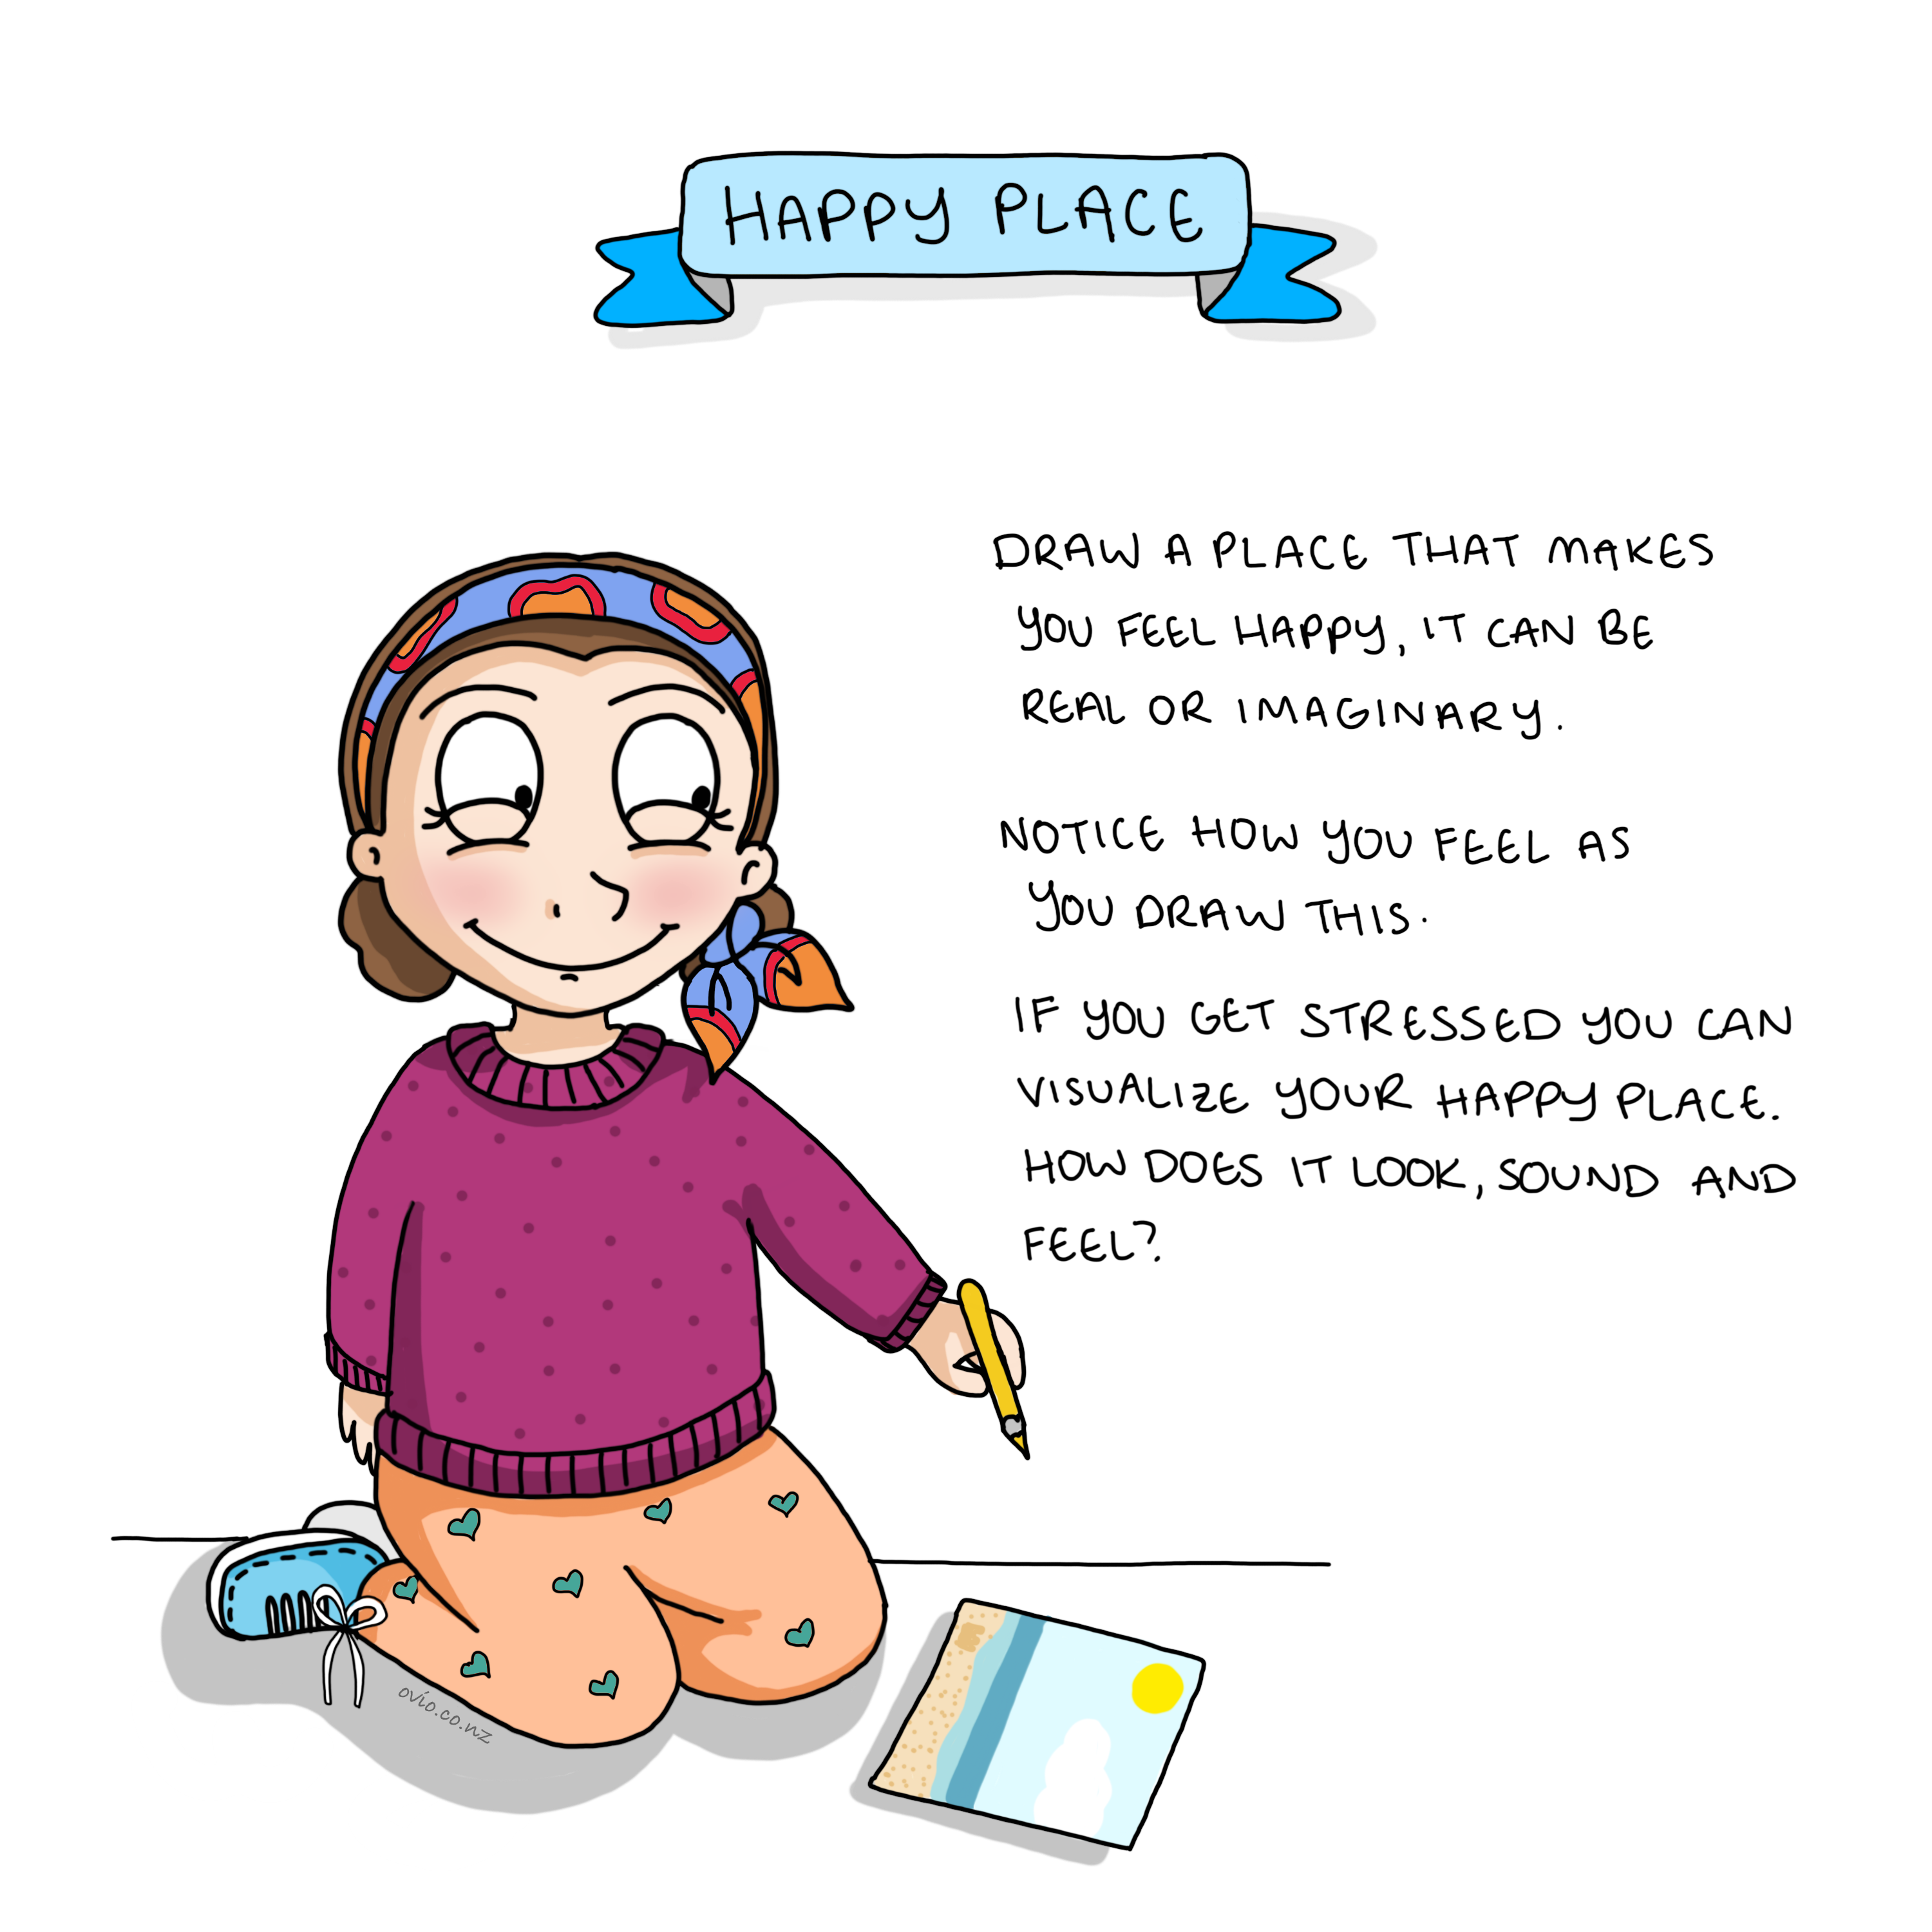
Notes:
Happy Place
This is a great exercise to do with children. Imagining and drawing a happy place can be helpful to evoke good feelings and a sense of calm during tough times.
Listen to this exercise here https://soundcloud.com/oviomindfulsolutions/kids-meditation-my-happy-place
When doing the exercise -
It is important that it is optional to show others their drawing.
It is ok for the drawing to remain personal to the child.

Slide 19
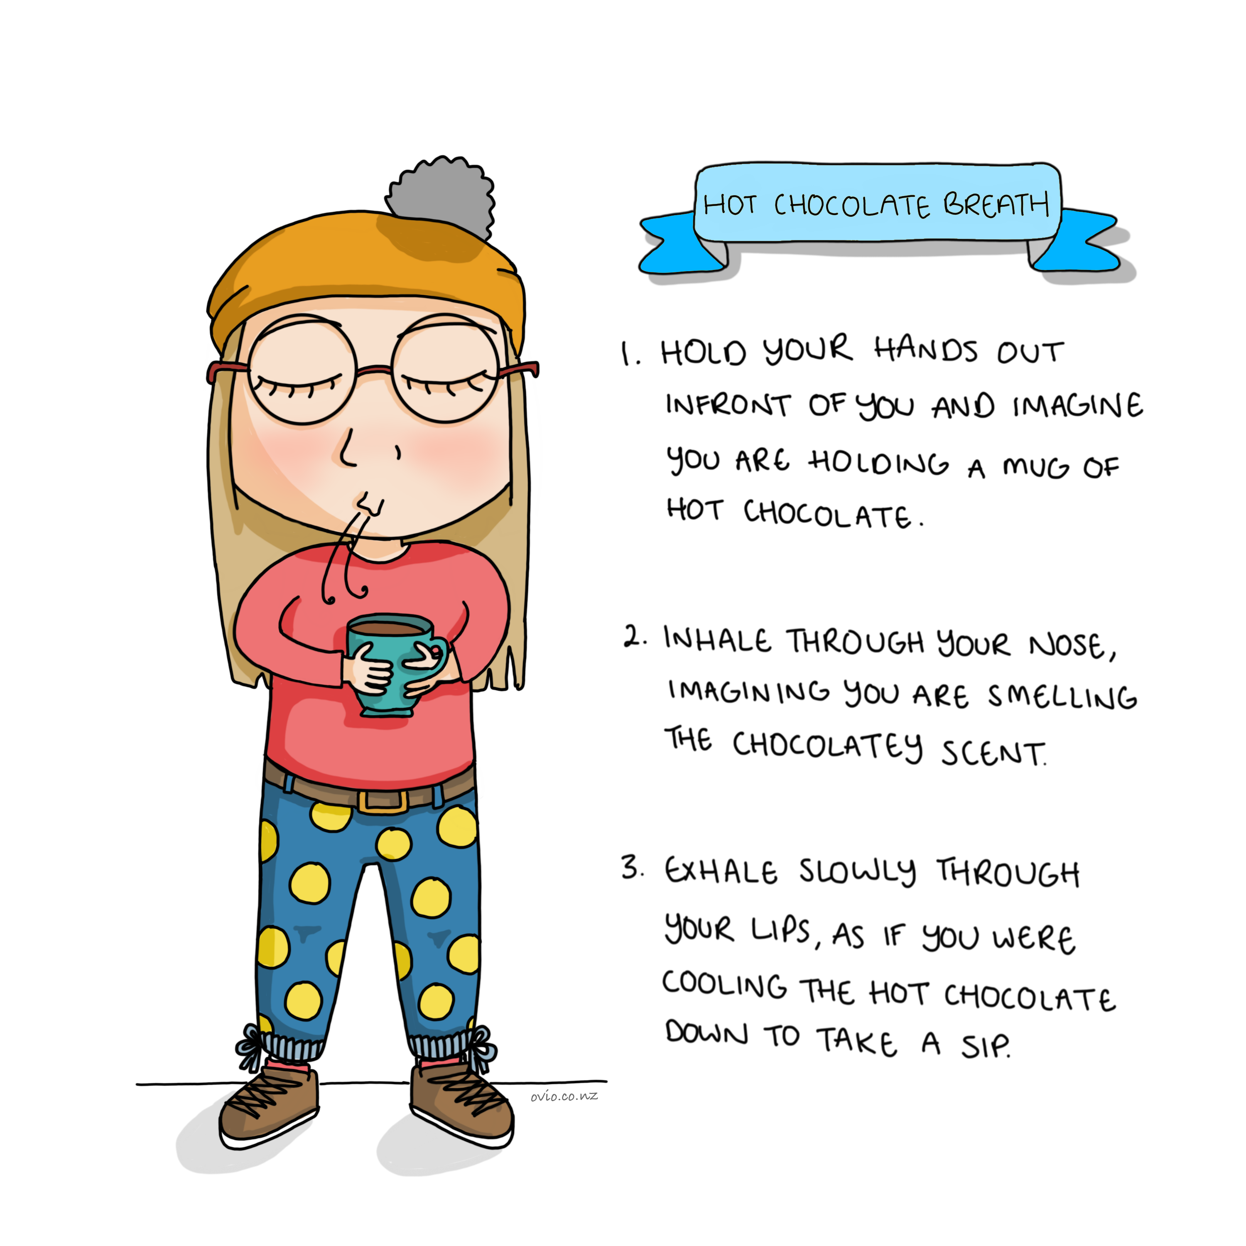
Notes:
Hot Chocolate Breath
This hot chocolate breath (real) or visualized can help slow the breath induce calm and happy thoughts/memories.
By making the exhale slightly longer than the inhale this activates the parasympathetic nervous system (rest and digest-green zone )
The breath needs to be natural not forced as when it is forced it can have the reverse effect that is why we use imagery.

Slide 20
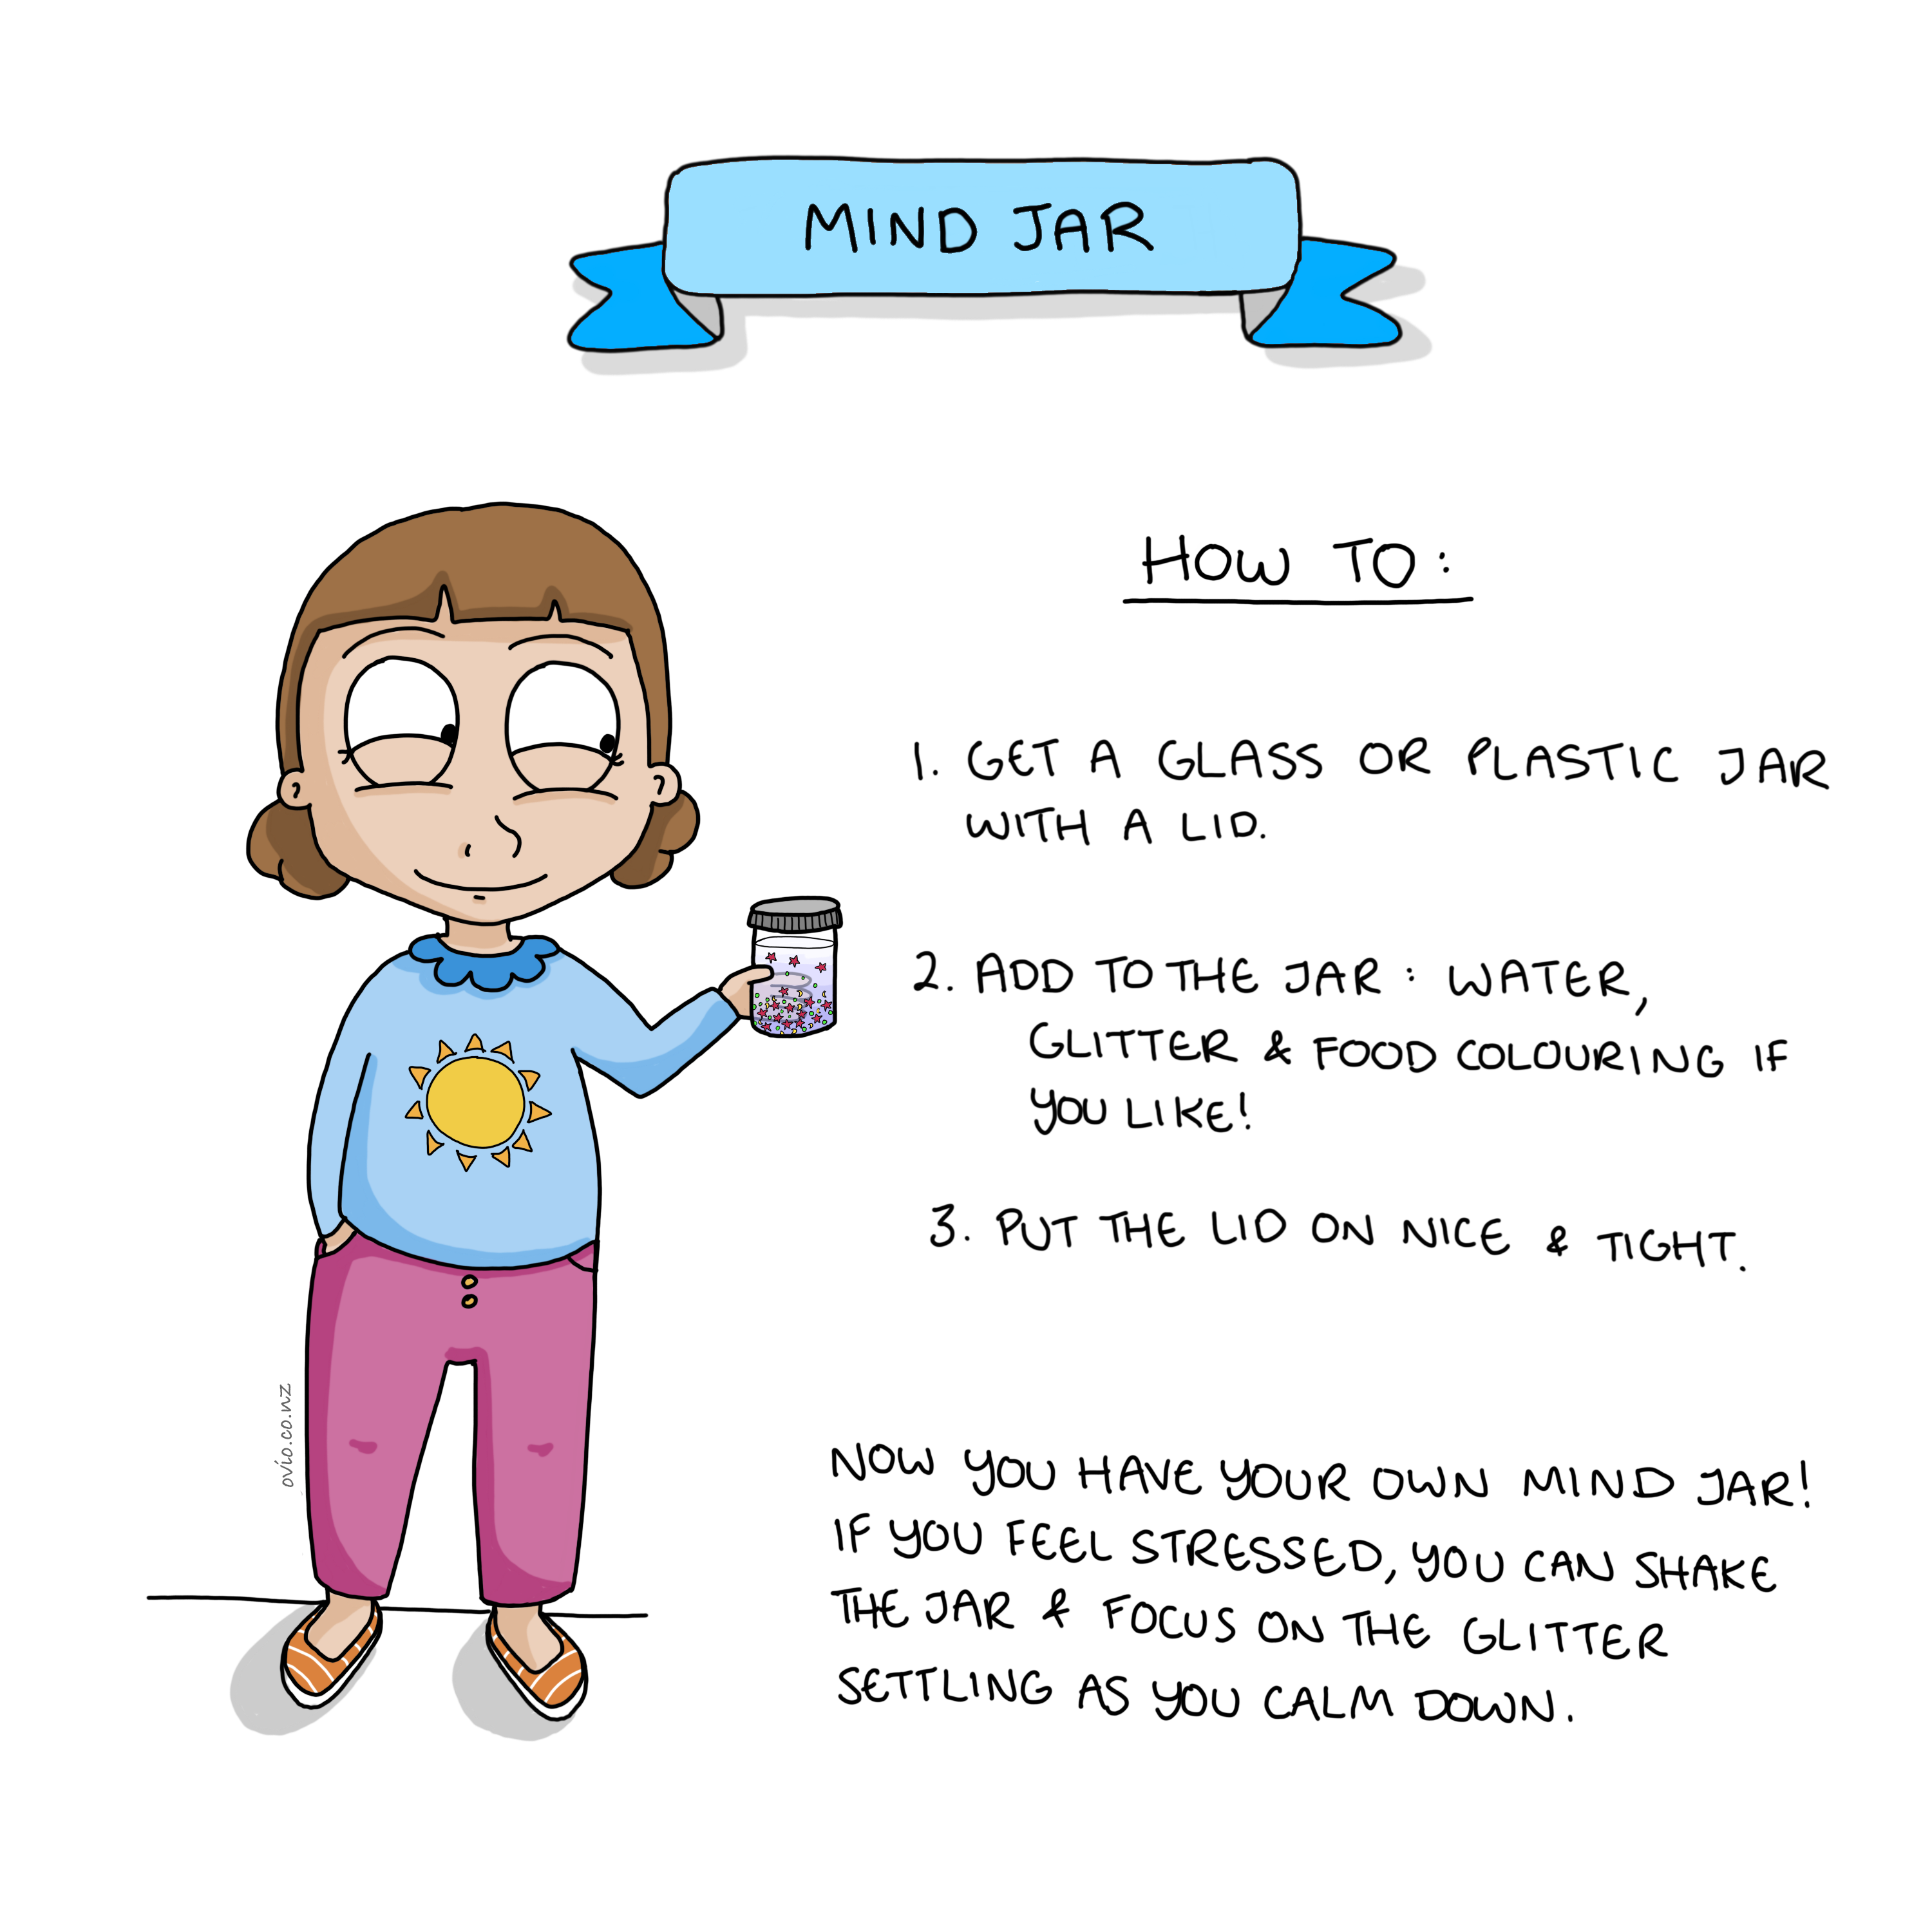
Notes:
Mind Jar
We can use this mind jar to explain to children the importance of pausing before we make decisions.
We can also use the mind jar to calm down by shaking it up and then watching as the glitter slowly settles. The glitter represents the thoughts and the water the space in the mind.
When the thoughts are racing we cannot see clearly to make good choices;
We can demonstrate this by shaking up the glitter in the jar and trying to see through it.
If we wait and balance ourselves then the thoughts (glitter) have time to settle and we can see clearly to make good choices.
See a full explanation of this exercise here-
Mind Jar exercise:
https://ovio.co.nz/kids_online_courses/bad-feelings-positive-actions/

Slide 21
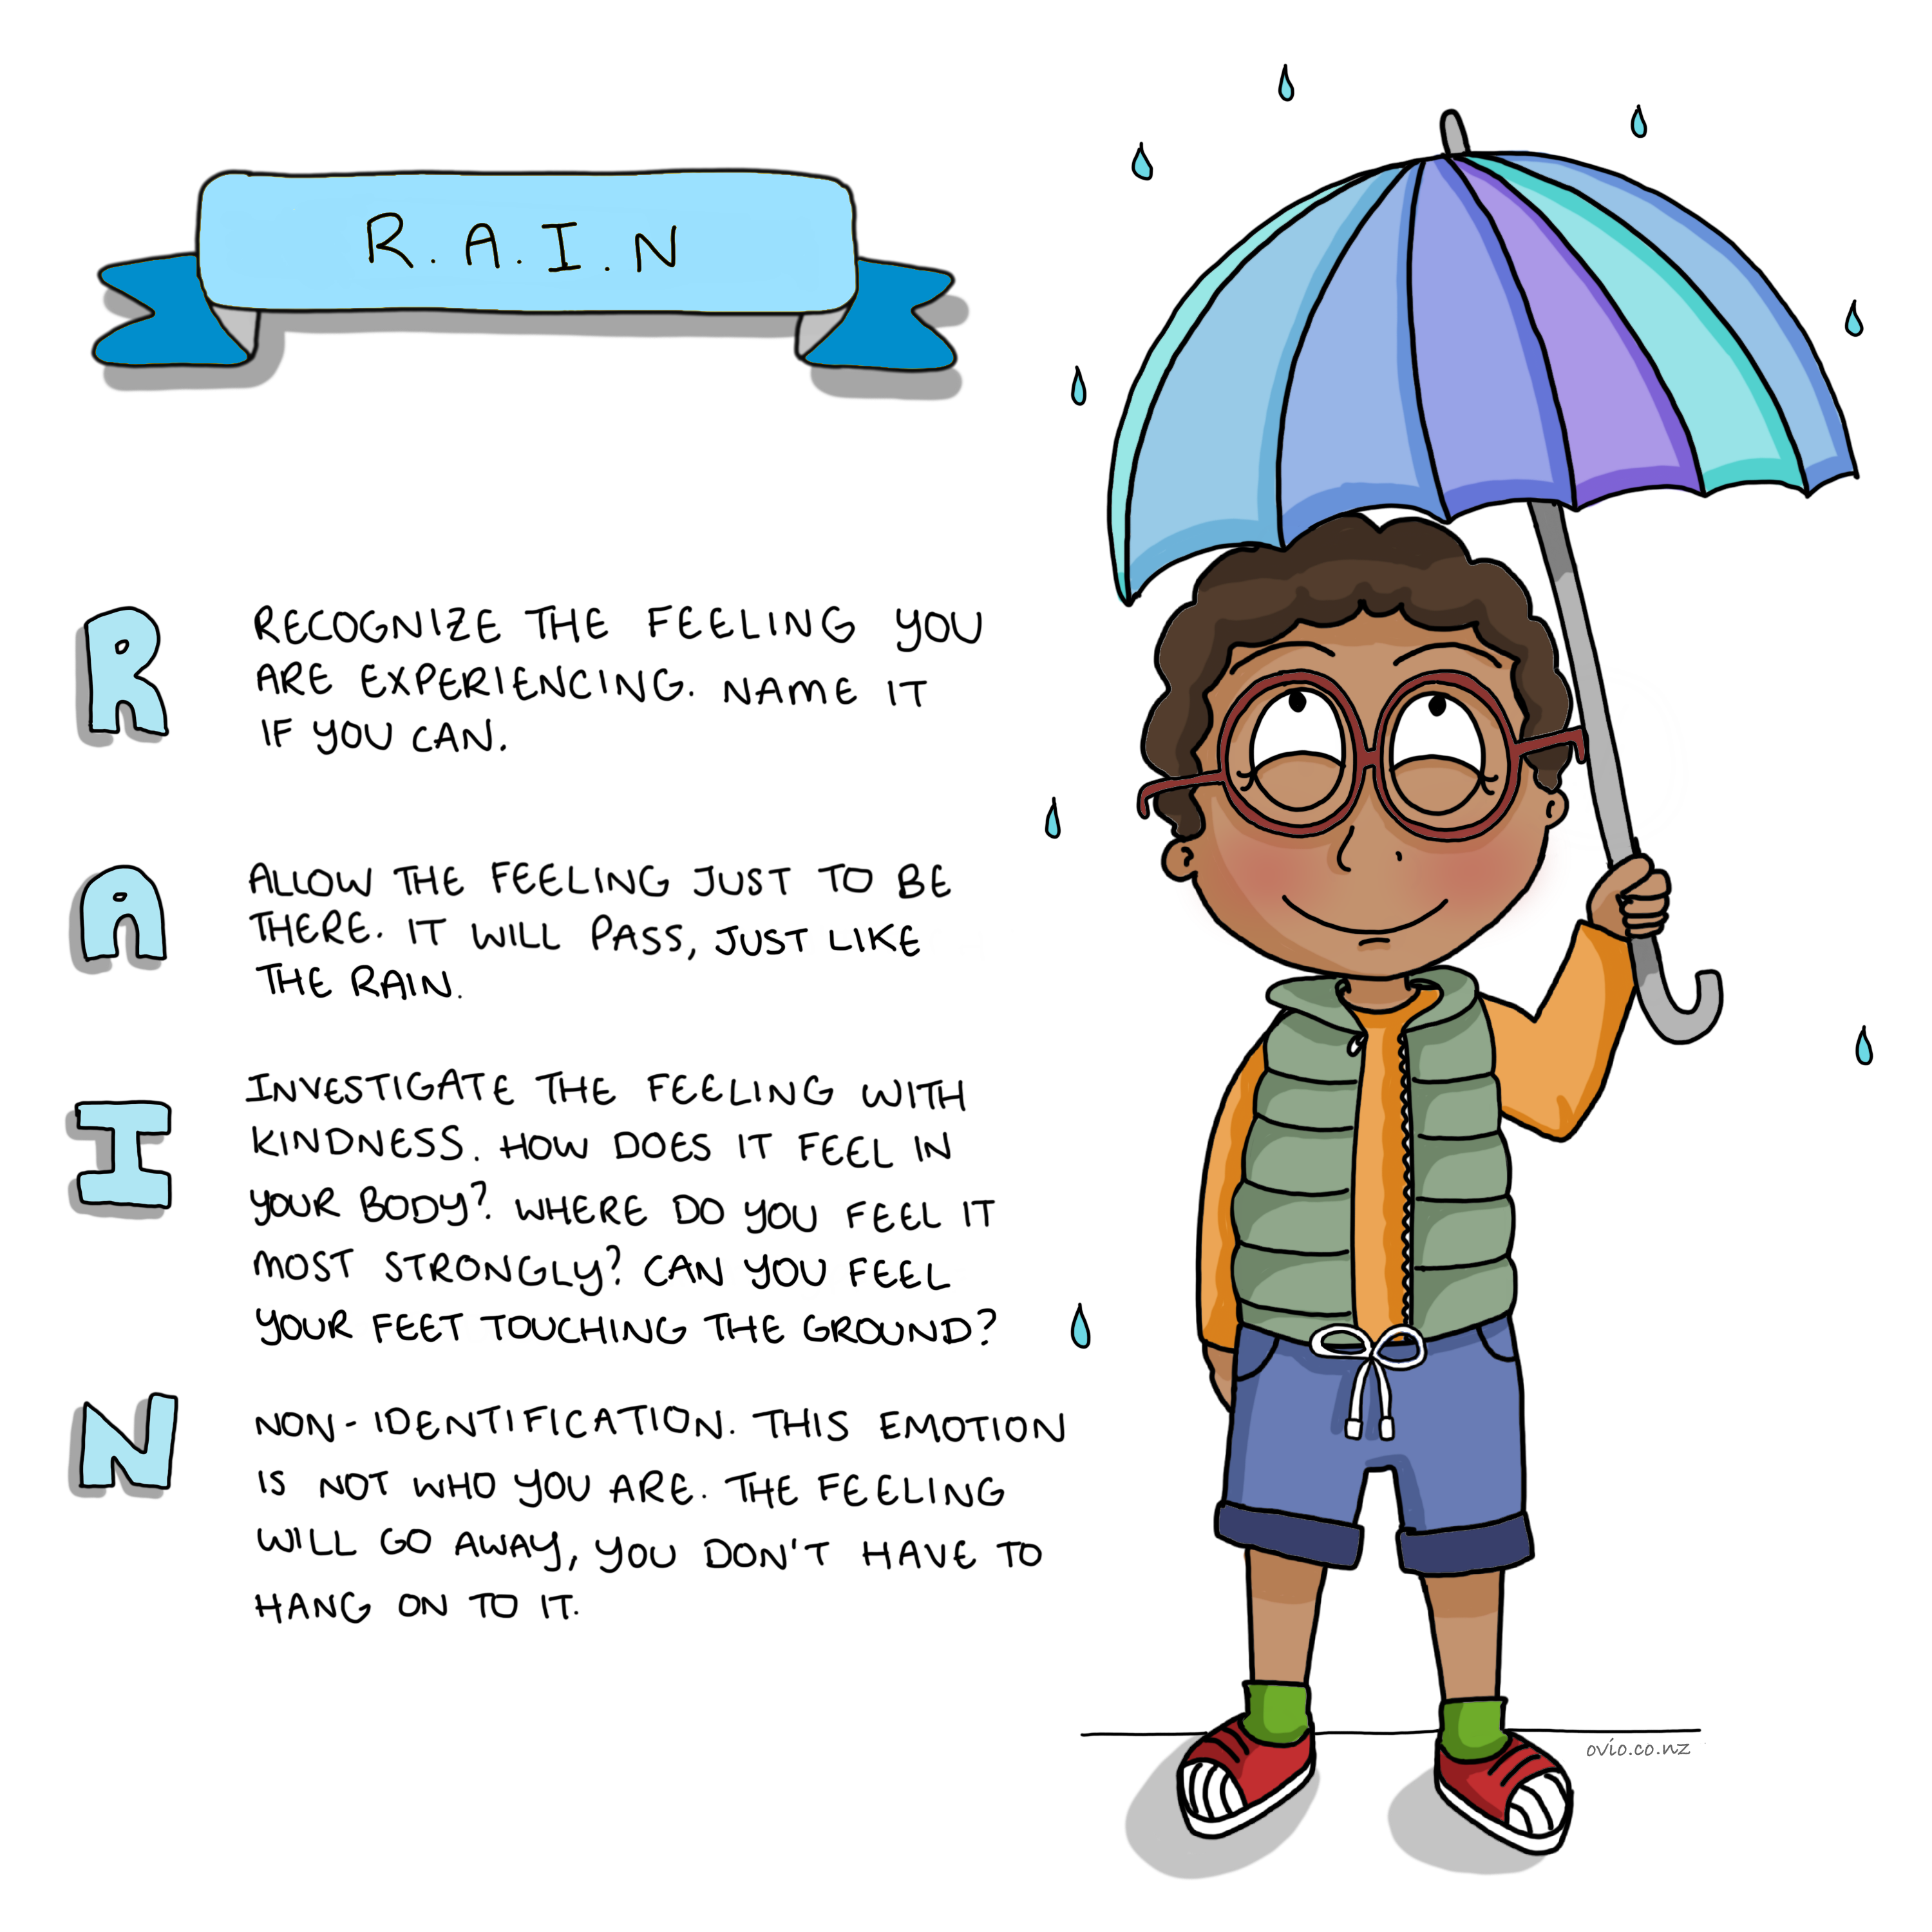
Notes:
RAIN is a 4-step mindfulness exercise that gives ‘on-the-spot’ aid for working with intense emotions.
With RAIN we learn to notice our emotions with kindness and accept them as what they are.
When we understand how emotions work, and that we are in fact experiencing emotions we can learn to calm down and reflect before we take action.
Mindfulness helps us create space between a strong emotion and our actions. We learn to deal with positive and negative experiences more calmly. When children experience difficult emotions it is useful for them to learn that they don’t have to act on the emotion by reacting.
It is important that children recognising that it is ok to have any sort of feeling, and just like the weather can be stormy, or calm, or hot or our emotions also come and go. This is ok and normal.
This is such an important skill. Life is not about just being happy.
This is crucial as children who believe they always need to be happy will struggle in life. Life is full of ups and downs and it is natural to have a diversity of emotions.
We welcome all emotions and just notice as they come and go the RAIN exercise helps us practice this.
It is when we attach thoughts that are unhelpful that we get stuck with certain difficult emotions and then the emotions can affect our behaviour.
Research shows - The average emotion would last 90 secs if we didn’t attach thoughts to it.
“Between stimulus and response, there is a space. In that space is our power to choose our response. In our response lies our growth and our freedom” – Victor Frankl
“It is our actions that define our lives not our emotions or our thoughts.” Cheryl
(I recommend children and their carers watch Inside Out, which is an animated movie that depicts the importance of a diversity of emotions in navigating life.)

Slide 22
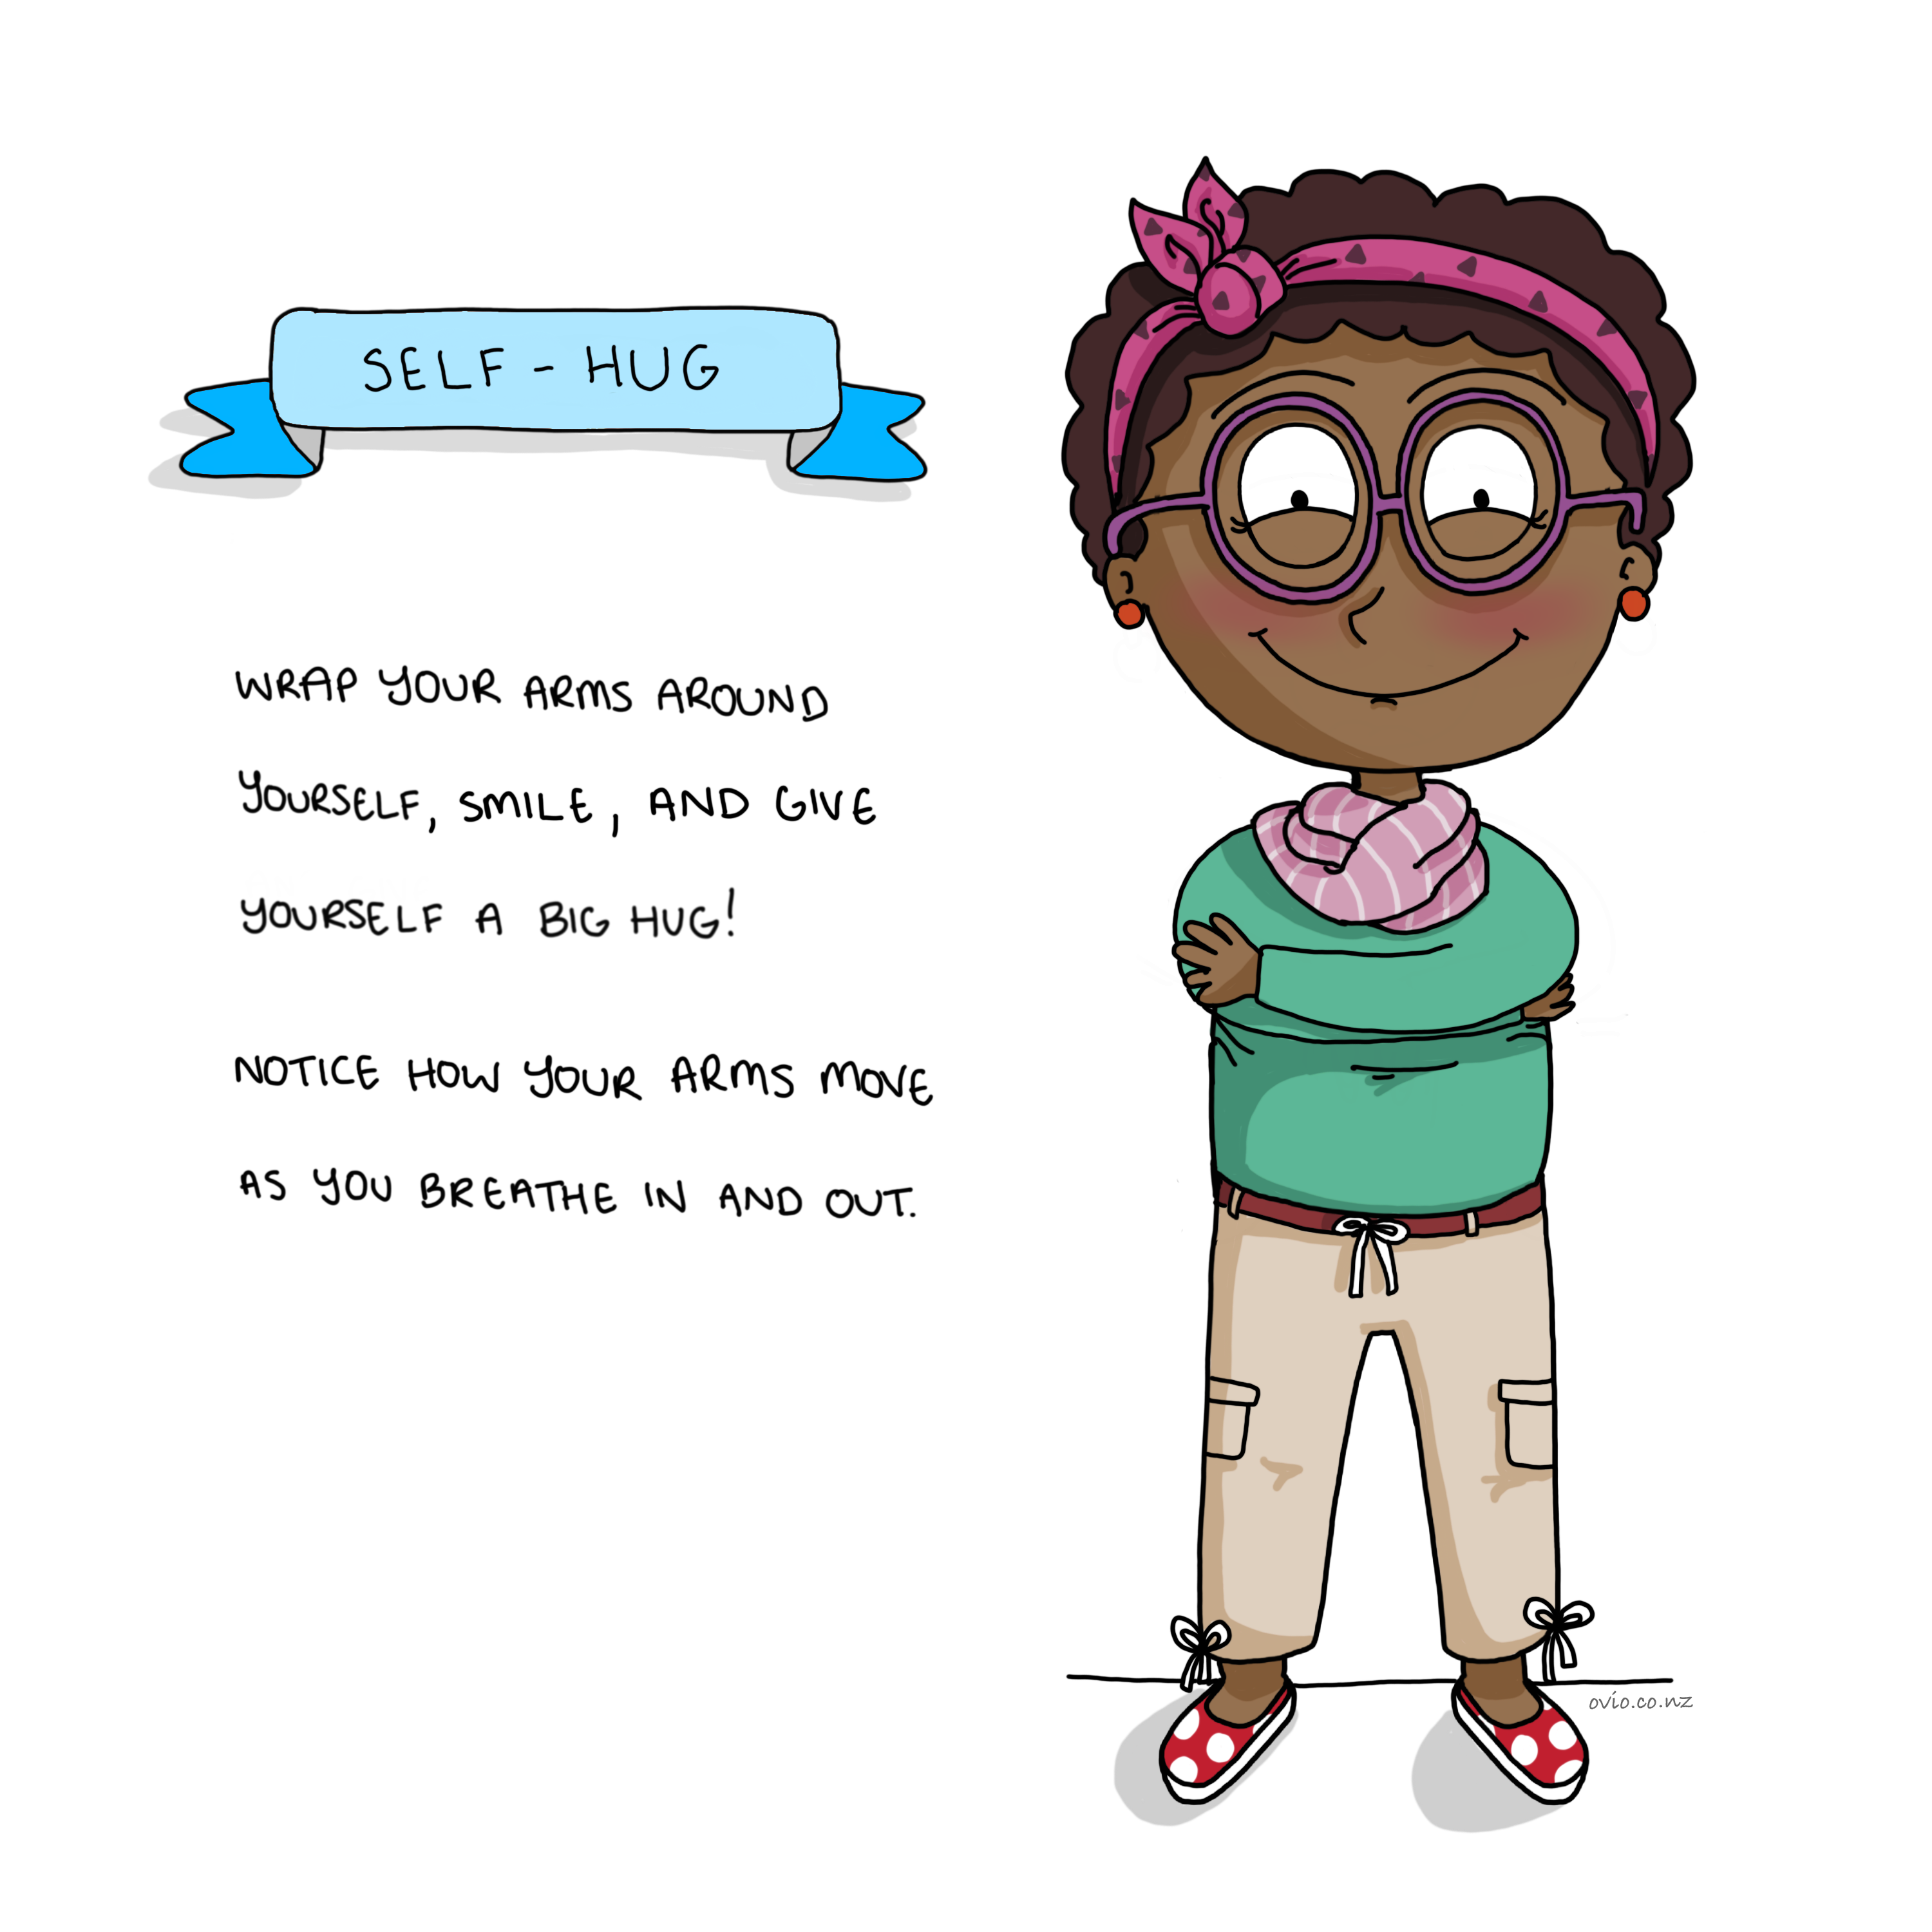
Notes:
Self Hug
Ahhh.. this feels so good!
A great way to help kids cope with stress anxiety or upset, independently.
This works well for children who find separation from their loved ones difficult.

Slide 23
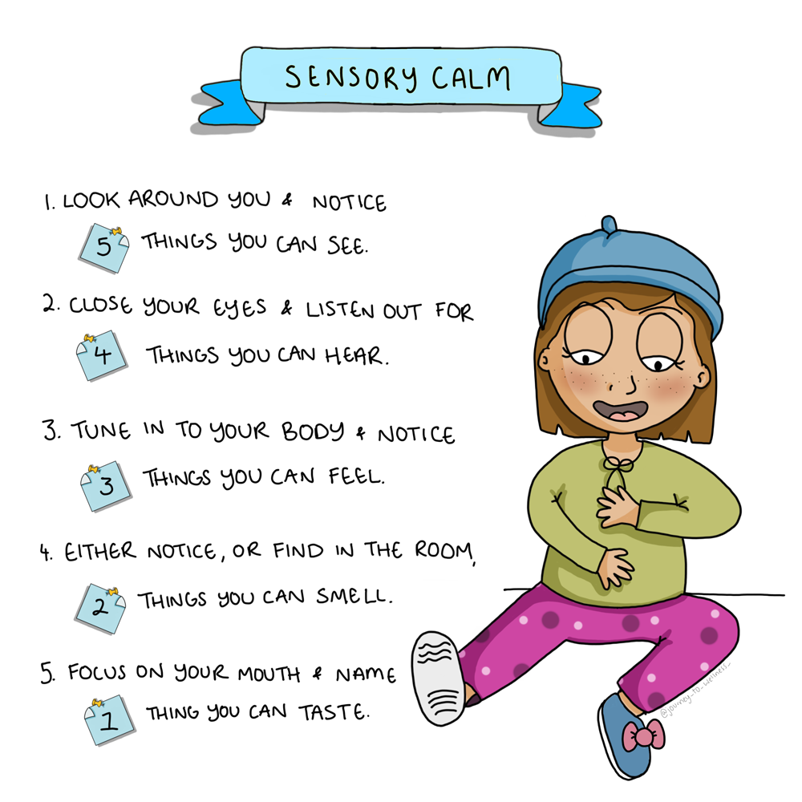
Notes:
Sensory Calm
A very popular calming and grounding exercise that can be employed when a child is experiencing difficult emotions and needs to find balance.
By “Coming to your senses” (An expression used when someone is acting irrationally “they need to come to their senses”
Makes a lot of sense as engaging senses brings us into the present moment and can give relief from past or future based thinking.

Slide 24
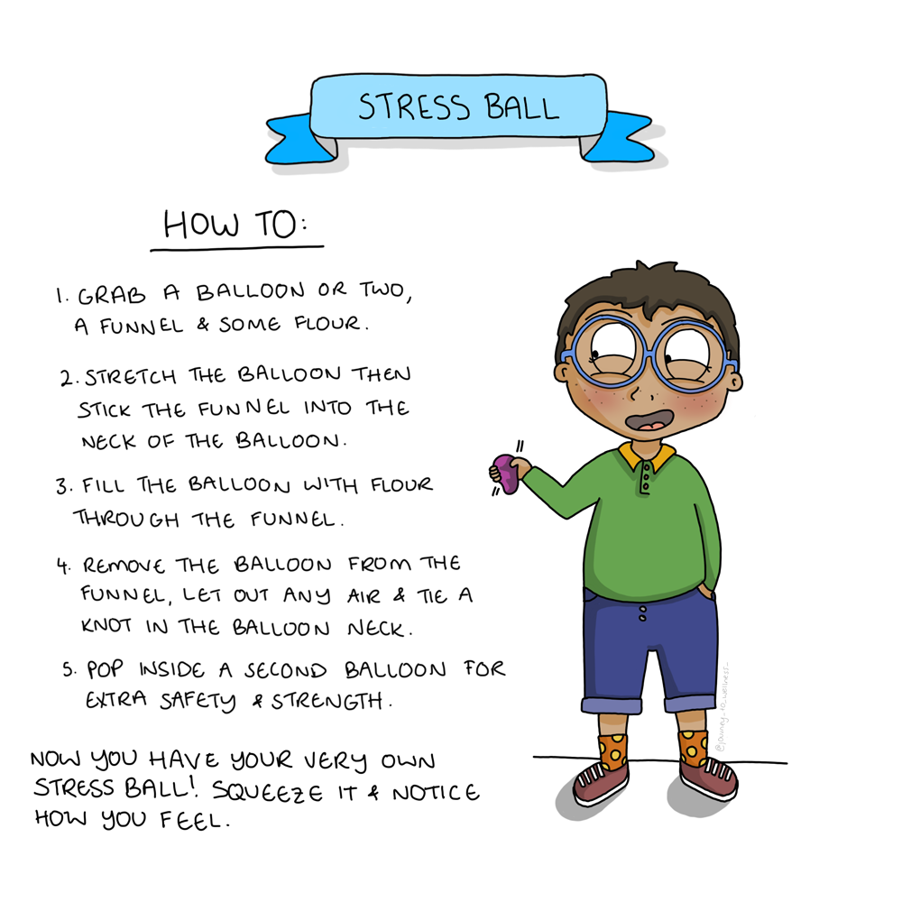
Notes:
Stress Ball
This is a fun exercise and it is useful to teach that touch can be an important tool or emotional regulation. The sense of appropriate touch can be grounding and calming.
You can make your own stress ball (lots of fun) or buy one, or use any other object that feels right for the child.

Slide 25
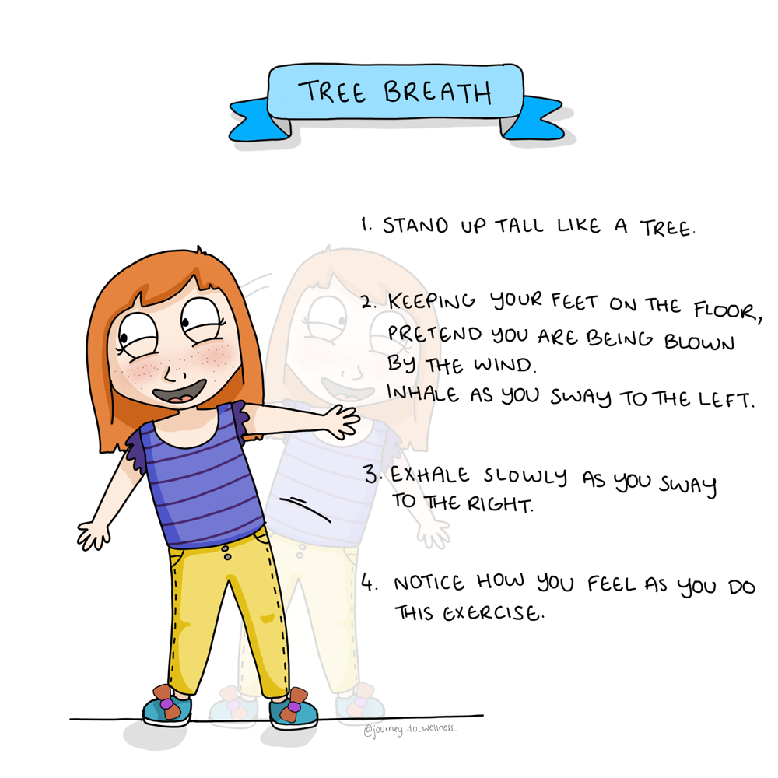
Notes:
Tree Breath
In this exercise breathing combined with the rhythmic sideways movement feels great and is very calming.
A good choice for children who find sitting still a challenge.
The sideways rocking causes the brain to release endorphins, the feel-good chemical. This helps the brain manage pain and stress. (Even animals such as elephants move their bodies side to side to reduce pain or distress).

Slide 26

Notes:
Connection
Connection and prosocial skills are crucial to learn in order to live a rich and fulfilling life. (Unfortunately research shows these skills are being eroded with the use of technology. https://www.pewresearch.org/internet/2018/04/17/concerns-about-the-future-of-peoples-well-being/)
Social connection is vital to mental wellbeing. It decreases depression and anxiety, increases our chances of longevity and strengthens the immune system. See the link to some of the research in the following blog. (click link) https://www.psychologytoday.com/us/blog/feeling-it/201208/connect-thrive
Children practicing these exercises develop an understanding that what they do and say affects others, and what others do and say affects them as well as their communities, and the world around them. They begin to understand that we are all interconnected. This helps them to form good healthy friendships & prosocial skills.
These exercises help foster:
Empathy- children are able to view a situation from another's perspective and imagine how they feel.
Compassion is responding to others with kindness and is brought about by empathy.

Slide 27
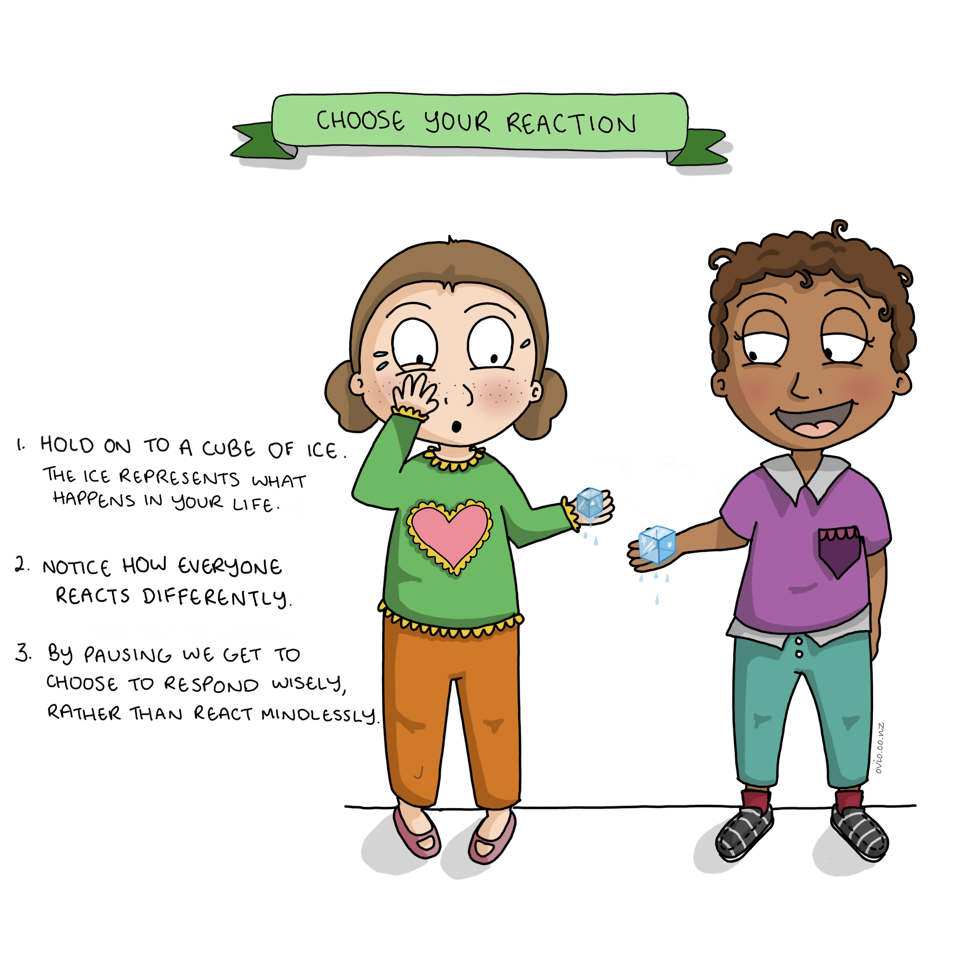
Notes:
Choose Your Reaction
This is a wonderful exercise to demonstrate the power of choice as well as understanding that there are many different ways to react to the same situation. This helps promote cognitive and emotional flexibility.
By observing others experiencing the same external condition as us, but reacting in a different way, is a valuable teaching.
We can point out the difference between what happens to us in life vs how we respond. This helps to foster an understanding that we have control over our responses but not about what happens to us.
It is important to avoid judgement here, to allow everyone to notice the different responses.
You can try the exercise once without pre-empting, so the children can see the different reactions.
Then do the exercise a second time asking children to focus on the experience so they can describe what it feels like to have the ice in their hand (focusing on senses) rather than reacting impulsively.
E.g. instead of screaming yuck it so cold and throwing it away they sit with the ice cube and notice as the sensation changes and the ice melts.
Noticing allows a pause between stimulus and response allowing the child to respond vs. react.

Slide 28
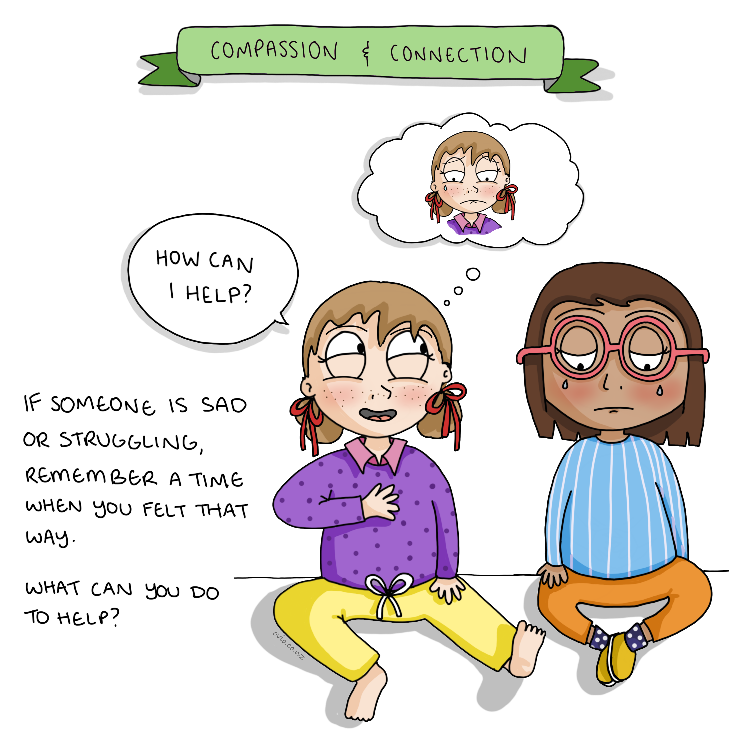
Notes:
Compassion and Connection
Empathy is when children are able to view a situation from another's perspective and imagine how they feel. (notice the other child then imagine a time you felt that way)
Compassion is responding to others with kindness and is brought about by empathy.
To keep compassion simple, we use the question “How can I help?”

Slide 29
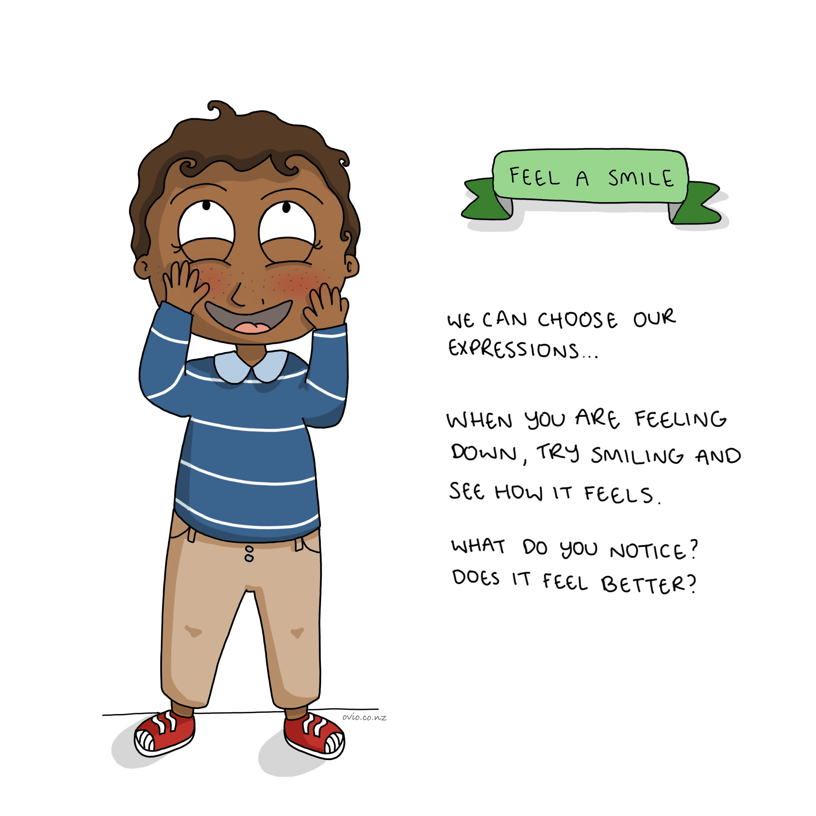
Notes:
Feel (Experience) a smile
This is a chance for children to smile and notice if the act of smiling can affect how they physically feel. Smiling releases endorphins (the body’s natural painkiller) it makes us feel good.
Children learn that they can have control over how they feel and when appropriate, they can smile to make themselves feel better. This is a great example of the feedback loop by changing our body we can affect our mood. (also see slide 20)
Movement and body posture has a profound effect on emotions and thinking. Watch this powerful TED talk on the topic.
Fake it until you become it! https://www.ted.com/talks/amy_cuddy_your_body_language_shapes_who_you_are

Slide 30
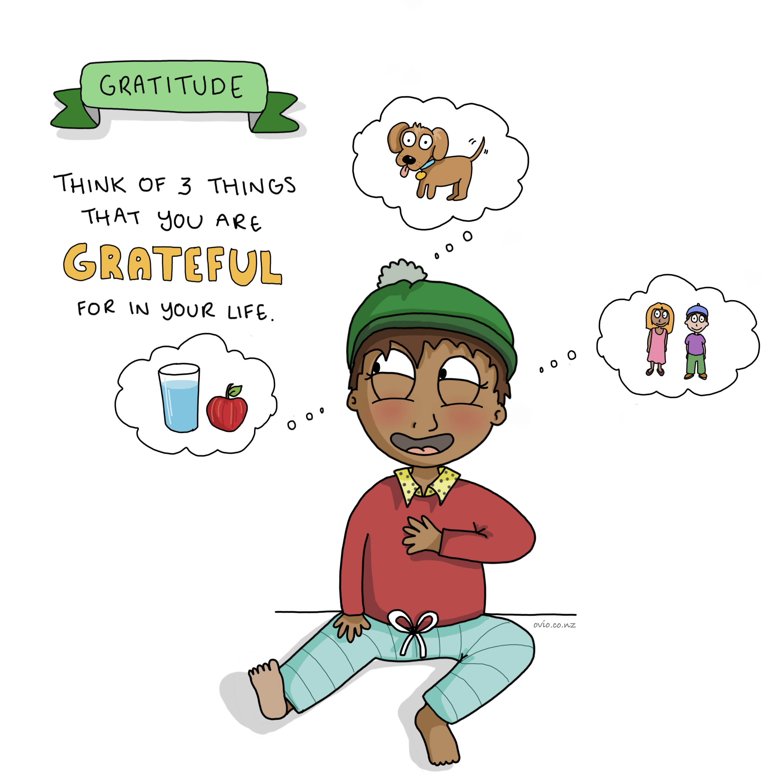
Notes:
Gratitude
Research confirms the many benefits of gratitude. Our ability to be grateful correlates well to optimism, prosocial behaviour and life satisfaction. https://www.ncbi.nlm.nih.gov/pmc/articles/PMC3010965/
By practicing gratitude, we can alter the negativity bias (our thought usually show a 3 to 1 bias towards predicting negative outcomes vs positive ones.) of the survival mind (in prehistoric times it was safer to assume the worse of a situation in order to escape danger) now we can hack our mind with gratitude so that we assume the best outcomes in our lives and situations. Leading to improved wellness outcomes.

Slide 31
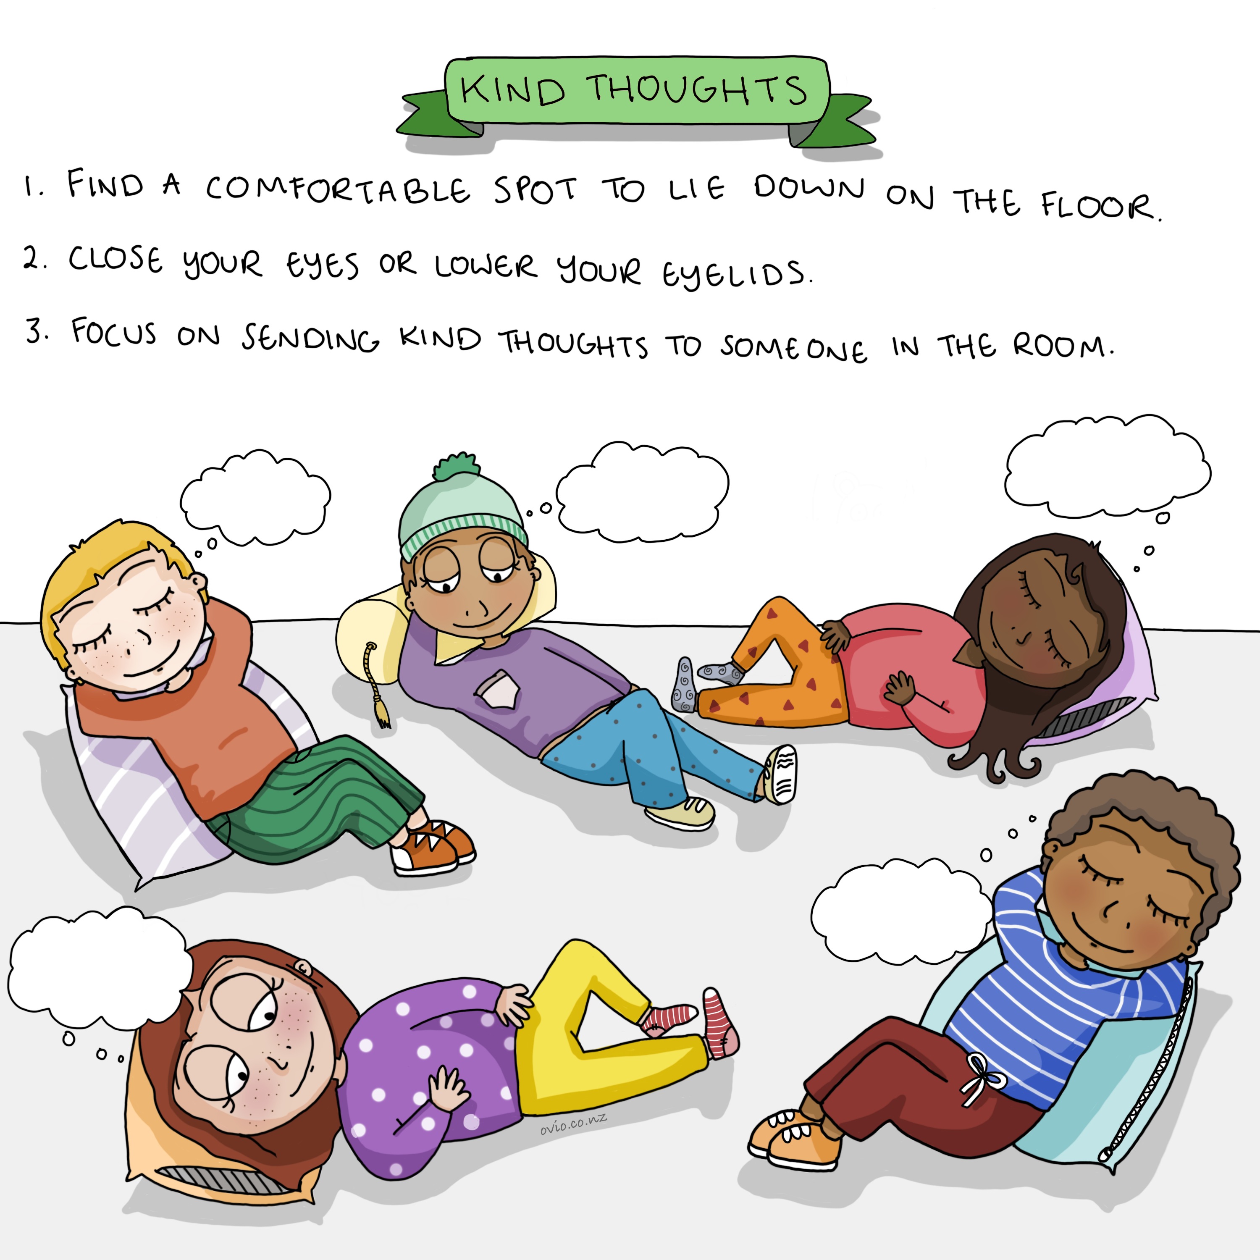
Notes:
Kind Thoughts
This is a great connection exercise. It is great both for those sending and those receiving kind thoughts. It feels wonderful to be part of a kind thought circle.
This exercise encourages children to be grateful and to take the time to care for each other and themselves.
Explain to the children that doing this will make them feel good as well as the others around them.
Research shows doing things for others makes us feel good.
Some interesting reading and science here
https://www.goodnet.org/articles/7-scientific-facts-about-benefit-doing-good

Slide 32
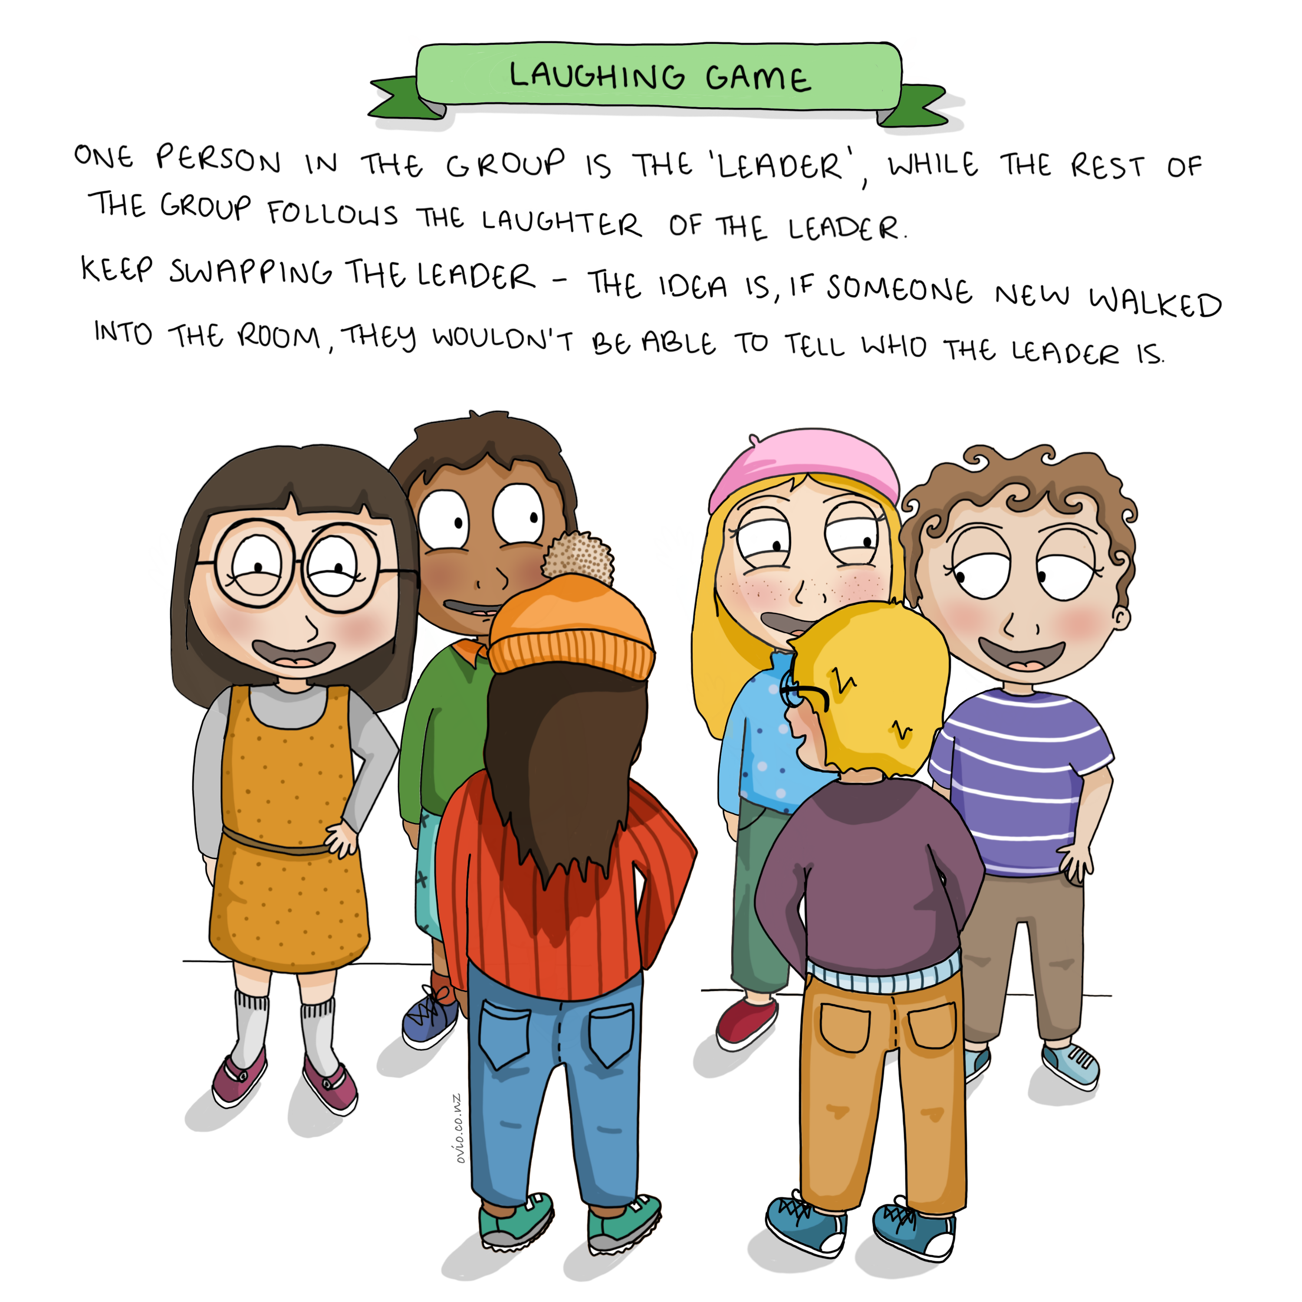
Notes:
Laughing Game
This fun exercise demonstrates the effect of our emotions on others.
In this exercise we see how laughter is contagious, children get to feel good as a result of laughing and smiling. (laughter is great for wellbeing as it releases endorphins which make us feel better)
https://www.psychologytoday.com/us/articles/200504/laughter-the-best-medicine
It is worthwhile to discuss with older children that other emotional states can affect others around them, not just laughter. i.e anger, frustration.
It is important that children begin to learn how their emotional state can impact others.
Being responsible for how we show up in the world and managing our emotions (see RAIN card for further explanation) is an important concept to learn.

Slide 33
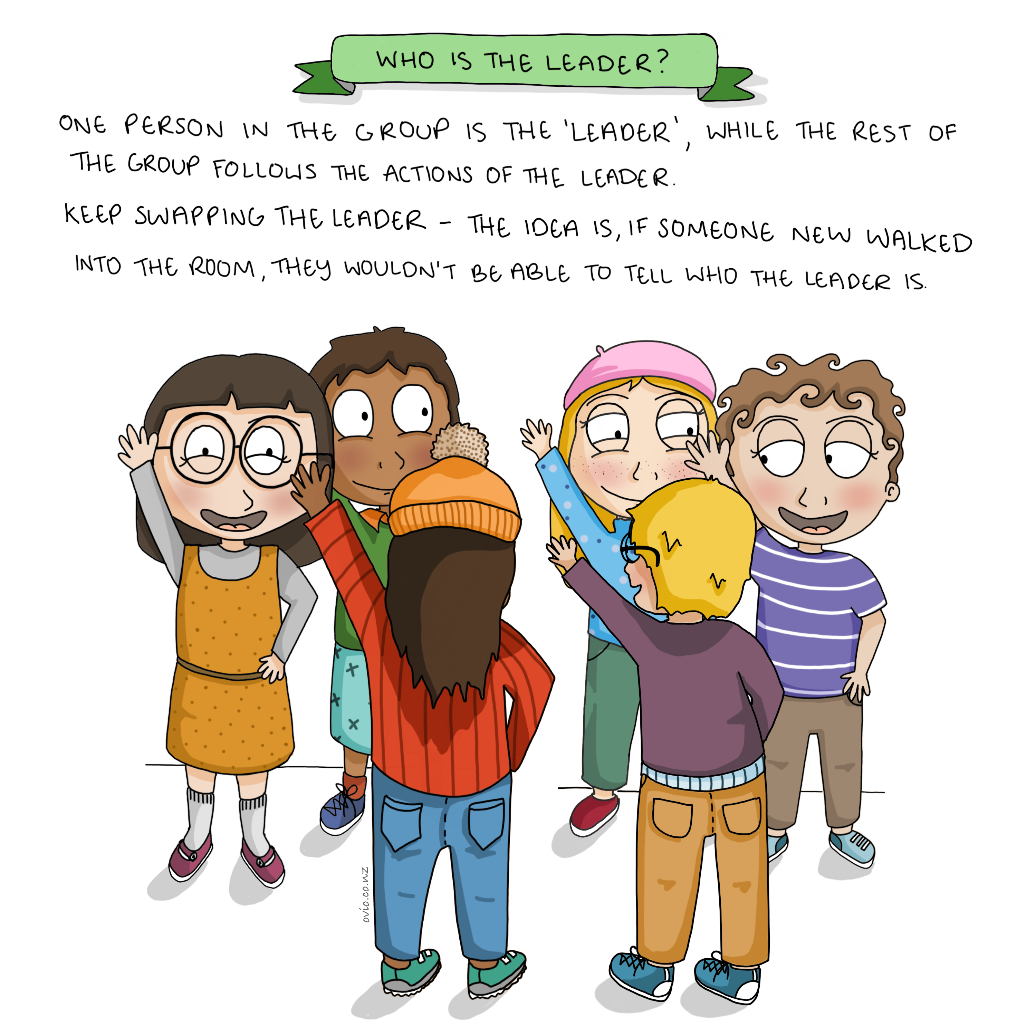
Notes:
Who is the Leader?
This exercise is great for practising open awareness as well as allowing children to experience being connected to a group.
Allow the children to take turns leading the exercise as It is empowering having the opportunity to lead and it helps foster an understanding of connection between themselves and others.

Slide 34
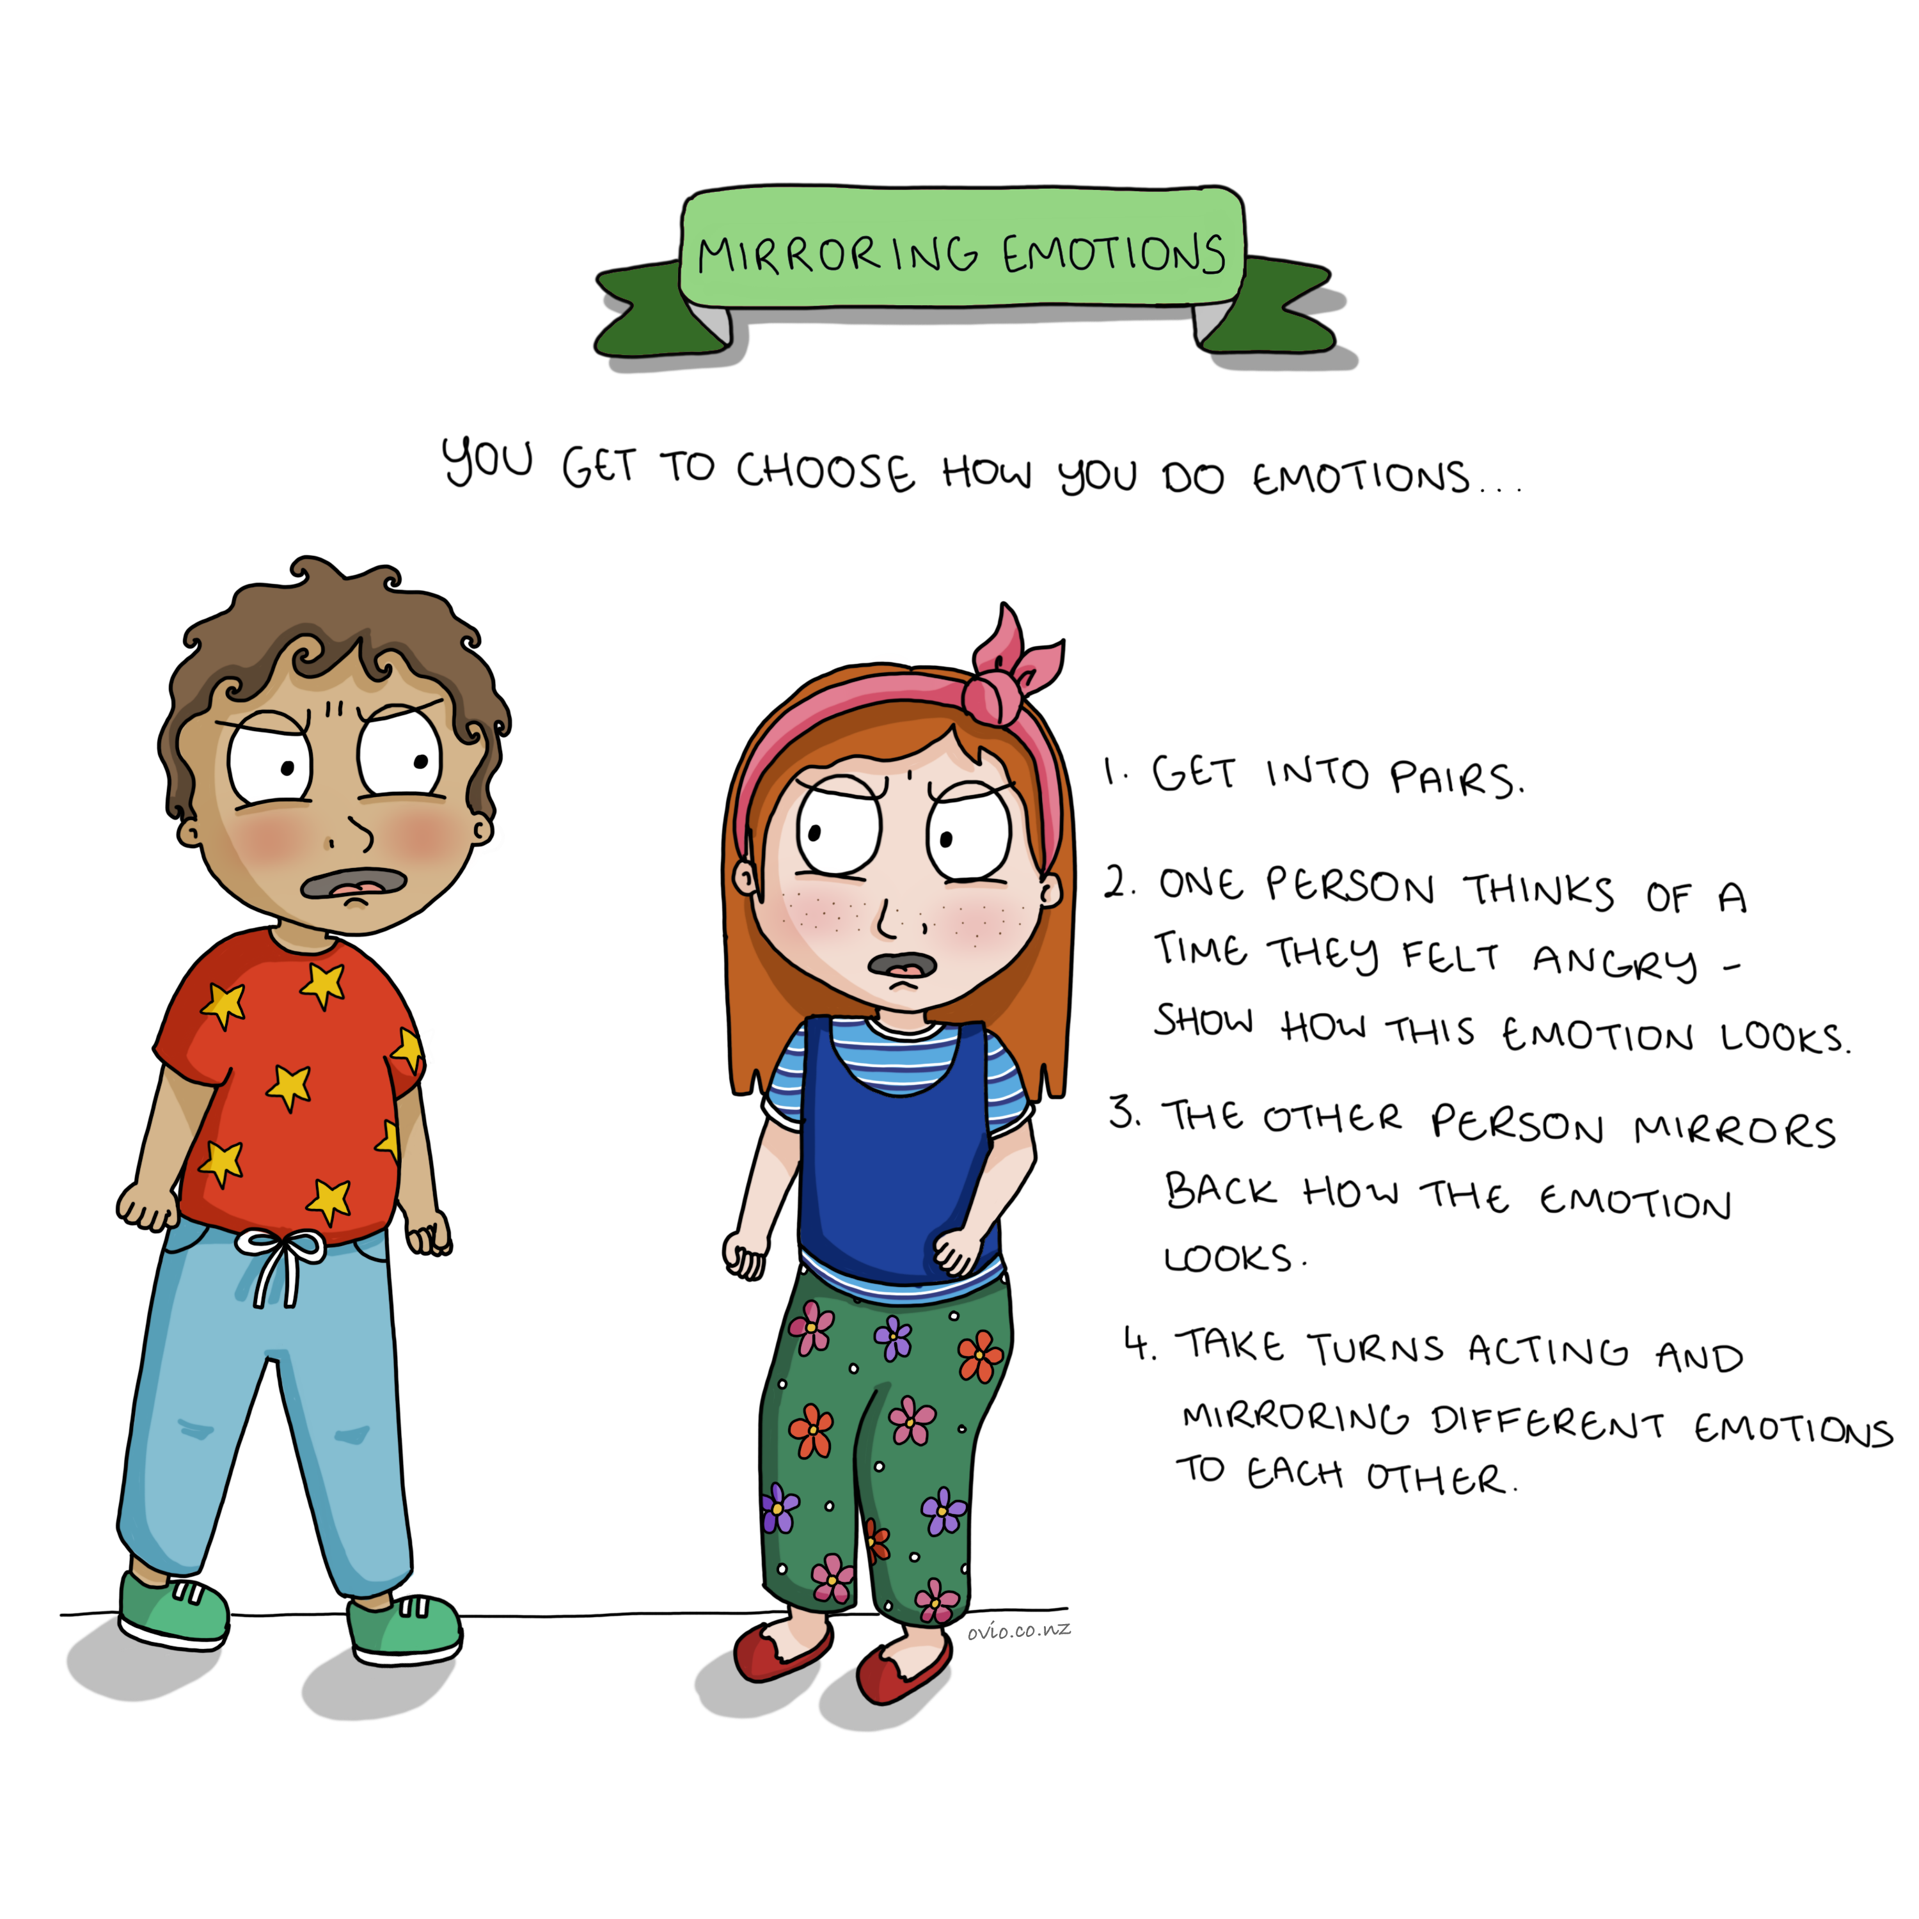
Notes:
Mirroring Emotions
This is a great exercise in self-awareness as well as empathy.
When children are asked to act out an emotion, they have to reflect on how they “do” the emotion which enhances their level of self-awareness.
By observing how other children act out an emotion it helps children foster empathy.
By helping children become aware of how they do emotions and then extend the learning (through discussion) children can understand how to undo the emotions e.g. by changing posture, facial expressions, thoughts and focus.
When children start to recognise that they have control over their actions and emotions they can make better choices over how they act.
This exercise works well when done in silence. (actions not voices)

Slide 35
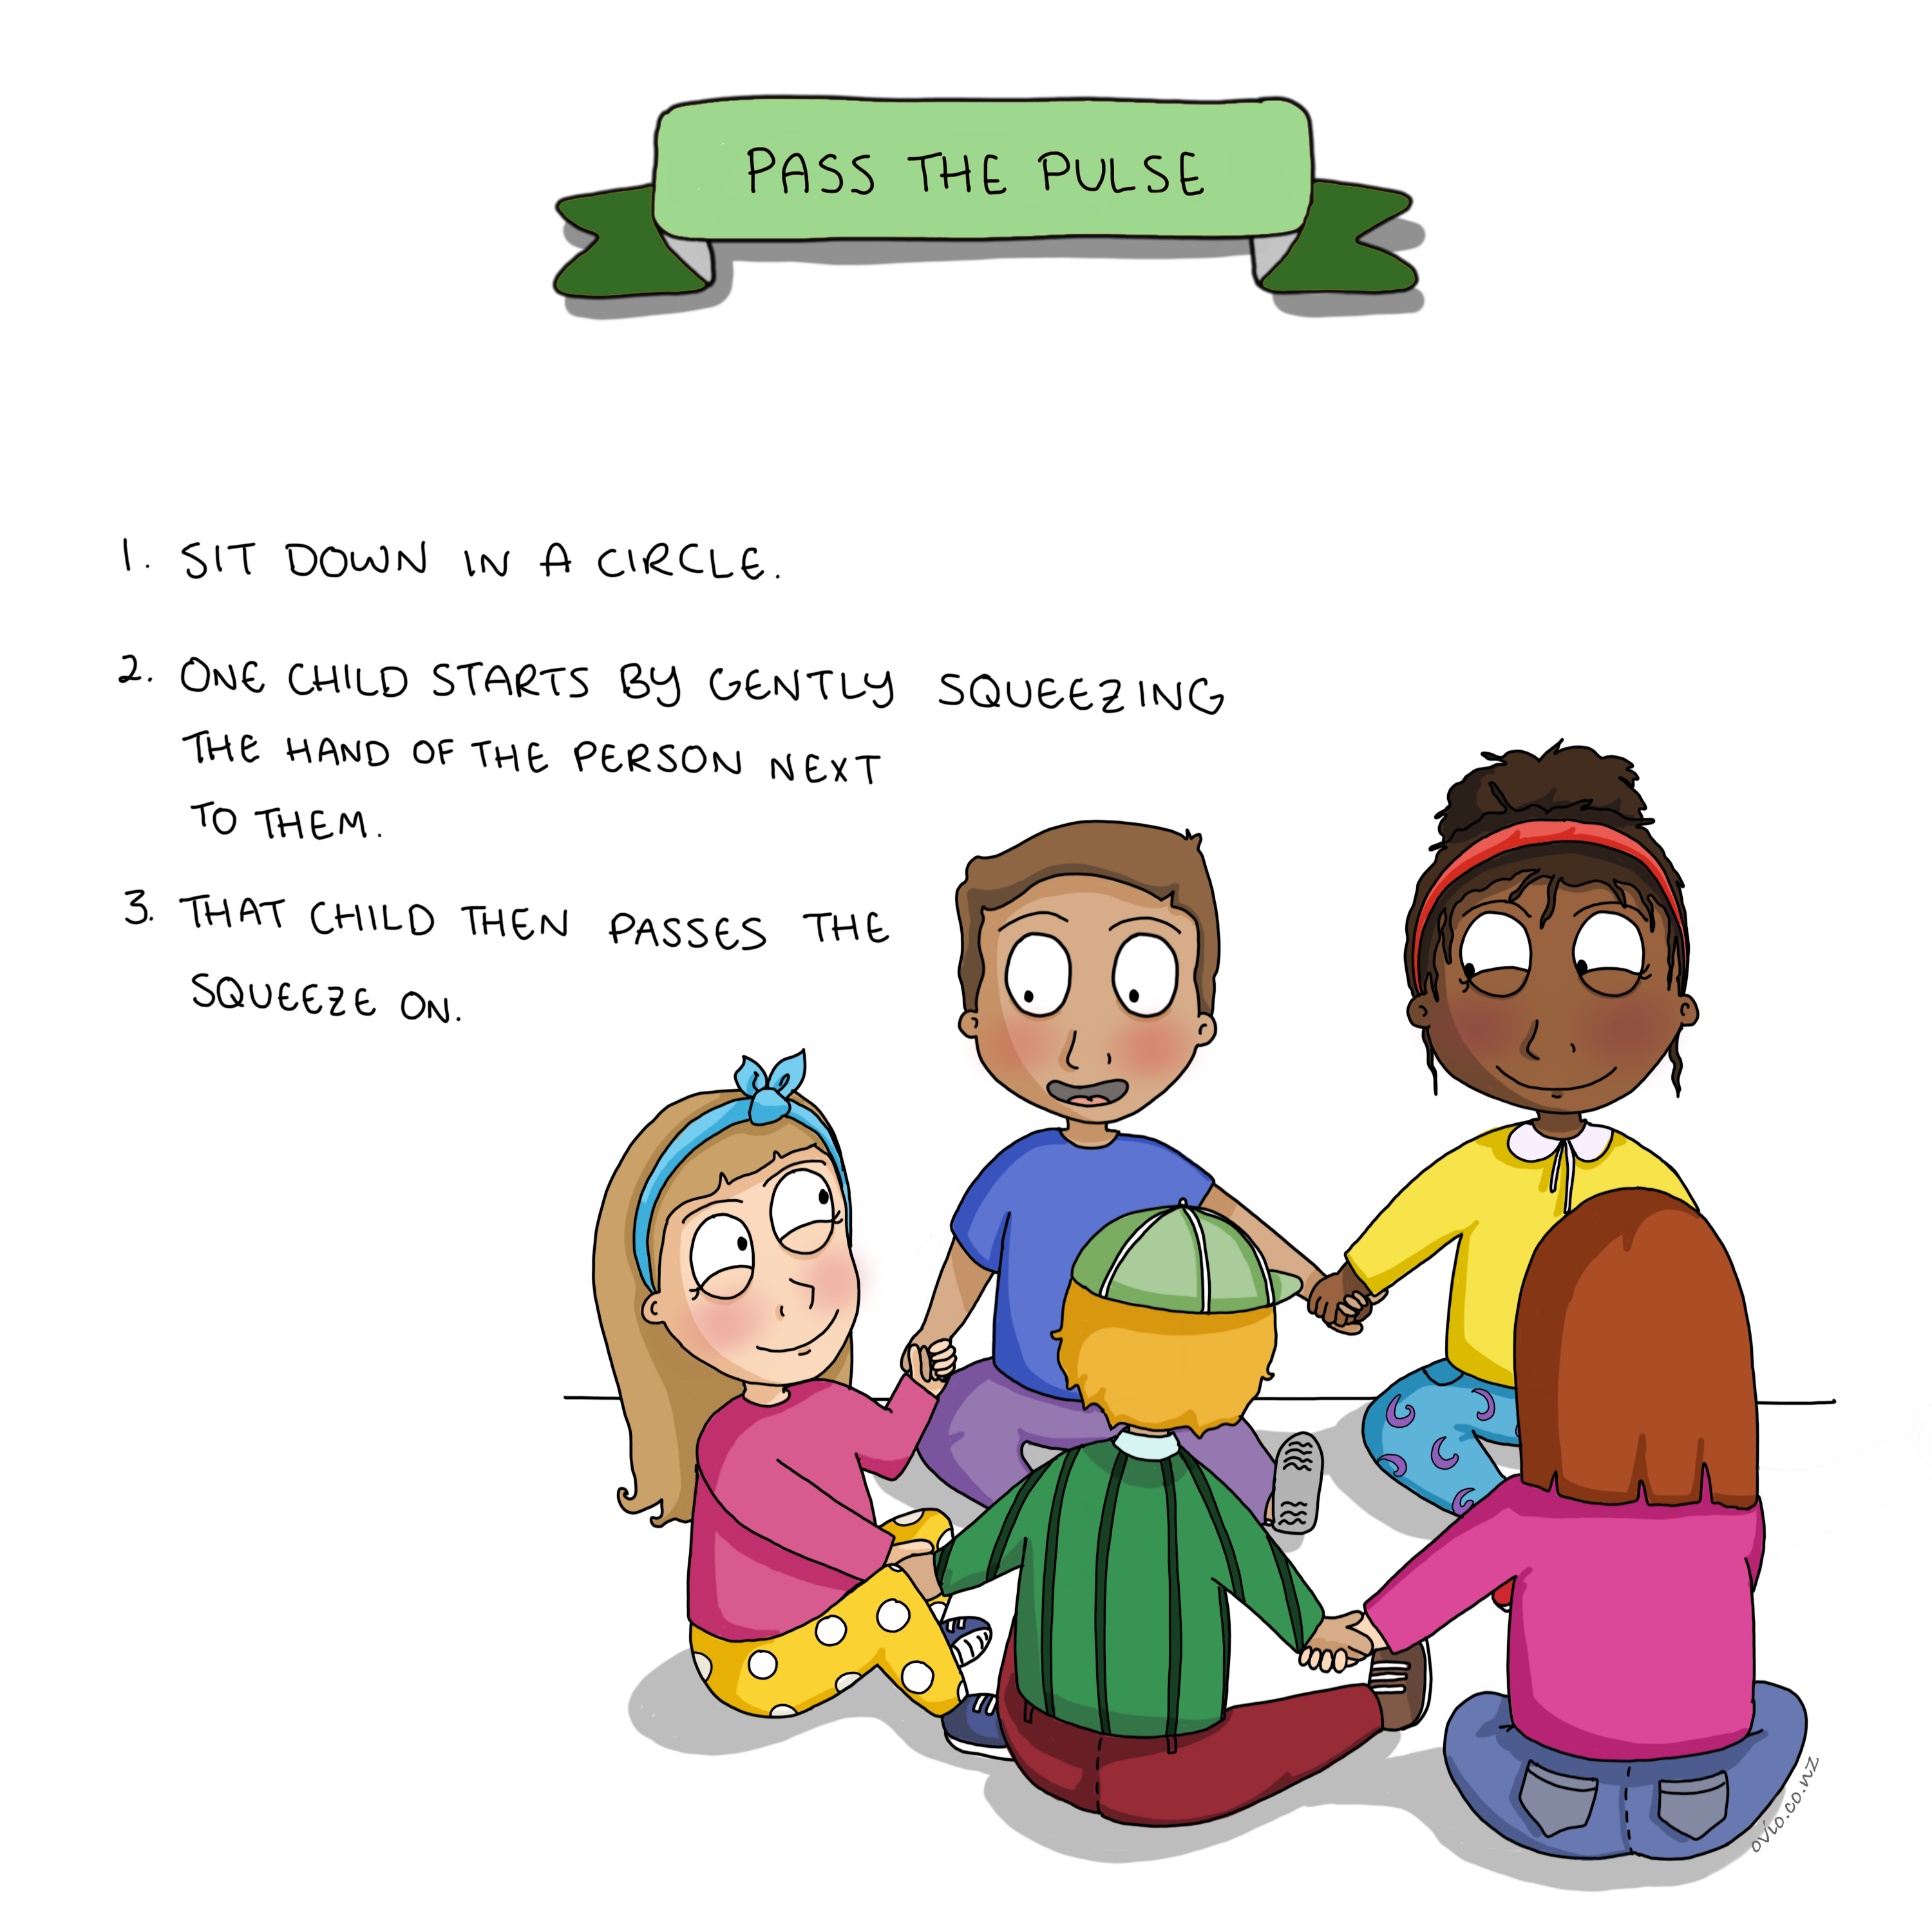
Notes:
Pass the Pulse
This wonderful exercise teaches interconnection and behavioural regulation. Children learn to work within the accepted boundaries of the group.
i.e. if you squeeze a person's hand too hard they may squeeze your hand too hard. Children need to keep focused and attentive if they forget to pass the pulse or miss it because they are distracted, they let the group down.
The teachers can choose a person to start the pulse and you can vary the exercise by adding another pulse or by choosing 2 children to pass the pulse at the same time.

Slide 36
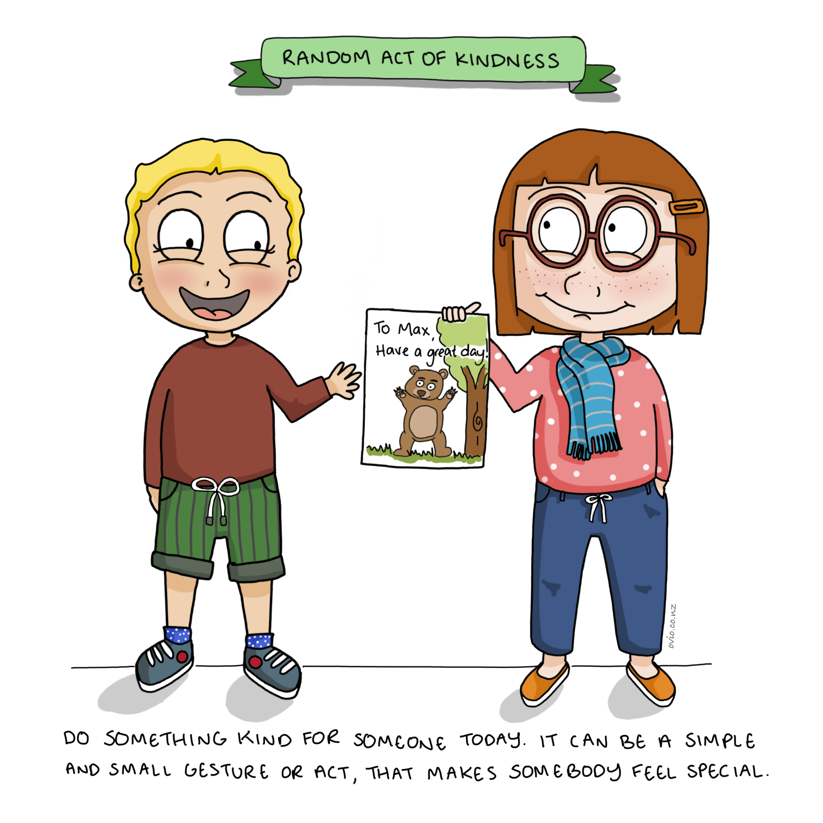
Notes:
Random act of kindness
This is a great ‘feel good’ exercise in connection and prosocial skills.
This exercise also encourages children to be grateful and to show compassion for each other.
There is a domino effect with kindness. When we experience kindness we are more likely to offer it to others and interestingly when we see others doing kind things we are more likely to do kind things ourselves.
A nice way to summarize this is in the statement “Compassion is contagious.”
Explain to the children that RAK’s will make them feel good as well as making others feel good.
Research shows doing things for others makes us feel good.
https://www.goodnet.org/articles/7-scientific-facts-about-benefit-doing-good

Slide 37
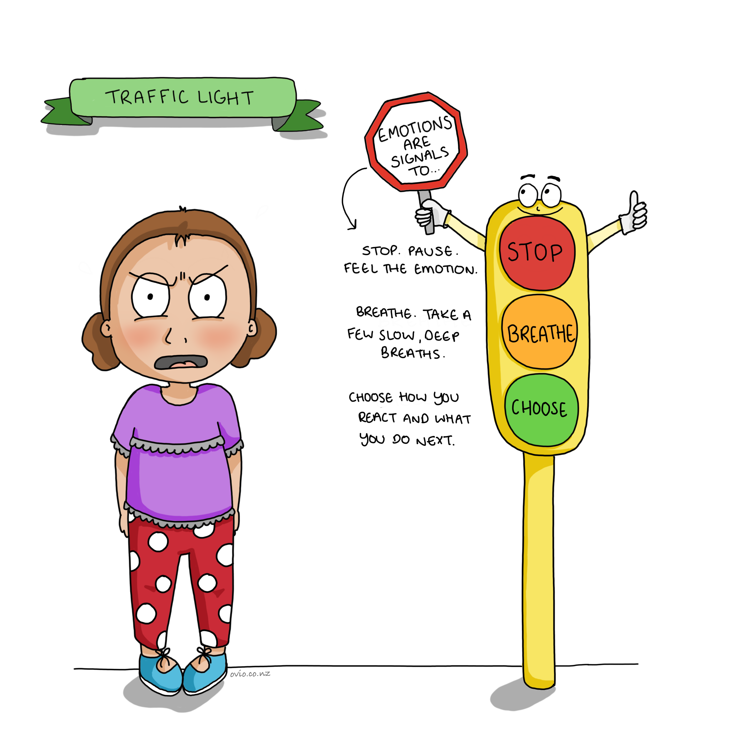
Notes:
Traffic Light
This exercise and teaching card helps children understand and practise the importance of regulating emotion prior to choosing a behaviour so they can act wisely.
Exercise instructions:
You will need 3 separate circles of coloured paper red/yellow/green.
Child walks up to Red circle
Child - Stops
Then you swap to Yellow circle - child chooses an exercise to balance their emotions (see balance section)
Then you swap to
Green circle - child chooses an action to take (discuss choices prior e.g. go left go right or sit down) the action is arbitrary the practice of Stopping/Regulating/Choosing is what is important)
It is crucial that children learn that they have a choice over how they behave and that when difficult or strong emotions arise they may need to breath and balance themselves before making a choice.
With these teachings we are encouraging a longer pause (stop) between stimulus and response (behaviour) in order to encourage wise decision making.

Slide 38
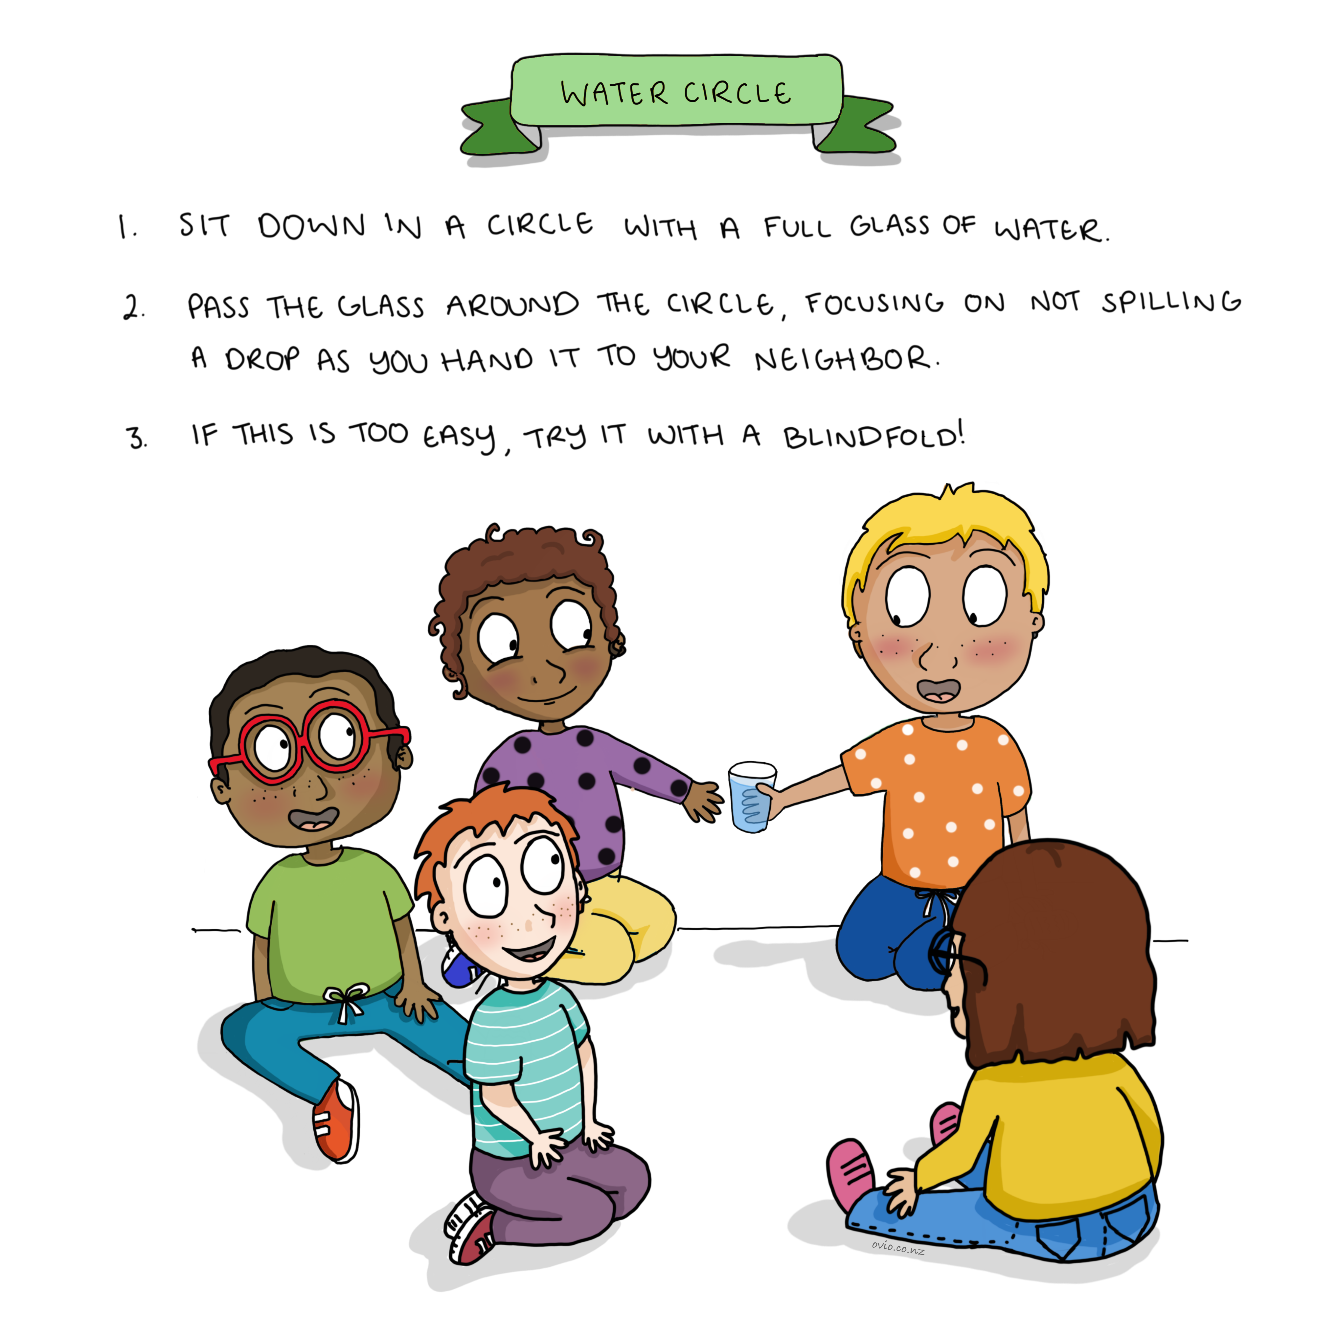
Notes:
Water Circle
Another opportunity to recognise the interconnection between us, others, and the environment around us.
The children have to sustain open awareness, then focused awareness during their turn.
It involves children recognising movement and speed in themselves (proprioception) and others and working within the boundaries set by the group.
Children increase focus and prosocial skills.

Slide 39

Notes:
The Children and The Elephant Story
Stories are a wonderful way to teach mindfulness concepts covertly. This card focuses on non-judgement, curiosity and open mindedness.
By listening to this story, children will begin to understand (or with our encouragement) that there are many different perspectives on the same thing and no that perspective is necessarily right or wrong.
We encourage children not to jump to conclusions or close their minds to different perspectives. When we are open to all perspectives we can gain a better understanding of the truth or the big picture.
Depending on the age of the child or children there are many different discussions that you can initiate with this story. This story and the understanding that can arise can enhance a child’s ability to see the world with a broader perspective.
When disagreements occur, shouting and screaming usually lead to nothing but additional problems. It is critical for children to recognise the importance of being open-minded, objective, and willing to consider other points of view
Understanding others' point of view fuels connection and compassion in the world.
Read this blog for some background information.
https://www.newyorkfamily.com/elephants-blind-men-and-lessons-in-perception/

Slide 40
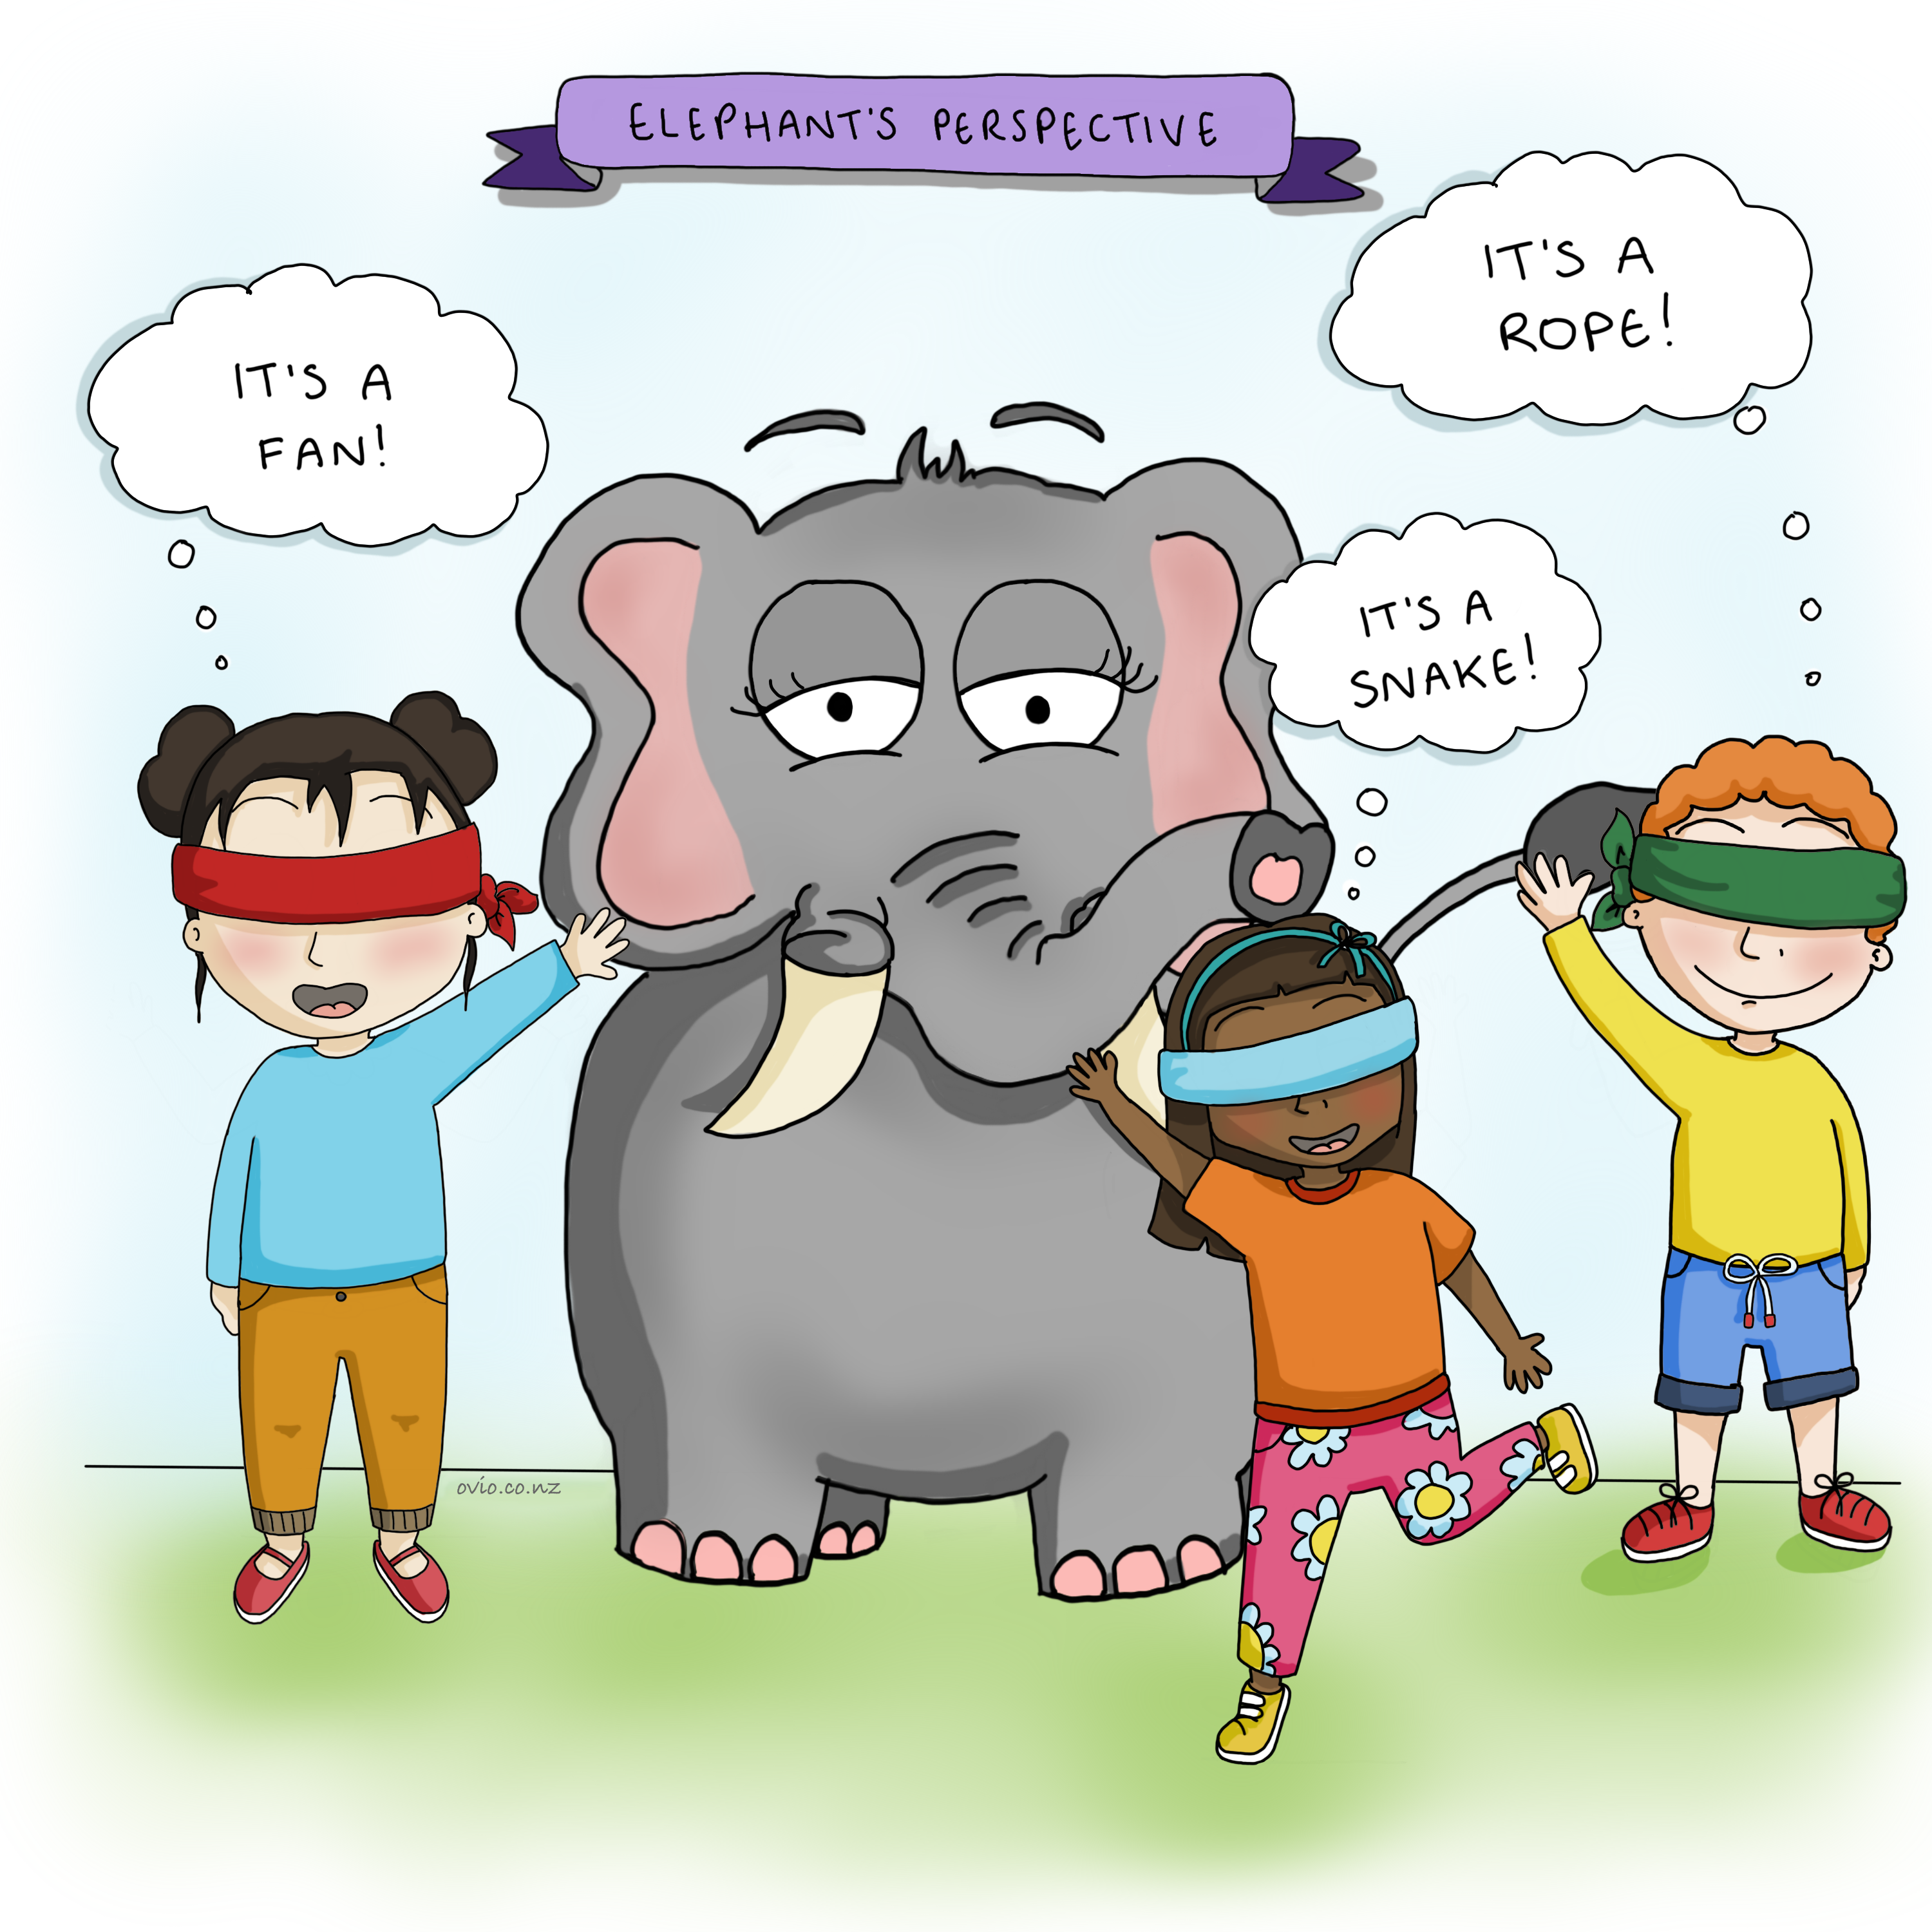

Slide 42
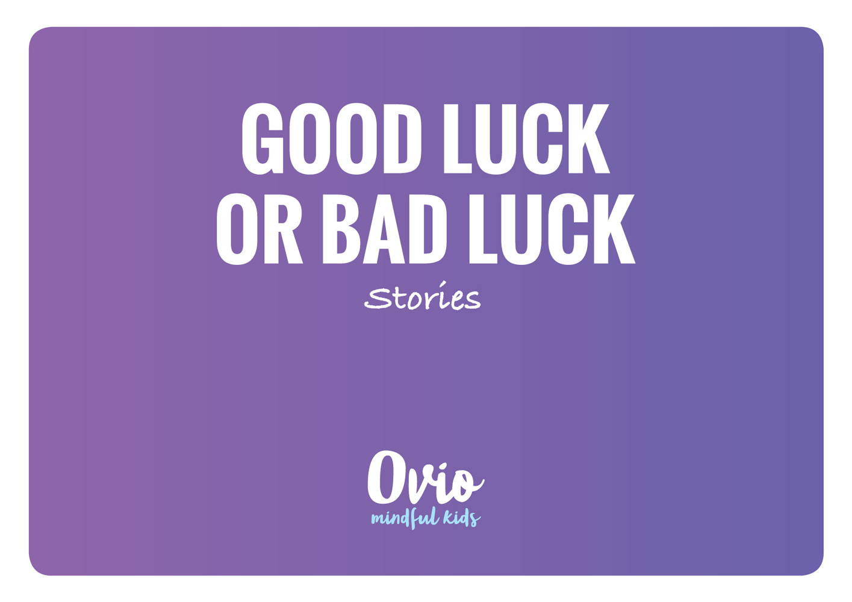
Notes:
Good Luck or Bad Luck Story
This story encourages children to avoid judging situations as either good or bad but to be curious as to what will happen next this helps children move forward in life and not get stuck in a certain emotional state because they feel helpless or that they have failed when things go wrong as well as not getting complacent when things go well.
This perspective helps children become resilient. When hardship prevails they are able to look ahead with curiosity. Curiosity fosters engagement in life leading to more positive outcomes and prevents children getting stuck in unhelpful mind states.
When something bad happens we stop predicting the future to be bad and we open our mind to other possible outcomes.

Slide 43
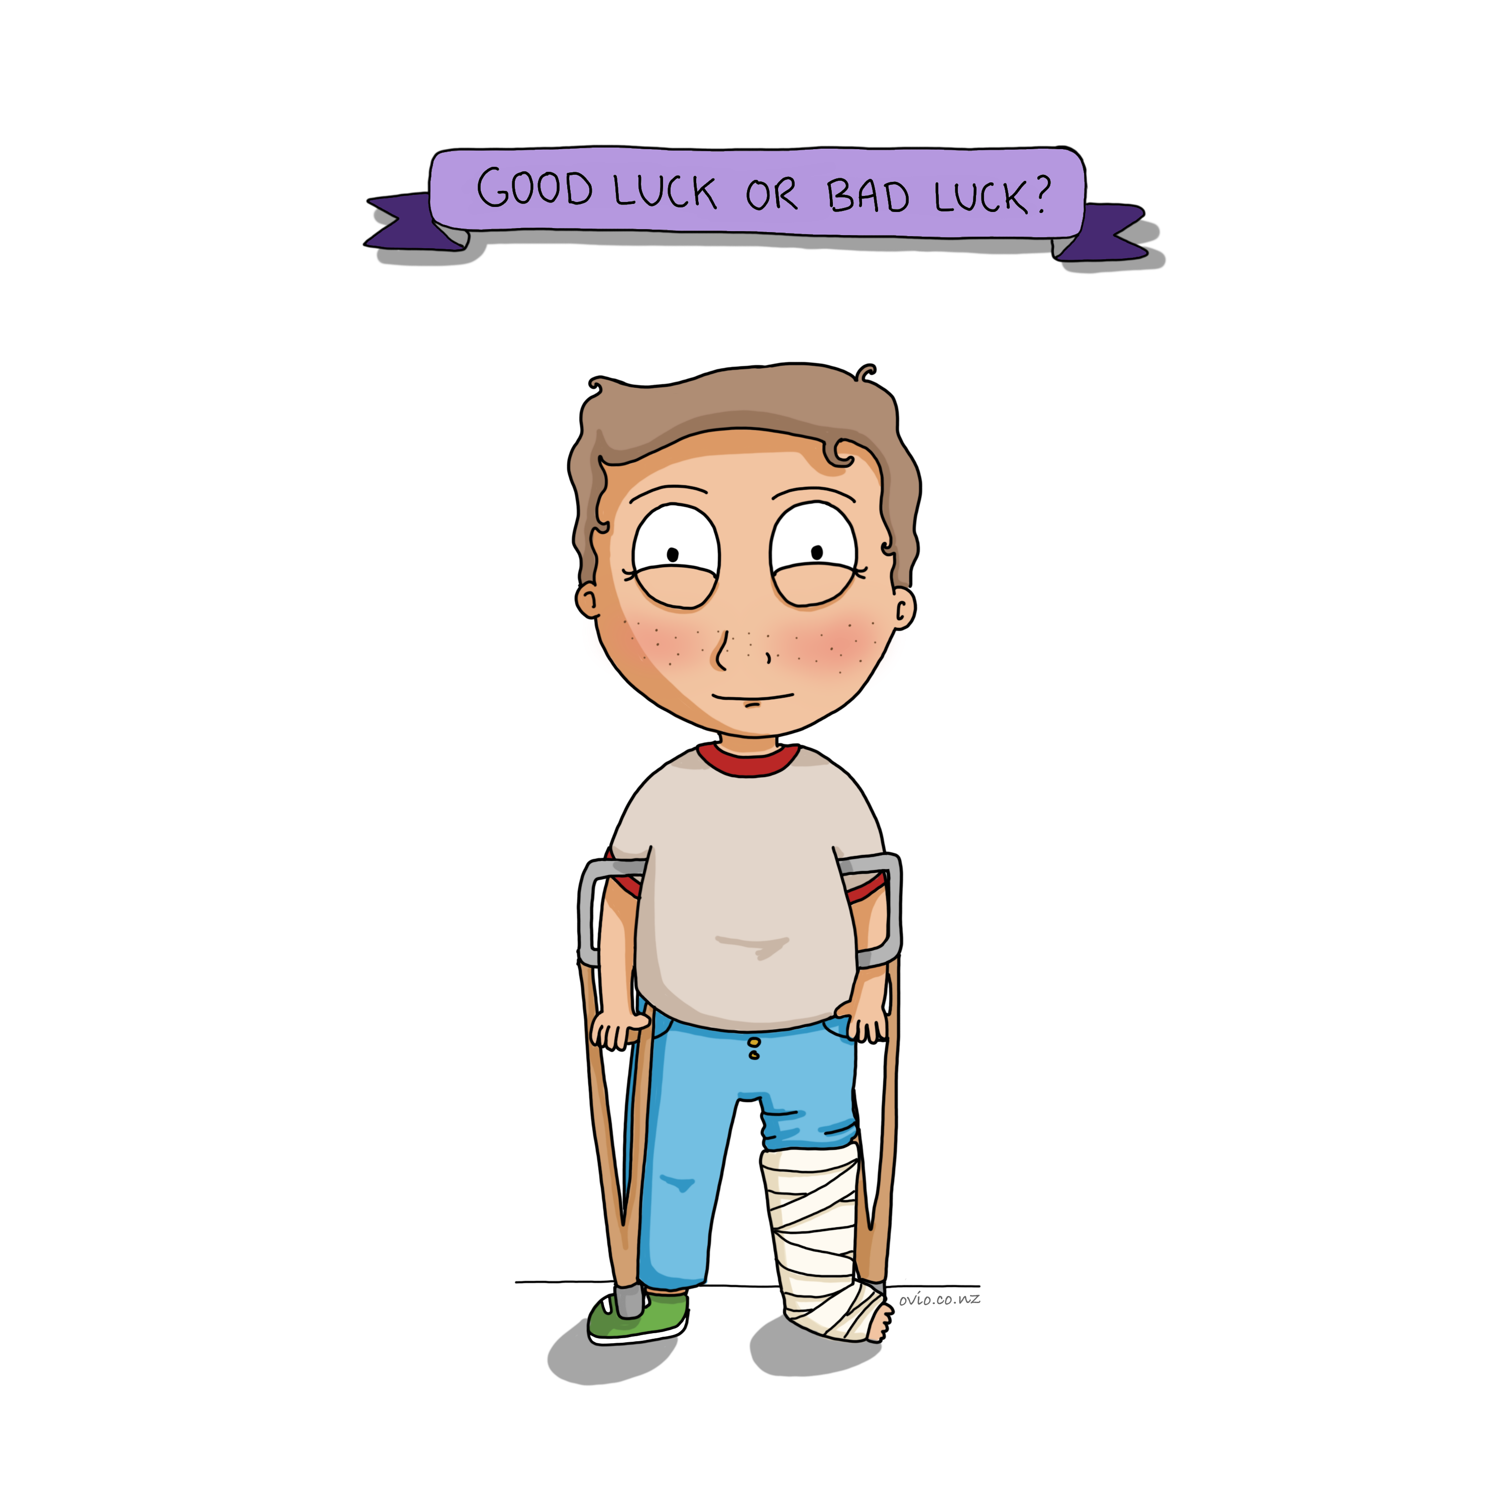

Slide 45

Notes:
Hedgehogs and the cold night story
Prosocial skills and connectedness are crucial in our modern world.
Social connection is an important factor in mental wellbeing.
This lovely story tells children that although it is prickly for the hedgehogs to huddle together they depend on each other’s warmth to survive. Likewise, it is important for children to realise that being close to others is not always positive and it can sometimes be challenging but closeness has its rewards. i.e. our best friends are the ones who can hurt us the most but we also can have the most fun with them.
(Please note: In the correct context this story can also act as a lovely reminder of the importance of good healthy relationships and what should or shouldn’t be tolerated in a relationship. We can discuss the difference between balancing tolerance on one side with allowing others to treat them badly on the other.)
Research shows we are fighting against nature and becoming more disconnected. This causes stress and unhappiness. It is against our wiring as human beings. Real face to face connection is becoming more challenging for children as they spend more time connecting digitally. Real connection helps children to embrace their strengths and vulnerabilities which improves their sense of connectedness and wellbeing. It makes their world ... a better place to be.

Slide 46
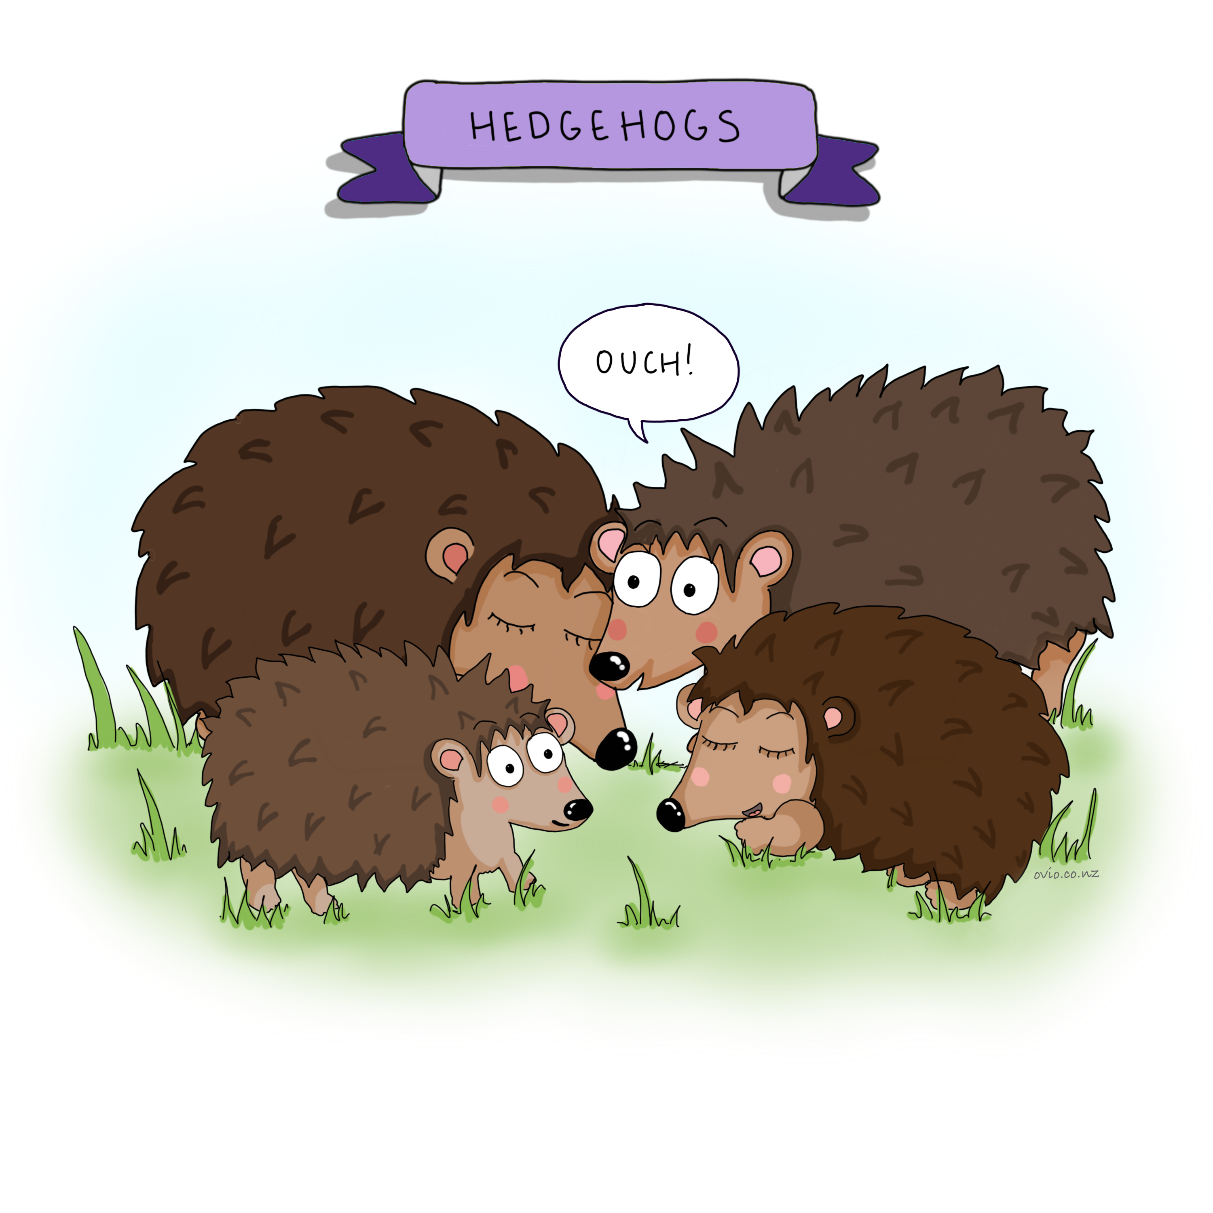

Slide 47
Notes:
Scary or not scary title card to go here

Slide 48
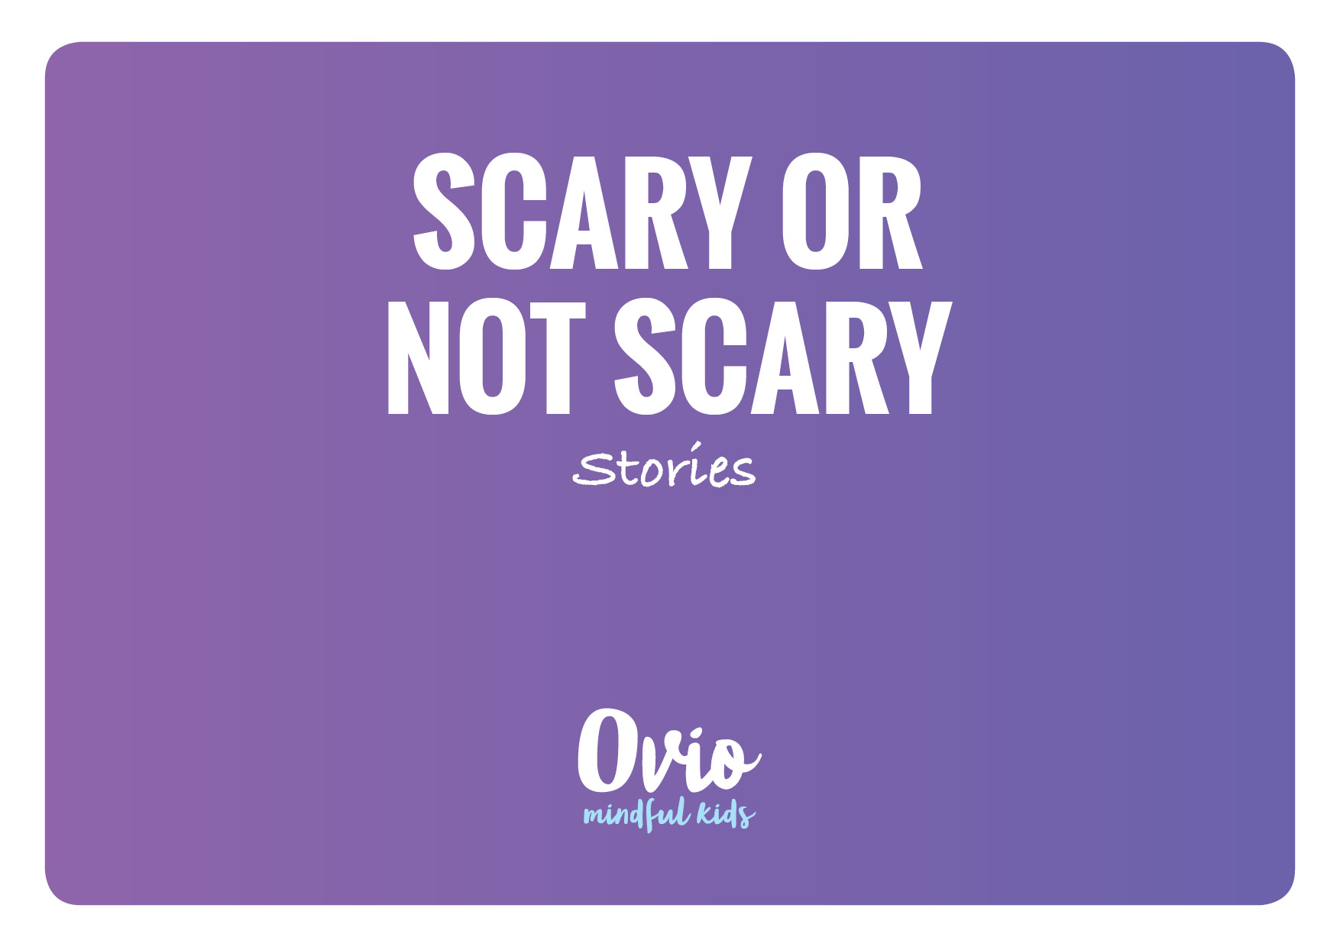
Notes:
Scary or not scary?
As human beings we are very lucky to have an emergency response switch in our body.
When we tell our body that there is something scary or dangerous in front of us it responds by switching off all the mechanisms in the body that are not needed for escaping or fighting.
You may notice these things in your body when you have turned this switch on-
Show cartoon
- You may notice that is it hard to think properly. “Now is not the time for maths or spelling or clever thinking, you just need to escape says the body.”
-Your heart starts racing or beating fast to pump more blood to body so it can move fast.
-You may notice a funny feeling your tummy because the body stops your digestion.
-You may notice that your legs are shaking because all your blood has been cleverly redirected to your lungs and heart so you can run fast.
-You may notice your breathing speeds up so you can get lots of oxygen to your heart and lungs so you can run fast.
- You may notice that you sweat as a result of these changes in your body.
So all of this is very useful when we really are in a dangerous situation and you need to run away or fight but it is not wise to switch this response on when we don’t need to escape or fight.
At this point discuss with children the difference between real and perceived dangers.
What is scary what just seems scary!!
(Remember to keep the discussion and explanation age appropriate)
Examples
So when mum drops you off at school and then leaves - do you need to engage your emergency response, is it really scary? (real danger vs perceived danger)
What about a Math test?
What about a horror movie?
Once children have the understanding that flight or fight is great for Sabre toothed tigers but no good for a math test or other modern day stressors they become better able to transition these feelings. Otherwise children can feel anxious then feel anxious about being anxious and then they feel they are no good and letting everyone down and the loop continues to keep the anxiety stuck!
What thoughts do you have that turn your emergency response on?
What balancing exercises can you use to turn it off? e.g. balloon breath.
This understanding and discussion will help children realise anxiety and stress are not necessarily good or bad. Although these feelings may feel uncomfortable, when they notice this discomfort they can easily allow the feeling to pass using RAIN and a balancing exercise. (See balance section)
Many children feel that there is something wrong with them because they get stressed, nervous or anxious. This card helps to explain that all of these responses are natural and normal and it is ok that the body responds this way. With mindfulness children become better able to regulate these emotions.
Some background information on the flight or fight response.
The struggle switch
https://www.youtube.com/watch?v=rCp1l16GCXI

Slide 49
