Slide 1
Notes:
Welcome everyone
This course is different from many in that it is based on the premise that you already know all you need to know to lead a wonderful fulfilling life what we are here to do is not add information but to teach you how to access all the knowledge and wisdom you already have.
We believe people are already overwhelmed with knowledge and information. Our programs are uniquely designed to teach you how to cut through the complexity and the noise in your head to live with in accordance with your values and what is most important to you.

Slide 2
Notes:
Introduce your self and share the story of your journey with Mindfulness.
(Your disclosure and vulnerability will help open and create a safe space.)
Depending on class size participants can introduce themselves to the whole group (best) or to a neighbour if the group is too big.
Guidelines for participant introductions
Depending on class size keep it brief (1min approx.)
-name
-previous Mindfulness experience
-what they hope to get out of the course

Slide 3
Notes:
Please guide this –Sit relax and take a few deep breaths arrive fully in the room making sure your thoughts are in the same place as your body. (1min)
Mindfulness helps us to find clarity in a stressed out digitally dependant world. We rarely allow ourselves to stop, we often think I will take a break once I get xyz done only to find then we have more to do. The purposeful pause can be done anywhere at anytime and it gives us a break from the busyness even if only for a few moments. After a short time you will feel the benefits of the purposeful pause and your day will feel more spacious, and less rushed.
Examples of times that is you may find it useful to take a purposeful pause are
Before driving somewhere
Before eating
Before meetings/classes
Before sitting at the computer
Before difficult conversations

Slide 4
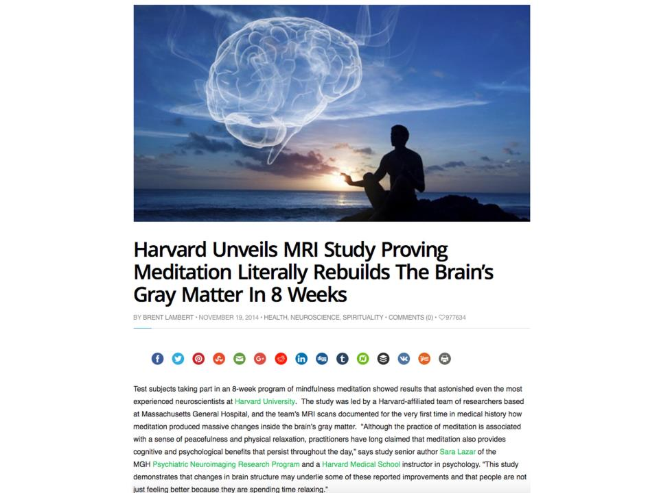
Notes:
There is so much media, studies and information about the benefits of Mindfulness available if you google Mindfulness that I don’t want to waste your course time going over all of its benefits.
I will skim over a few media stories which are backed by studies to give you an idea of the scope of benefits that can be expected from mindfulness. You will also find a list of benefits listed in your journal.
This study showed that participants who did mindfulness meditation for an average of 27 mins per day for 8 weeks showed structural brain changes, which lead to less stress and reactivity and increased focus and emotional regulation.
(cerebral cortex thickening (attention and emotional regulation) and an increased density of grey matter in the hippocampus (self awareness, compassion ) Less grey matter density in Amygdala.)

Slide 5
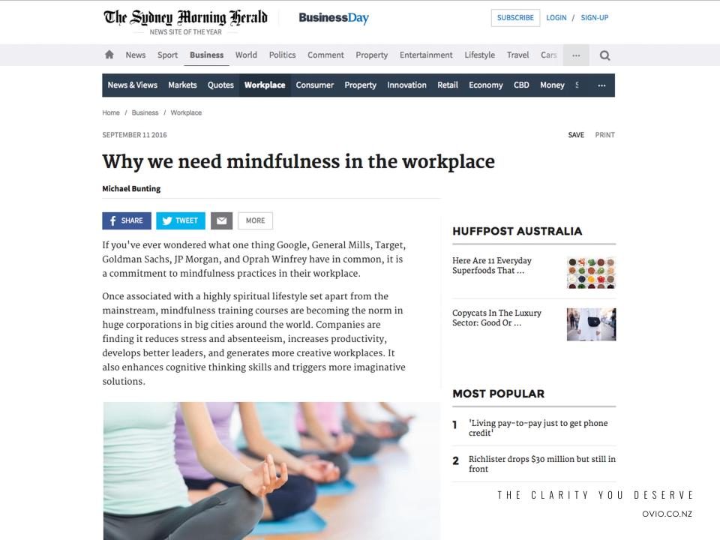
Notes:
Feeding frenzy for Mindfulness in the workplace currently.
Reduces stress and absenteeism, increases productivity, increased creativity and innovation, improved workplace culture.

Slide 6
Notes:
Lancet (leading medical journal) study. 212 patients with depression were randomised to 2 groups Group 1 Continued with meds Group 2 discontinued and practiced Mindfulness-results showed no difference in numbers of relapse or time taken to relapse between the 2 groups.
Also can add
Anxiety and stress- there are well over 165 studies show Mindfulness has a huge impact on reducing stress and anxiety.
(If anyone is on medication please talk to a qualified health professional before going off your medication.)

Slide 7
Notes:
Mindfulness upgrades the brain –djokovic “my brain now functions better.
Can add
Attentional blink study -if you are shown a series of letters with some numbers interspersed in the series and you are asked to remember the numbers in series if 2 numbers are shown within ½ second of each other then t
he second one was not detected. After Mindfulness training the attention blink (previously thought untrainable ) was reduced, i.e. so now you could show the numbers closer together and the 2nd one would not be missed.
Background reading
https://siyli.org/the-science-behind-mindfulness-2/

Slide 8
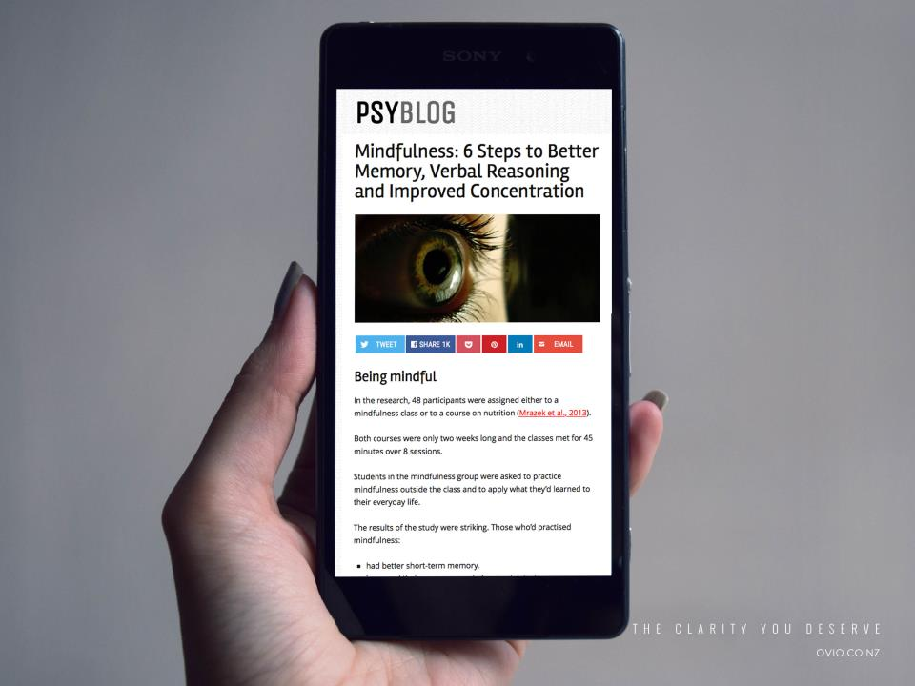
Notes:
MFN improves focus concentration and memory …This is from a study of students sitting a Global reasoning exam. They were randomised to 2 separate groups one group received Mindfulness training and the other a nutrition class for 8 weeks. Students took GRE before and after training. Group doing Mindfulness performed overall better in the post test. Reduced mind wandering and distractabilty was thought to be responsible for improved memory and reasoning ability.

Slide 9
Notes:
MAAS Mindful attention awareness scale is designed to see how well we can tune into what is going on in any moment, this is referred to as dispositional mindfulness. The MAAS has a 83% correlation to with cardiovascular risk. As assessed by testing BP/FBG/Chol/BMI/Smoking/Lifestyle.
There are countless other examples of Mindfulness helping with many different physical conditions eg IBS, psoriasis etc
Also psoriasis study UV gp and UV plus MFN group. UV plus MFN 45 days for 50% skin clearance UV group 80 days till 50% skin clearance.

Slide 10
Notes:
What is Mindfulness?
Mindfulness is a huge topic and is not so much a skill as a way of being. The positive effects we receive from practising Mindfulness radiate out to loved ones, friends, communities and the world.
Please point out.
Mindfulness is not clearing your mind
You can’t get it wrong as all you are doing is paying attention to your experience as it actually is, everything is included good and bad (non-judging.)
It is about being curious, kind and compassionate.
See page 4 of journal for principles of Mindfulness these are the principles we uphold within this group as well as respecting each other’s privacy.

Slide 11
Notes:
Laugh at photo Ha ha We don’t need to sit in lotus or levitate to learn Mindfulness.
List the things that we will do in this course to learn Mindfulness.(Meditation, journaling, discussion)
The exercises all help us increase our awareness of ourselves, others and our environment.

Slide 12
Notes:
Mindfulness increasing our awareness so we see clearly, we see the reality of ourselves and situations, (we let go of the ‘stories we tell ourselves) once we embody this awareness we are best equipped to know how to act and respond in accordance with our values and what is really important to us. We gain clarity despite all the complexity. Helps us navigate our way through life. We see clearly.

Slide 13
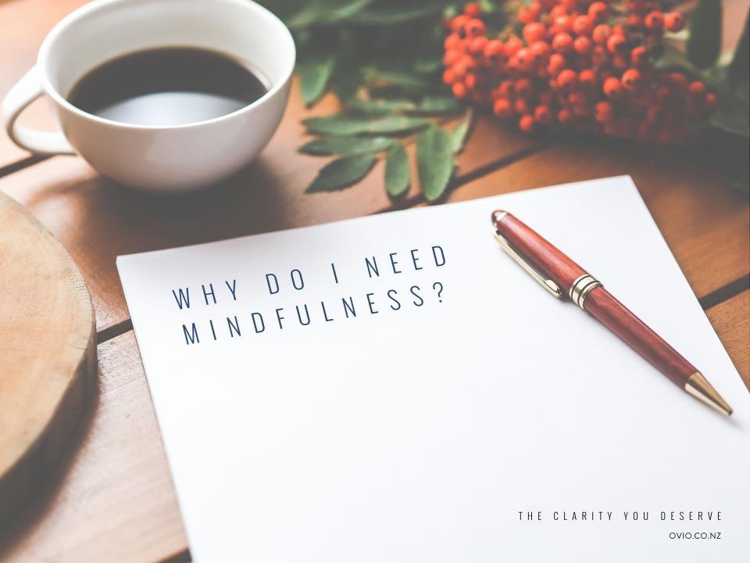
Notes:
It is important that everyone set an intention for learning and practicing Mindfulness. This will help people get the most out of this course.
Ask participants to think about what has brought them to this class, what is it they want to get out of the next 3 weeks?
Remind them of what it took for them to turn up for the course. Booked tickets etc. Huge act of kindness to themselves and others to get this far.
Take a few moments to give them time to reflect on how their lives are now and where they think mindfulness may be of use.

Slide 14
Notes:
This exercise helps us become aware of the random nature of our thoughts. Our Mind is to thoughts what our ears are to sounds.
Please play audio for this.
After exercise
Would anyone like to share what they noticed? (this encourages noticing rather than controlling thoughts)

Slide 15
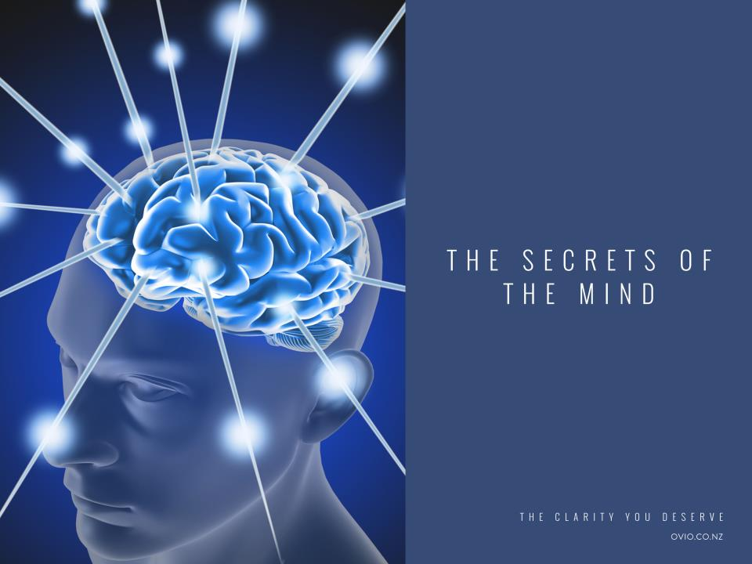
Notes:
Now before we go any further lets shine some light on the workings of the mind and how these things serve us.

Slide 16
Notes:
Ask the participants
Raise your hand if you regularly multitask?
Who thinks multitasking helps them get through their workload?
Now lets do an exercise to demonstrate the effect of Multitasking.

Slide 17
Notes:
Participants will need pen and paper. They can use their journals but many prefer to save the journals for journaling.
Do not start till I tell you
We will do 2 separate timed exercises one not multitasking then second multitasking then you will compare your experience of each exercise.
This is not a competition and no one gets to see your results it is simply for you to compare the experience of multitasking versus monotasking.
Explain this exercise carefully and make sure you have confirmation that everyone understands what they have to do.
Start and read out time intervals in 10sec increments until everyone is finished.
Ask participants who found when multitasking
They were more stressed
Made more mistakes
Took longer
Research shows reduced multitasking lead to better focus, less stress and better memory. (Discuss your own experience)

Slide 18
Notes:
Our mind like our phones takes a small amount of information and builds up the rest of the story. Like our phones our minds can get this wrong.
Auto prediction is important so we can understand speech etc. but without self awareness it can lead to mindless stress!
Give examples of when your minds auto prediction was wrong
e.g. Someone listening to my class looked like she hated it and disagreed with all that I was saying. I began to doubt myself then after class she told me that she loved the class it was exactly what she needed as she suffered stress induced headaches and she had one during the class hence the painful look on her face!
Mindfulness helps us stay present so we become more aware of when we are on autopilot.

Slide 19
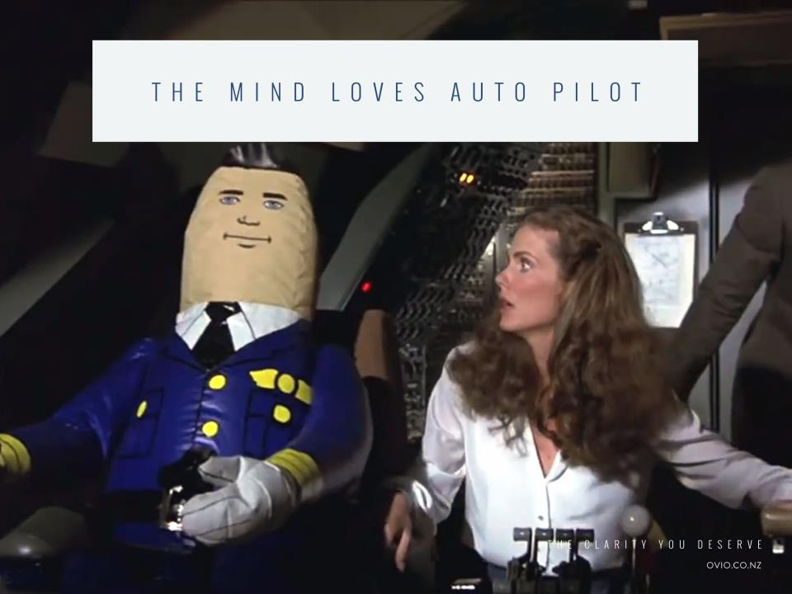
Notes:
When we are on autopilot we don’t know we are on autopilot. Research shows we are on autopilot 48% of the time so by practicing Mindfulness we are better able to notice when we are on autopilot and return to the present. A study showed that we are happier when our mind is focused on what we are doing, even if that is taking out the rubbish. So by becoming mindful we get to enjoy more of our life.
Give an example of when you were on autopilot and missed something important.

Slide 20
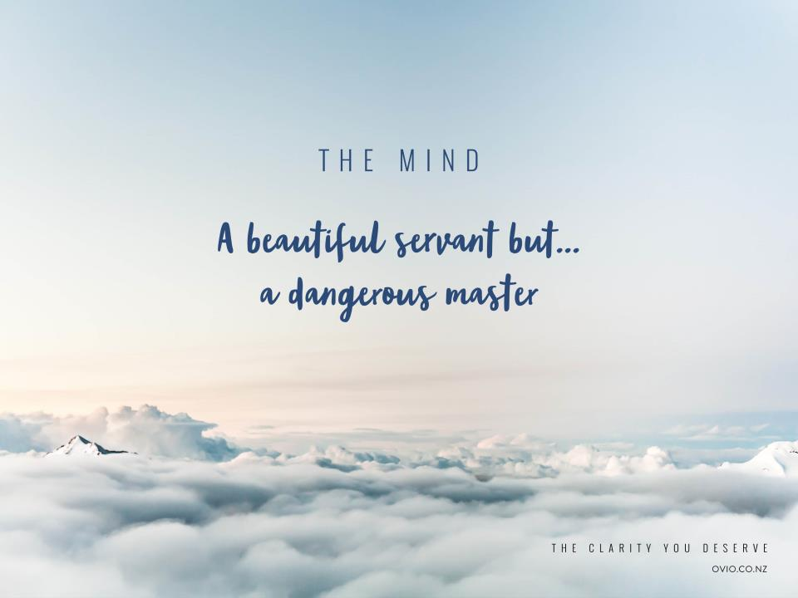
Notes:
Read quote then add by practicing Mindfulness we become the master rather than the servant so our Minds are working for us rather than against us.

Slide 21
Notes:
This exercise helps us look at all the tendencies of the mind, we get a chance to observe our thoughts both a mindful listener and speaker.
Presenter to time this exercise ring bell after 2mins for participants to switch over.
1/Listeners
Listen in silence can smile and use eye contact just not speak.
Notice your minds tendency to want to silver line or dramatise what you are hearing.
Try to focus on what is real for the speaker. Connect with your sense of hearing
Notice your internal commentary, forming an opinion on what is being said, pre framing what you are going to say, be curious and focus on your sense of hearing.
2/Speakers
Notice your tendency to edit what you are saying, to making it better or worse.
Notice how different it feels to be mindfully listened to.
Our Mindful awareness builds when we observe ourselves and others.

Slide 22
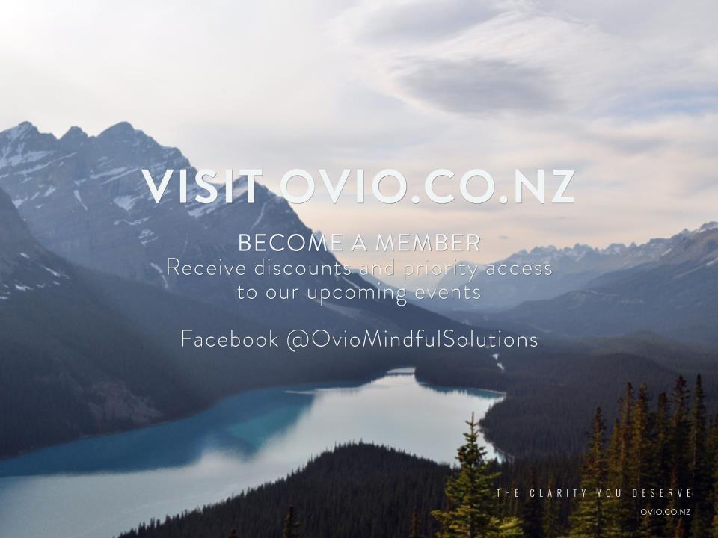

Slide 23
Notes:
Welcome everyone as they come into the class.
Feedback from participants from previous session or the time between sessions if time allows.
Reflections on last session. Last session focused on Mindfulness and thoughts this session gets exciting as we look at emotions and stress management.

Slide 24
Notes:
Please guide this –Sit relax and take a few deep breaths arrive fully, making sure your thoughts are here with you in this room.
Feedback from participants that have started using a purposeful pause throughout their day.

Slide 25
Notes:
Read the quote. This quote is important as many people think being in the present is only important to ensure we don’t miss the magic moments of our lives but it is equally important to be fully present so that we can respond to life rather than react out of habit. We need to be fully present to act and to make decisions that align with our true values. Most of us live in a state of partial attention, we eat without tasting, we listen without hearing, sometimes we speak without realising the impact of our words.
Ask participants.
“How do we get present?”
Explain
Our 5 senses help us to be present seeing, hearing, tasting, feeling, touching.

Slide 26
Notes:
What happens when we are not present?
Talk about visual
If I put my hand on hot plate and I am not present I don’t notice as my hand slowly heats up until it is too late and I am burnt, I react by pulling my hand back yelling! When I am in a distracted state of partial attention I become reactive instead of responsive.
By training ourselves to be present in our lives we can being to notice what we are doing to ourselves and recognise the impact it is having on us. When we get a choice most of us know what to do, we just don’t notice early enough so we don’t get to choose.
Mindfulness helps us be present and notice proactively this allows us to respond by making choices that align with our values.
Give an example of this in your life.

Slide 27
Notes:
Run audio.
After exercise
Would anyone like to share what they noticed? (this encourages noticing rather than controlling thoughts)

Slide 28
Notes:
This is another chance for participants to practice mindful speaking and listening this time not just focusing on thoughts but also listening for and noticing feelings.
Note we talk about stress which in this case includes difficult emotions as they are exacerbated by stress.
After the exercise get feedback on stressors then pre empt the next slide on how the types of stressor we have these days induces the same reaction in our body as those stressors that our body was designed for.

Slide 29
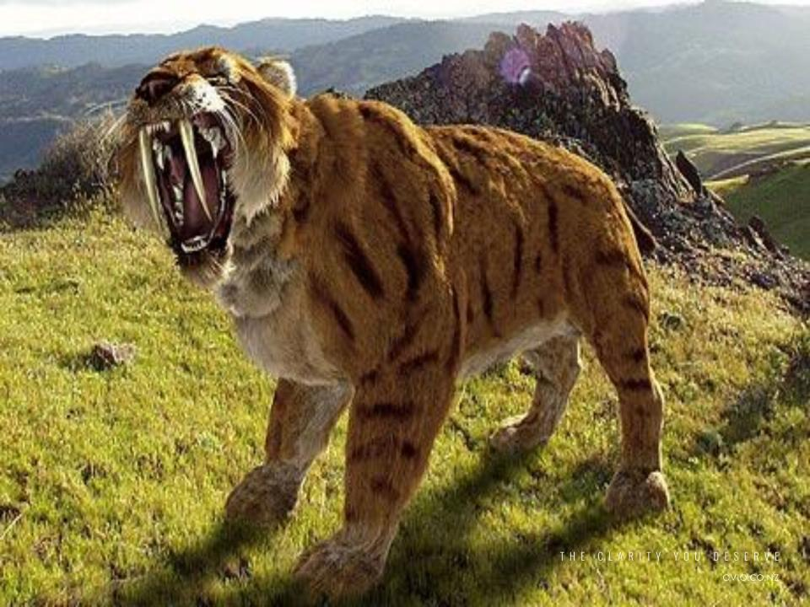
Notes:
This is the type of stressor our body was designed for.
Discuss the flight or fight response.
Adrenalin and cortisol are released the heart rate is increased, digestion shut down and focus becomes narrowed, higher level cognition switched off, we have tunnel vision and become non productive. Great for dealing with Sabre toothed cat but no good for a math exam or work deadline.

Slide 30
Notes:
Many of us live in a state of chronic stress where we run on stress and can’t switch off. Why ?
Explain the difference between us and animals by the story of a lion killing a gazelle and the gazelle returning to grazing vs if a lion was to come into the room and eat a participant I wouldn’t be able to return to my lunch.
Ask participants why?
Answers should lead to the fact humans thinking allows to question. What if …and fill in the gaps hence we keep our flight or fight reaction switch on all day and sometimes night.

Slide 31
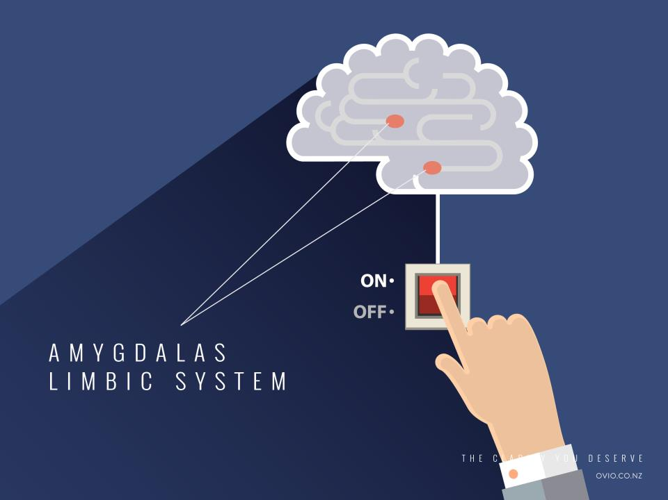
Notes:
Our flight or fight response is triggered in the amygdala this is a part of the brain that becomes less reactive with mindfulness.

Slide 32
Notes:
One way of turning off the flight or fight response is by a technique based on the acronym R.A.I.N
Most important to mention that when you get to the end of RAIN you get to choose a response rather than react.
Explain
Give an example of when you have used this technique.

Slide 33
Notes:
Other ways to switch off the stress response brought about by difficult thoughts.
Ask for other suggestions from participants remember everyone learns from each other.

Slide 34
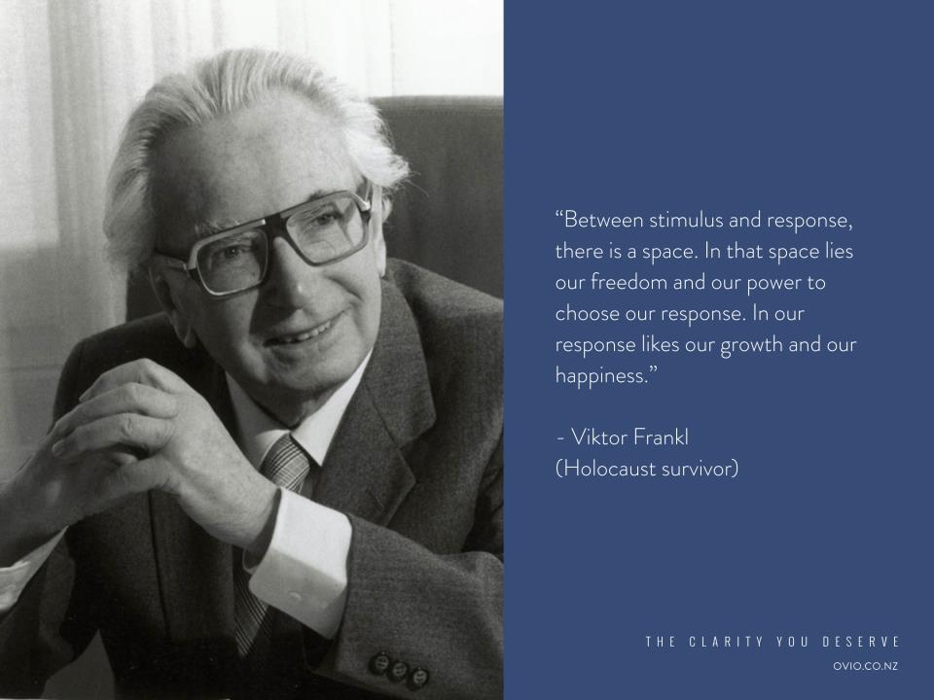
Notes:
Read quote. Mindfulness helps to create the space between stimulus and response.
Demonstrate using the Mind jar with a personal example of when you have created space between stimulus and response.

Slide 35
Notes:
Stress is also reduced by focusing on what gives us joy and fulfills us.
Mindful journaling rules. (page 50 of journal) Invite and encourage your thoughts to flow. You may write about anything that comes to mind even if it strays from the prompt. If you have nothing to write just keep writing "I have nothing to write” There is no right or wrong just keep writing until the time is up.
Time 1 min on each prompt.

Slide 36
Notes:
Read out the slide
The body scan audio can be found on the resources page of the website or on page 11 of the journal.
Any questions?

Slide 38
Notes:
Welcome the group.

Slide 39
Notes:
Please guide this –Sit relax and take a few deep breaths arrive fully, making sure your thoughts are here with you in this room.
Feedback from participants that have started using a purposeful pause throughout their day.

Slide 40
Notes:
We have a movie inside our heads of how we expect our life to be then there is reality. We are happy if our life matches our movie but disappointed if it doesn’t. We are also disappointed when the characters in our movie respond differently in real life than what we expect.
This type of thinking creates a gap between our expectations and our reality. When our mind notices this gap it asks why. The answers to this question can spiral us into a cycle of negative thinking. Why am I not happy? Because… I am not attractive enough, nothing ever works out for me, I am not smart enough … With Mindful awareness we become aware of the gap (‘Mind the gap’) and learn that in some cases all we need to do is get rid of the movie in our heads and turn our expectations into appreciation.
We learn to throw away the movie and approach life with curiosity, gratitude and kindness.

Slide 41
Notes:
Acceptance is another tool we can use to create joy in our lives. Acceptance is not passive it is seeing through the façade to what is really there so we stop resisting and start engaging.
Use the example above. Girl wanted to be at the concert but missed out so is at work. She is getting nothing done as she is so annoyed, she fails to look behind her where an amazing guy is sitting who she could fall in love with and things could have worked out so much better for her than if she had gone to the concert.
When we accept we engage and get to make choices.

Slide 42
Notes:
Resisting is opposite to acceptance.
It is complaining getting annoyed frustrated etc It takes us away from being happy, engaged and present.
The principles of Mindfulness work against the popular ‘positive thinking’ mind set. ‘Positive thinking’ is simply a habit that encourages us to push away, disallow, fix, rise above, block out, or ignore any emotion we judge as bad. It allows us only to experience good emotions. To avoid difficult emotions, we distract ourselves with TV, overeating, too much alcohol, drugs. Often, we become unable to complete the task at hand.
By engaging with an experience, in the present moment, that experience becomes a source of wisdom and knowledge. Focusing on a present moment experience means we disengage from the thoughts and stories we habitually tell ourselves, shift out of our autopilot mode of reaction and respond with more clarity and perspective.

Slide 43
Notes:
We put the welcome mat out for all of our emotions we don’t judge them as good or bad, we approach our the with curiosity and kindness.

Slide 44
Notes:
Forgive others not because they deserve forgiveness, but because you deserve the peace.
Letting go of what we expected does not mean being passive or a door mat by letting go we can hold the present moment in awareness whether it is pleasant, unpleasant or neutral it, we can allow it to be exactly as it is then suddenly it becomes possible for us to stand fully in the present moment without it having to be different. Then we get to see what is then if in the next moment you need to act you will act out of mindfulness with emotional intelligence instead of being hijacked by your feelings. Or you wont be as mindful as you thought but you will notice and learn from that.
Can take along time let go of certain deep seated emotions such as anger rage grief be patient it is your journey not anyone else's.
Letting go is a radical act of kindness to yourself, that takes a lot of courage.
A story you may want to share.
A senior monk and a junior monk were traveling together. At one point, they came to a river with a strong current. As the monks were preparing to cross the river, they saw a very young and beautiful woman also attempting to cross. The young woman asked if they could help her cross to the other side.
The two monks glanced at one another because they had taken vows not to touch a woman.
Then, without a word, the older monk picked up the woman, carried her across the river, placed her gently on the other side, and carried on his journey.
The younger monk couldn’t believe what had just happened. After re-joining his companion, he was speechless, and an hour passed without a word between them.
Two more hours passed, then three, finally the younger monk could contain himself any longer, and blurted out “As monks, we are not permitted to touch a woman, how could you then carry that woman on your shoulders?”
The older monk looked at him and replied, “Brother, I set her down on the other side of the river, why are you still carrying her?”

Slide 45
Notes:
Play audio
After exercise
Would anyone like to share what they noticed? (this encourages noticing rather than controlling thoughts)

Slide 46
Notes:
As you become more accepting,curious, kind and non judging of yourself your relationships with others will improve. You will naturally offer them the same kindness. Everyone is unique but everyone has a heart. Be curious, non judging and present.
Everyone is unique but remember everyone has a heart.
Take ownership notice your reactions and express how things are from your experience.
There is no separation we are all interconnected.

Slide 47
Notes:
This exercise helps us to get to the qualities that have real significance to us rather than the often admired and sort after superficial qualities.
Mindful journaling rules. (page 50 of journal) Invite and encourage your thoughts to flow. You may write about anything that comes to mind even if it strays from the prompt. If you have nothing to write just keep writing "I have nothing to write” There is no right or wrong just keep writing until the time is up.
Time 1 min on each prompt.

Slide 48
Notes:
We may catch ourselves thinking life would be easy if it was just me …..but we are a species, the human species. From an outsiders perspective we don’t behave like we are the same species we wage war, we allow others to starve while we have plenty etc you would think with everything going on in the world we would want to huddle together. Research shows we are fighting against nature and becoming more disconnected. This causes us stress and unhappiness it is against our wiring as human beings. Oxytocin is a stress hormone why because in times of danger we should huddle together, but we are supposed to put on a brave face and carry on alone looking successful on the outside and oftentimes suffering on the inside-Why? Mindfulness helps us to embrace our vulnerabilities which improves our sense of connectedness and wellbeing. It make a workplace, family … a better place to be.
Porcupines and the coldest winter ever
It was the coldest winter ever, and many animals died because of the cold. The porcupines, realizing the situation, decided to group together. This way they covered and protected themselves; but the quills of each one wounded their closest companions even though they shared their heat with each other.
After awhile, they decided to distance themselves one from the other to stop being wounded.
As they did this, they began to die... alone and frozen. So they had to make a choice: either accept the quills of their companions or disappear from the Earth. Wisely, they decided to go back to being together. This way they learned to live with the little wounds that were caused by the close relationship with their companion, but the most important part of it, was the heat that came from the others that enabled them to survive the coldest winter ever

Slide 49
Notes:
With Mindfulness we becoming more compassionate and this increases our happiness which ripples out and affects others.
Ask the participants to think of someone they are having difficulties or disagreements with and then talk them through this exercise while they have that person in mind.

Slide 50
Notes:
This will help to anchor the participants learning
Time 2 mins each and 1 min for free flow conversation.

Slide 51
Notes:
Ask if participants want to connect with someone in the group to remind them to practice. A Text works well.
Participants can refer to page 15 of manual for noticing thoughts exercise or website for guided exercise.
Any questions?

Slide 52
Notes:
This course for most of you, your first step towards a more fulfilling, energised life.
Please continue with your practise at least by following along with the next 5 weeks of audio exercises to get the full benefit of this course.

